Slide 1


Strategies for Defibrillation During Out-of-Hospital Cardiac Arrest
Shocking Insights
Scandinavian perspectives on alternative defibrillation strategies in out-of-hospital cardiac arrest
Initial use of double defibrillation in out-of-hospital cardiac arrest
Bertram Lahn Kirkegaard
Vegard Nordviste

Slide 2

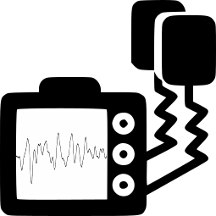
Background
~4 M
20%
75%
Cardiac arrest
Shockable rhythm
> 1 shock
Notes:
I

Slide 3
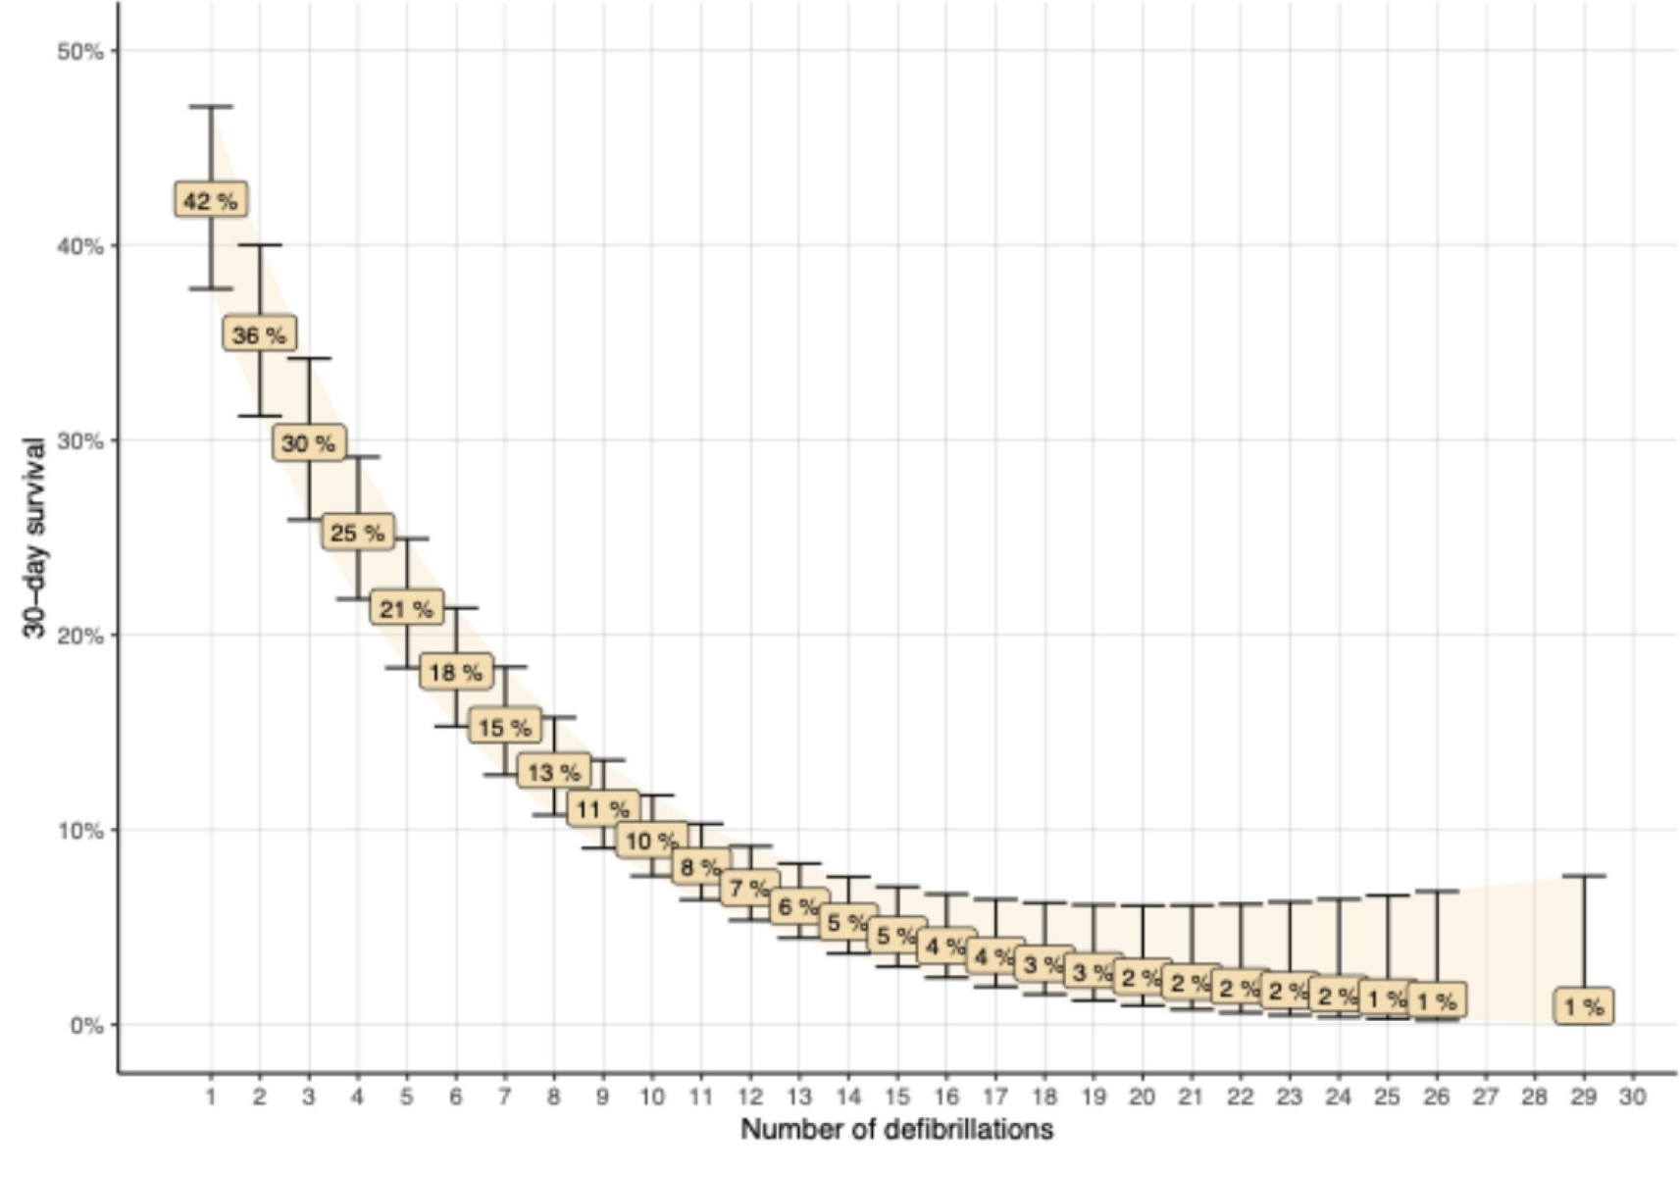
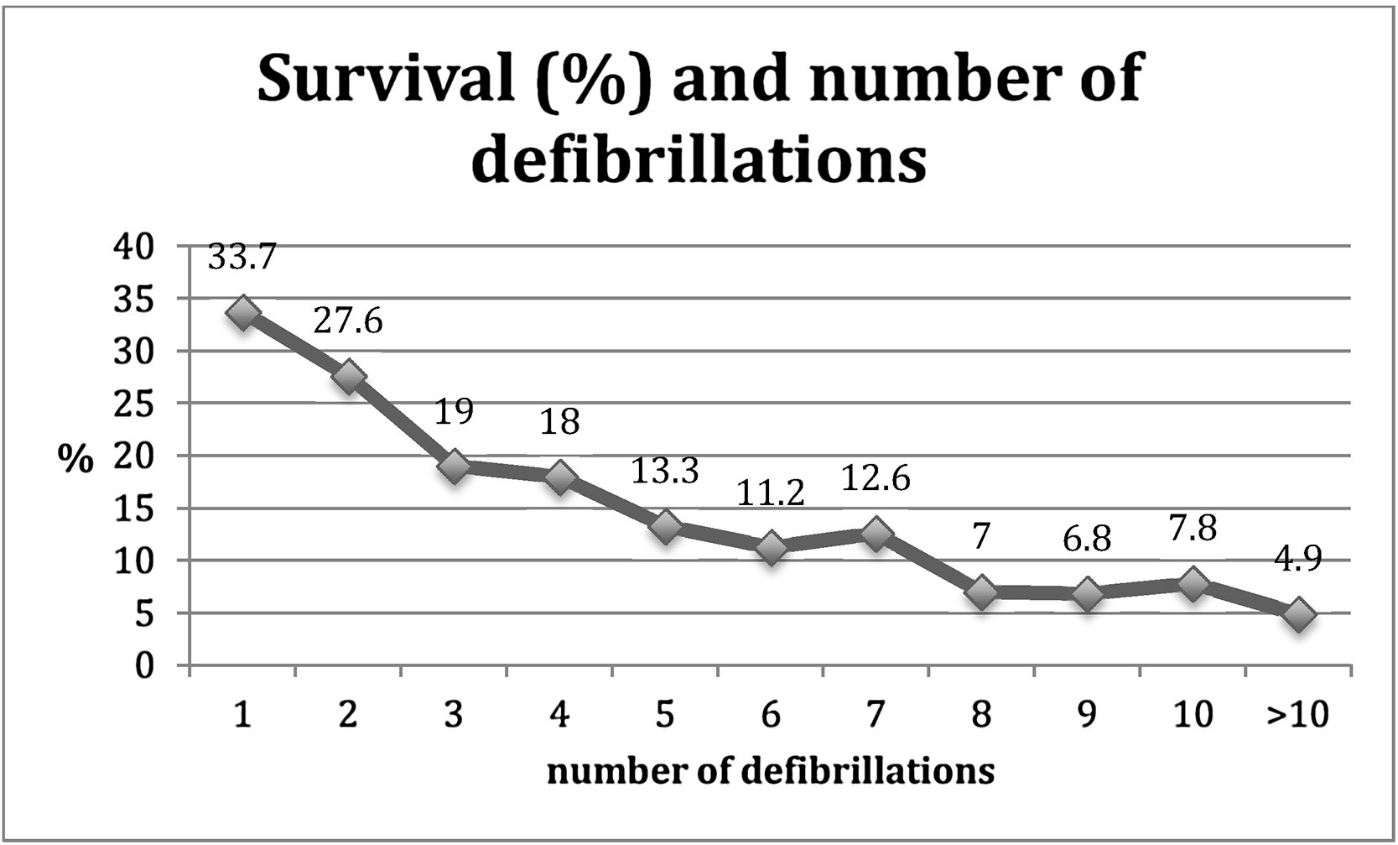
Background
Holmen, et al. Resuscitation 2017
Harryson, et al. Resuscitation 2024
Notes:
I

Slide 4
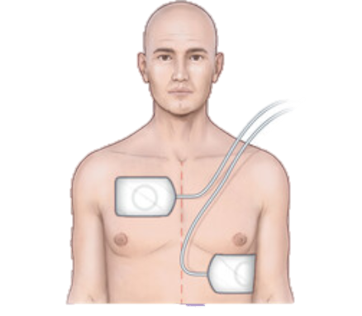
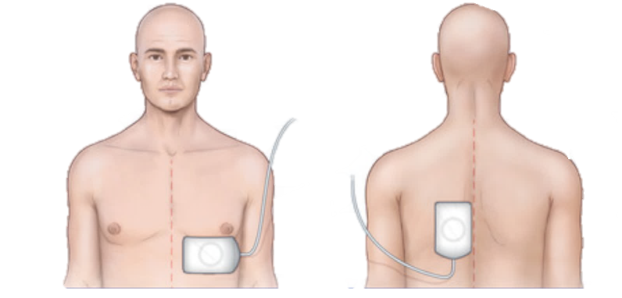
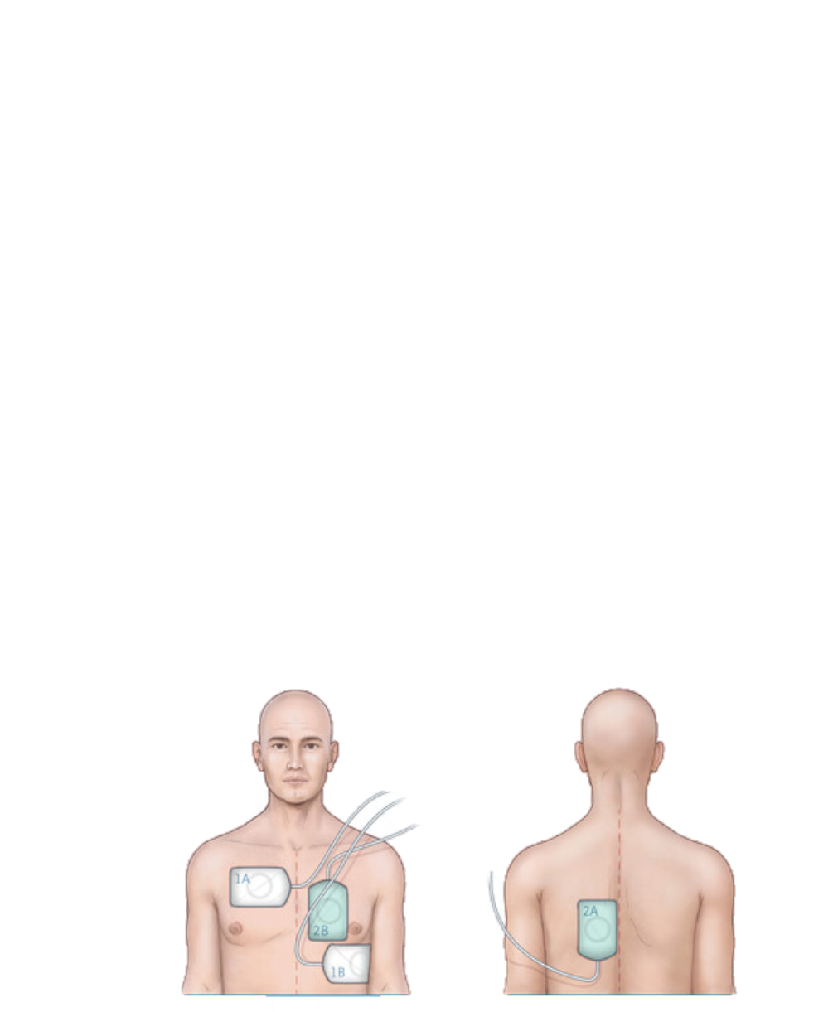
Previous trials
DOSE-VF
Anterior-lateral
Anterior-posterior
Double sequential defibrillation
13%
22%
30%

Slide 5
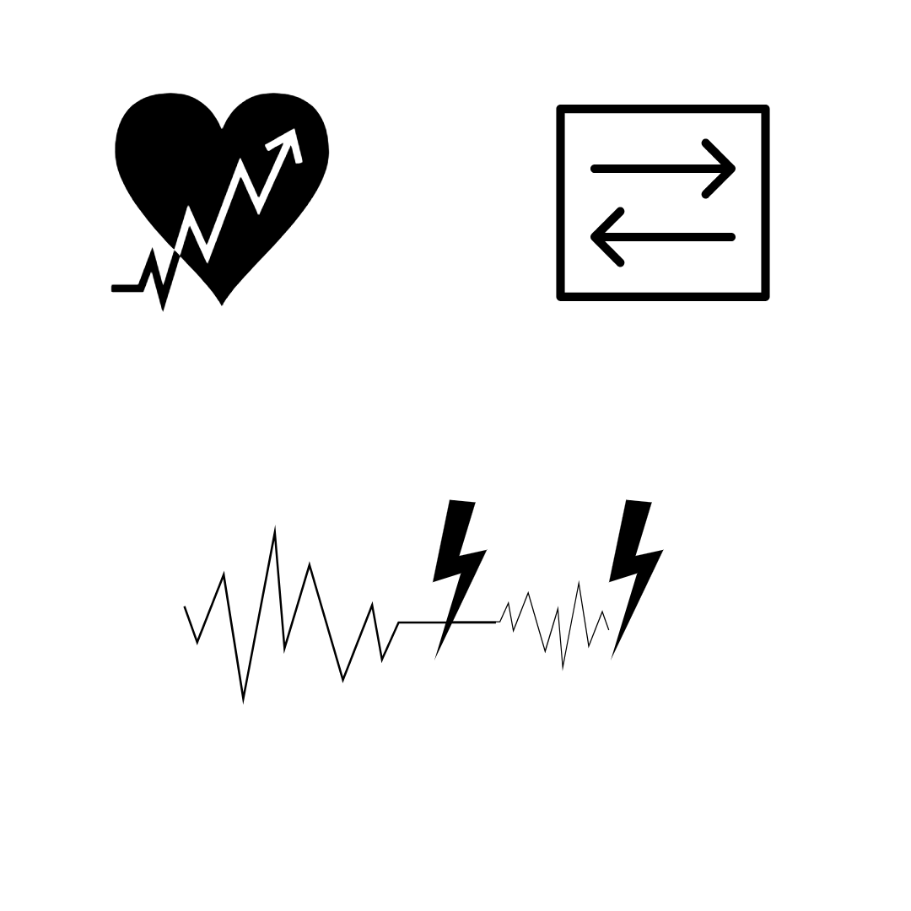
Background

Slide 6

Background
“For refractory VF, defined as continuous VF after three consecutive shocks, and having ensured correct antero-lateral pad positioning, consider using a defibrillation vector change by using an alternative defibrillation pad position (e.g. antero-posterior). After a failed third shock, prepare to place a fresh set of defibrillation pads, at the time of the following rhythm check.
Dual (double) sequential defibrillation (DSD), …… has been advocated for use in refractory shockable rhythms. Given the practical challenges of using two defibrillators to deliver DSD and the limited evidence for its efficacy the ERC does not recommend its routine use.”
“Equipoise still exists regarding DSD and there are two European trials (STRAT-DEFI [NCT06781892], The Dual Defib Trial [NCT06672159]) of DSD that will help inform guideline updates.”
Soar, et al. Resuscitation 2025

Slide 7

Strategies for Defibrillation During Out-of-Hospital Cardiac Arrest
A Randomized Clinical Trial
Bertram Lahn Kirkegaard

Slide 8
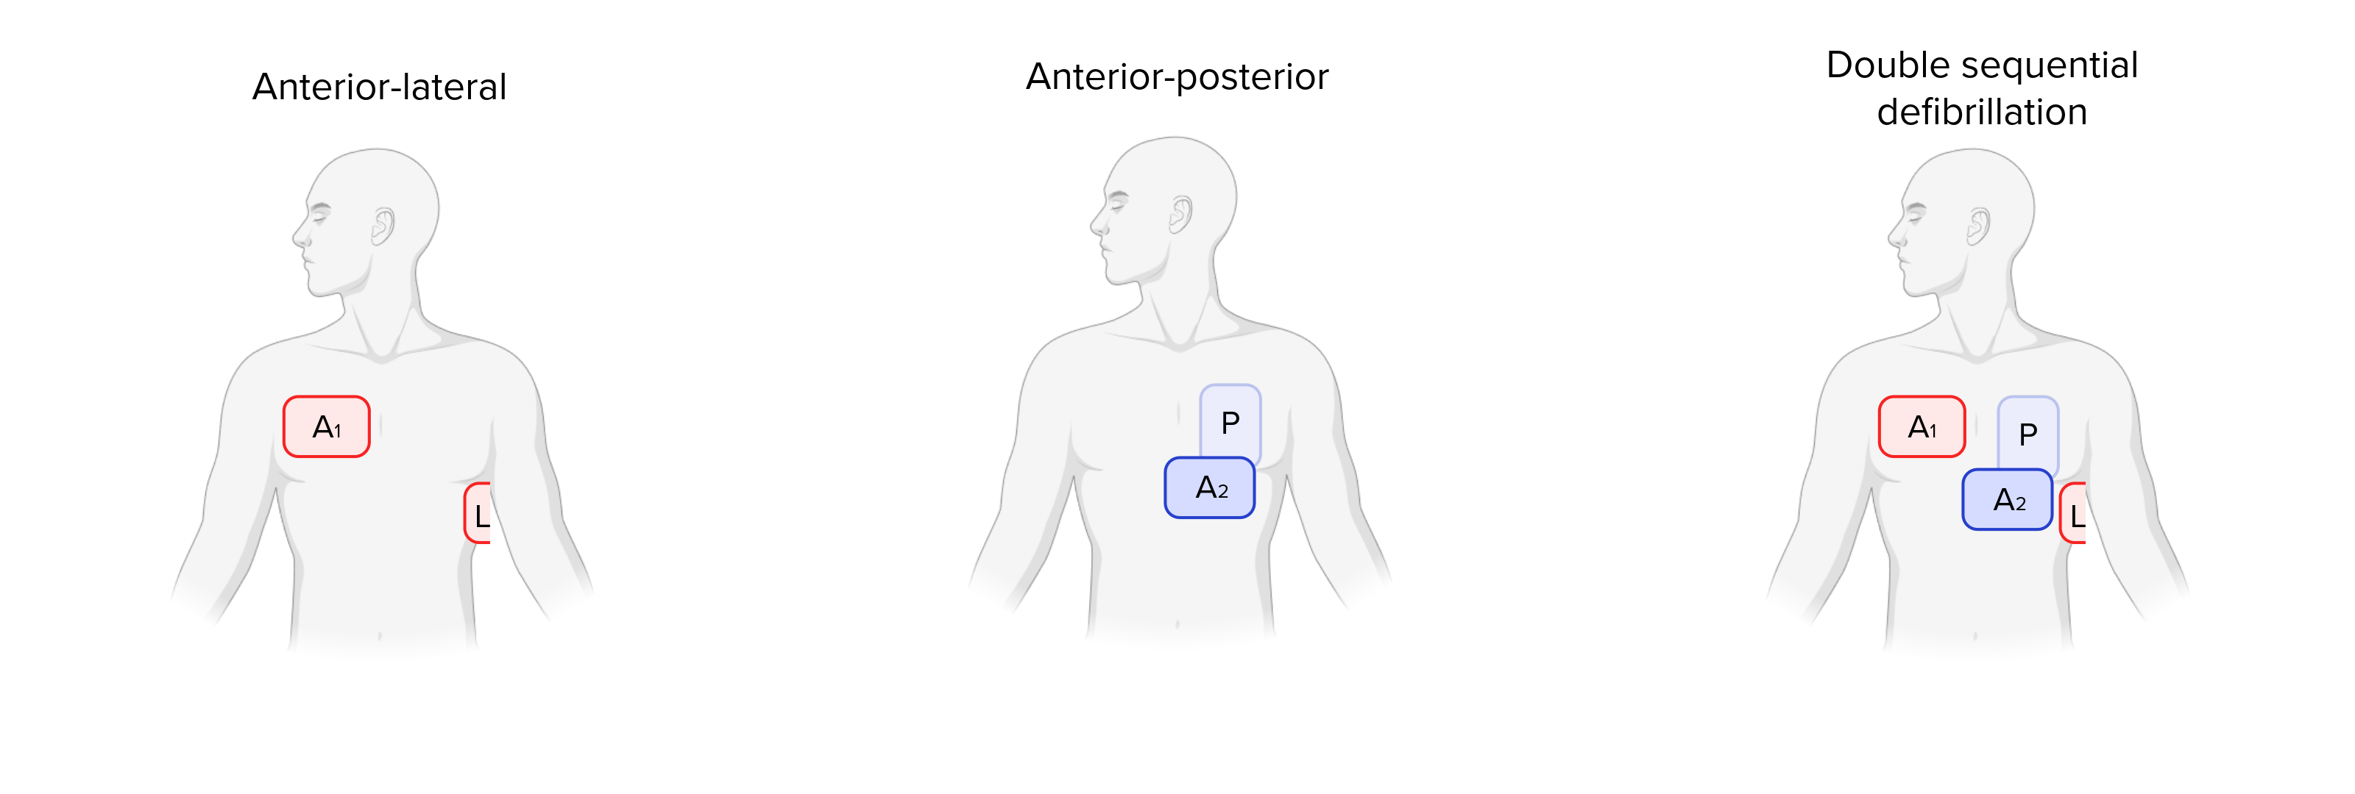

Interventions
Notes:
Nu vil jeg gennemgå de forskellige strategier altså interventioner vi vil udføre i forsøge.
I STRAT-DEFI vil patienter blive lige fordelt til en af 3 interventionsgrupper. Den første gruppe vil modtage defibrilleringsforsøg som vanligt, altså med pads placeret på højre bryst og venstre flanke i en anterior-lateral pad position. Den anden gruppe vil få placeret nye stødpads som vist på tegningen med pads placeret på venstre bryst og venstre side af ryggen anterior-posterior. Den sidste gruppe vil modtage stød med en metode kaldet double sequential defibrillation. Her har patienten pads placeret som de to forrige grupper og ved hjælp af to seperate defibrillatorer leveres to stød hurtigt efter hinanden.

Slide 9
Interventioner
Notes:
Nu vil jeg gennemgå de forskellige strategier altså interventioner vi vil udføre i forsøge.
I STRAT-DEFI vil patienter blive lige fordelt til en af 3 interventionsgrupper. Den første gruppe vil modtage defibrilleringsforsøg som vanligt, altså med pads placeret på højre bryst og venstre flanke i en anterior-lateral pad position. Den anden gruppe vil få placeret nye stødpads som vist på tegningen med pads placeret på venstre bryst og venstre side af ryggen anterior-posterior. Den sidste gruppe vil modtage stød med en metode kaldet double sequential defibrillation. Her har patienten pads placeret som de to forrige grupper og ved hjælp af to seperate defibrillatorer leveres to stød hurtigt efter hinanden.

Slide 10
Interventioner

Slide 11
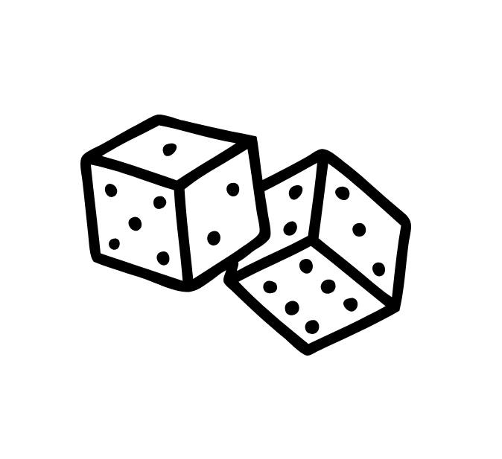

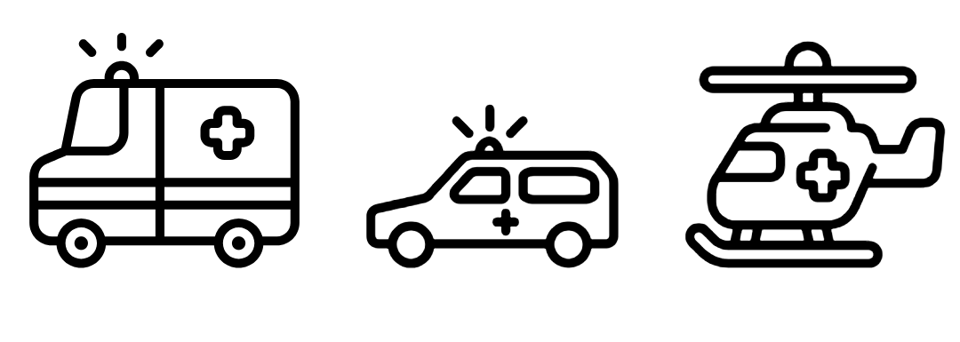
Method

Slide 12
Eligibility
Inclusion criteria:
Out-of-hospital cardiac arrest
Age ≥ 18 years
≥ 1 manual defibrillation attempt by emergency medical services
Shockable rhythm as the last known rhythm
Two manual defibrillators present on-site
Exclusion criteria:
Traumatic cause of the cardiac arrest
Prior enrollment in the trial
Posterior pad placement not deemed possible by on-siteclinician

Slide 13
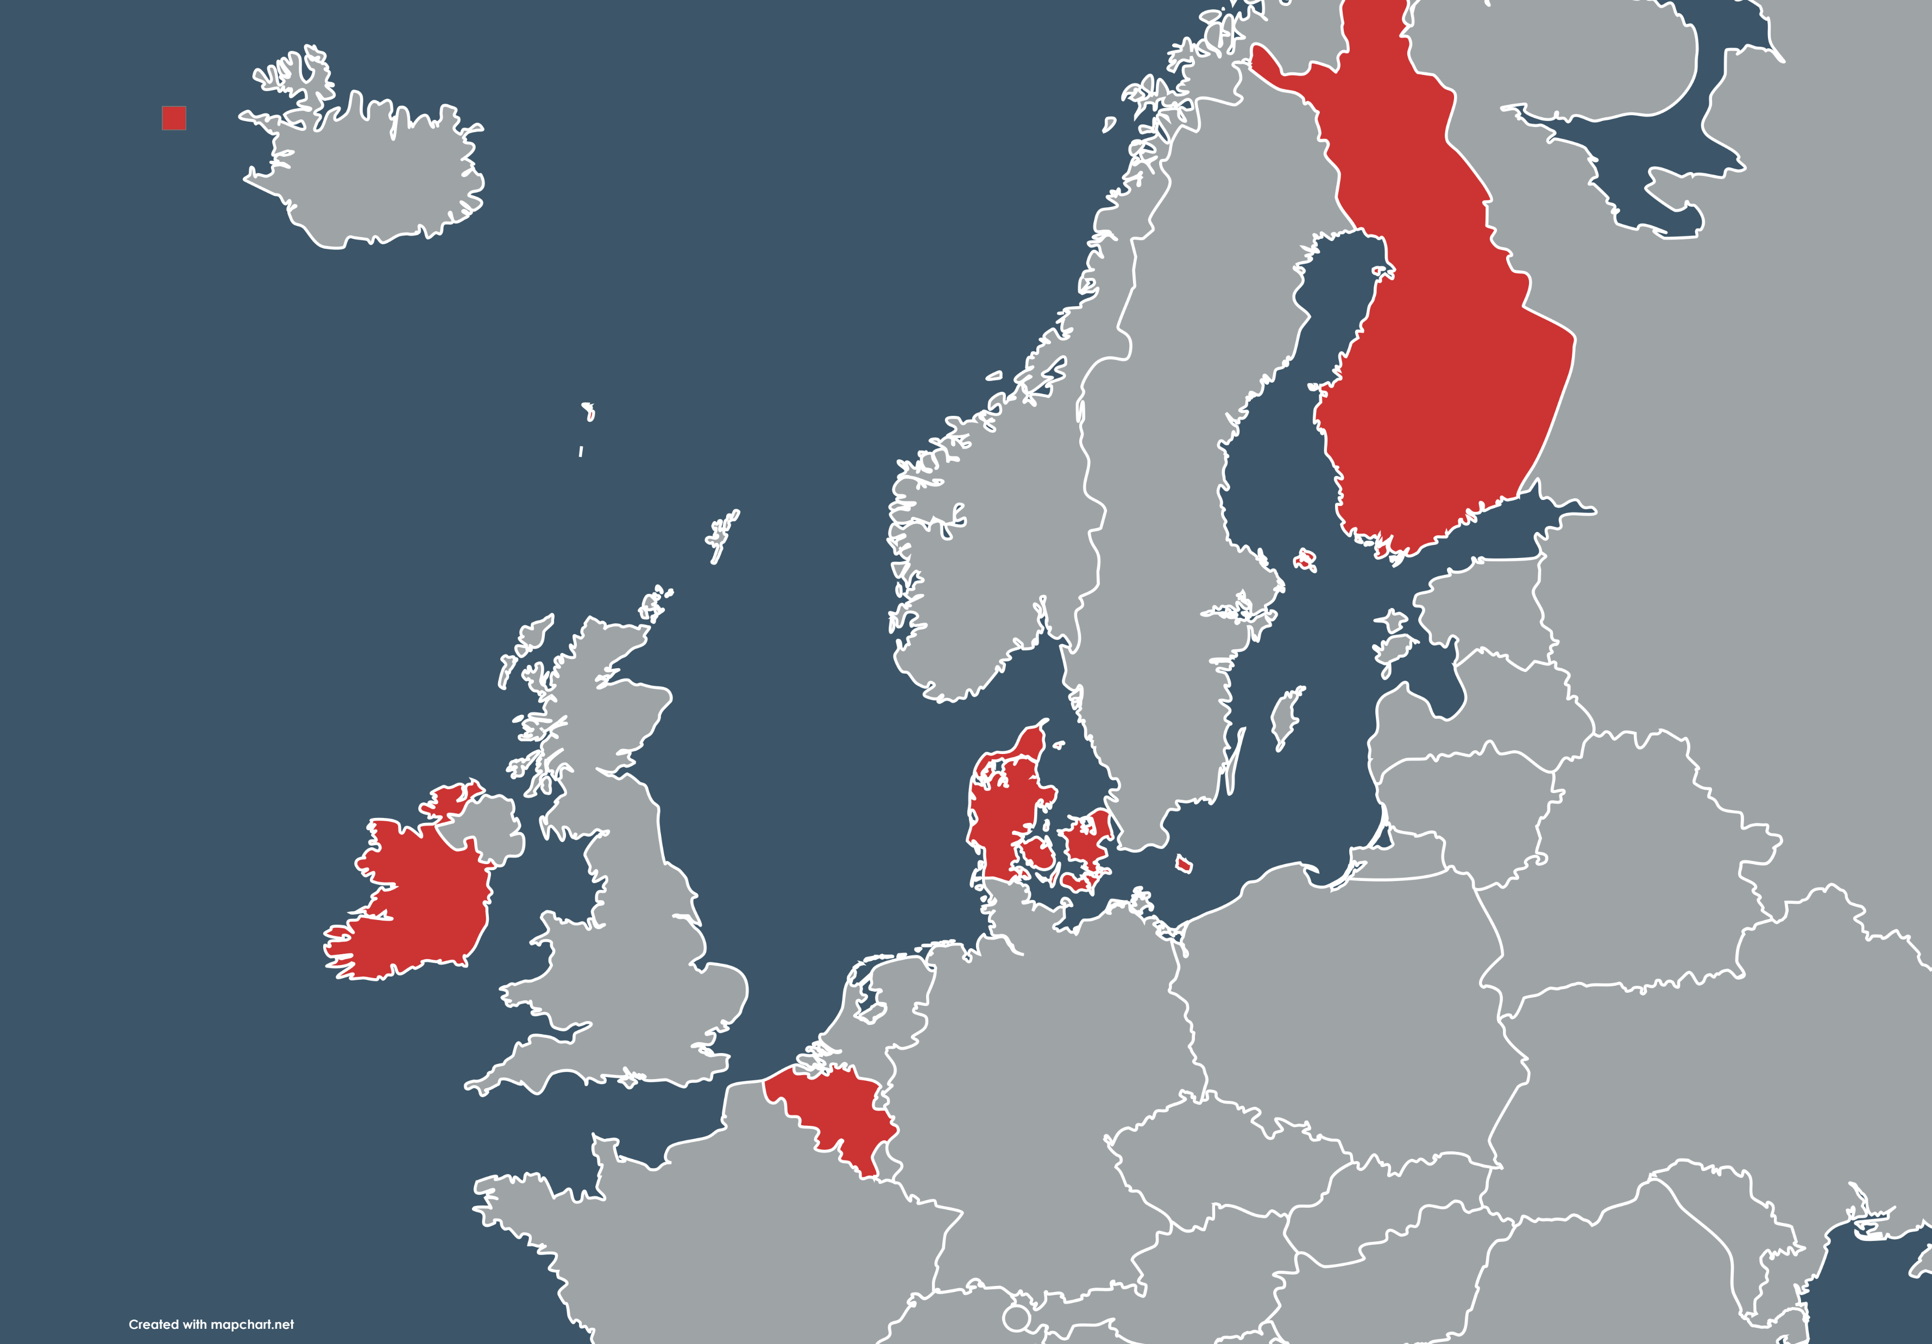
Method
909 Patients
Primary outcome:
Survival 30 days
Secondary outcomes
Survival at 90 days
Survival at 30 and 90 days with a favorable neurological outcome

Slide 14

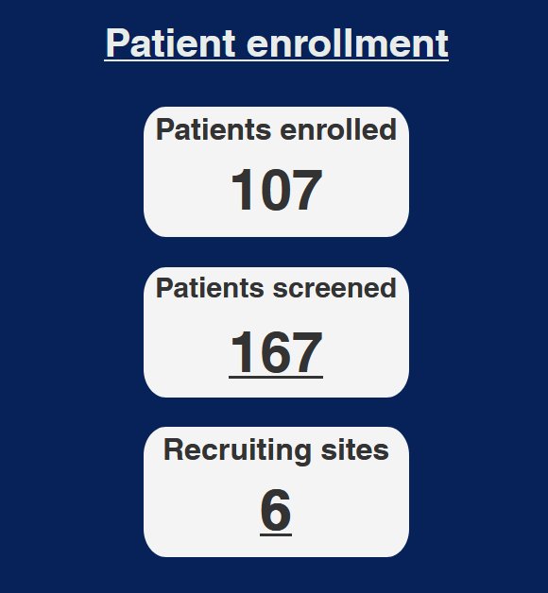



Status
Nationwide enrollment in Denmark
Finland will start enrollment during this winter
- Helsinki, Turku, Tampere, Kuopio
Enrollment will start 2026

Slide 15
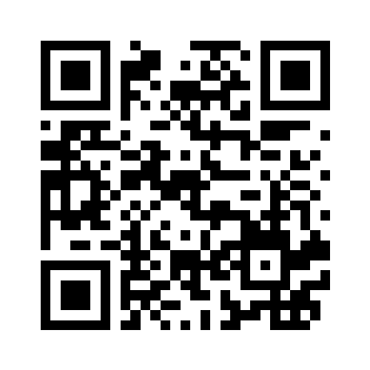




STRAT-DEFI.com
Funding:
Contakt:
e-mail: strat.defi@rm.dk
Tlf: +45 91 17 43 23

Slide 16
Initial use of double defibrillation in out-of-hospital cardiac arrest
A pilot study
Vegard Nordviste

Slide 17
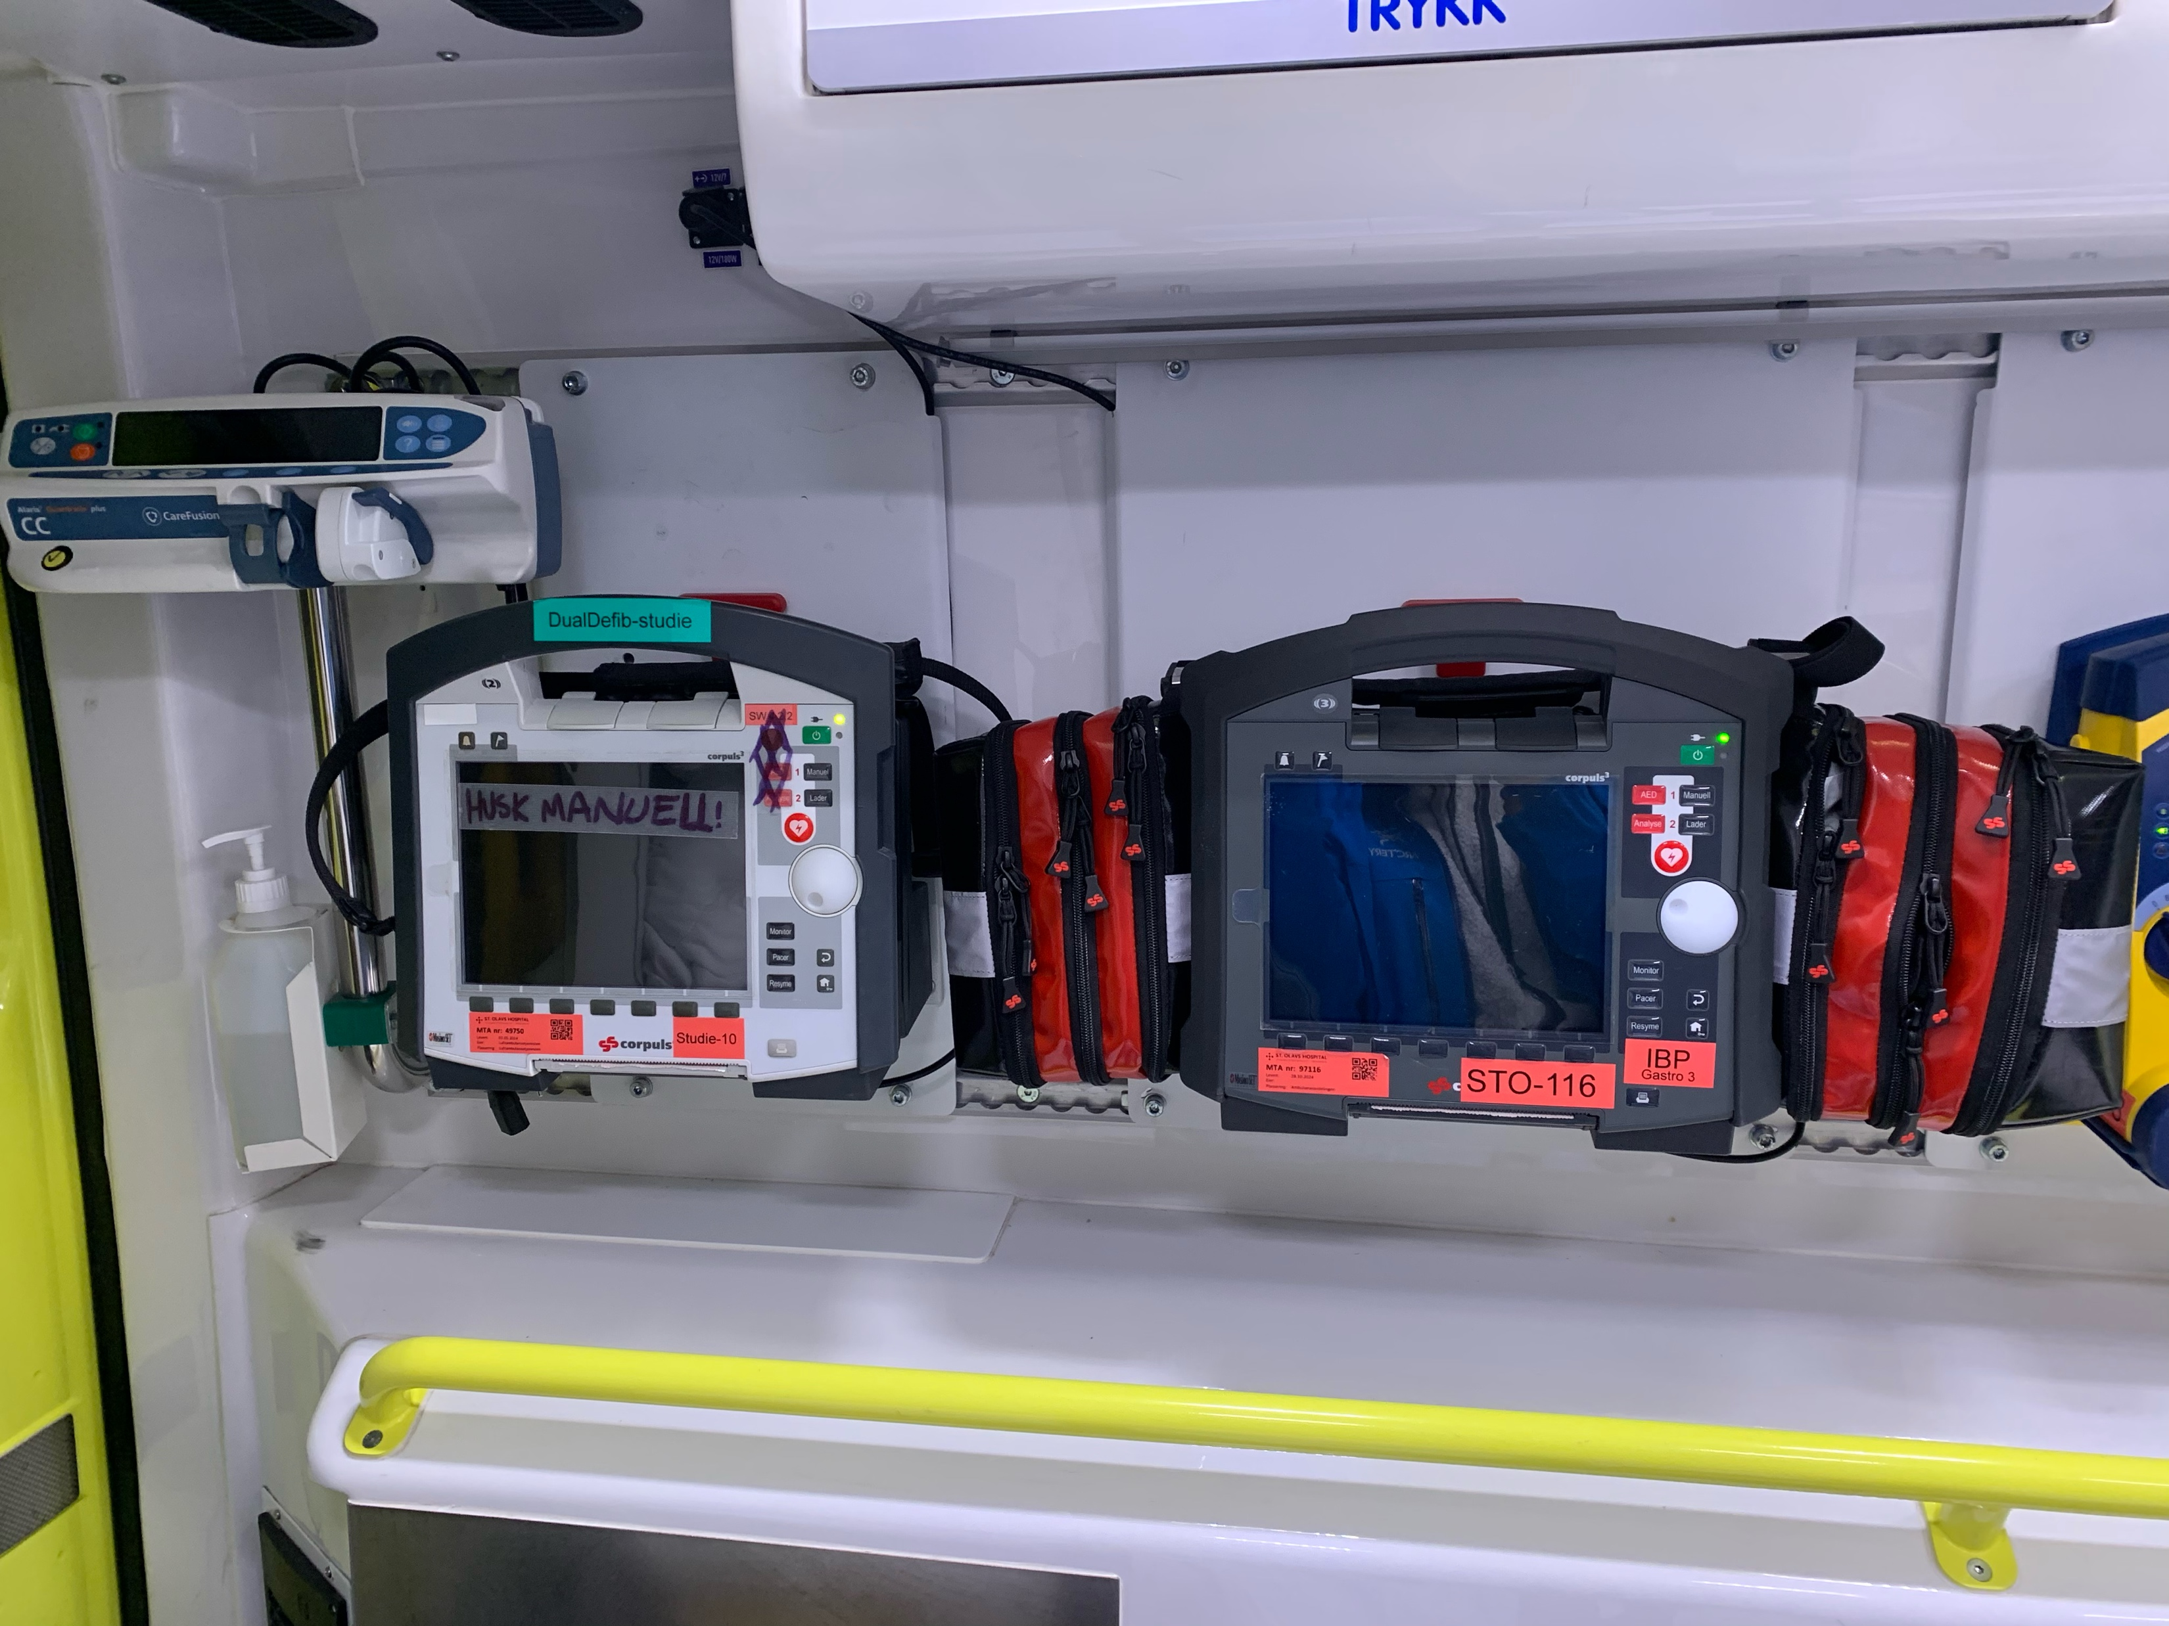
Study rationale
Set-up of included ambulances

Slide 18
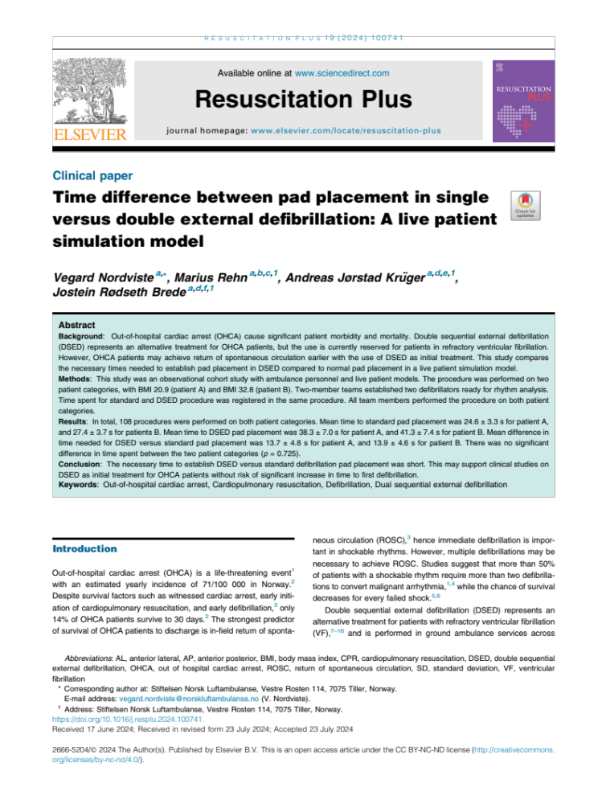
Study rationale
Ethical challenge
Background: It is known that rapid defibrillation increase chance of survival.
Dilemma: If the scope shows VF after applying the first defibrillator,
what is the cost of applying a second defibrillator?
Results:
→Time difference two vs one defibrillator: 14 sec
→No time difference in BMI 21 vs 33

Slide 19
Eligibility
Inclusion criteria:
Out-of-hospital cardiac arrest
Age ≥ 18 years
Shockable rhythm
Exclusion criteria:
Traumatic cause of the cardiac arrest
Known do-not-resuscitate status
Vulnerable patient groups
  Pregnancy
  Incarcerated patients

Slide 20
Study outcomes
Primary outcome:
Survival to hospital admission
Secondary outcomes:
Prehospital ROSC
Survival to
  Hospital discharge
  30 days
  90 days
  1 year
Neurological state at
  30 days
  90 days

Slide 21
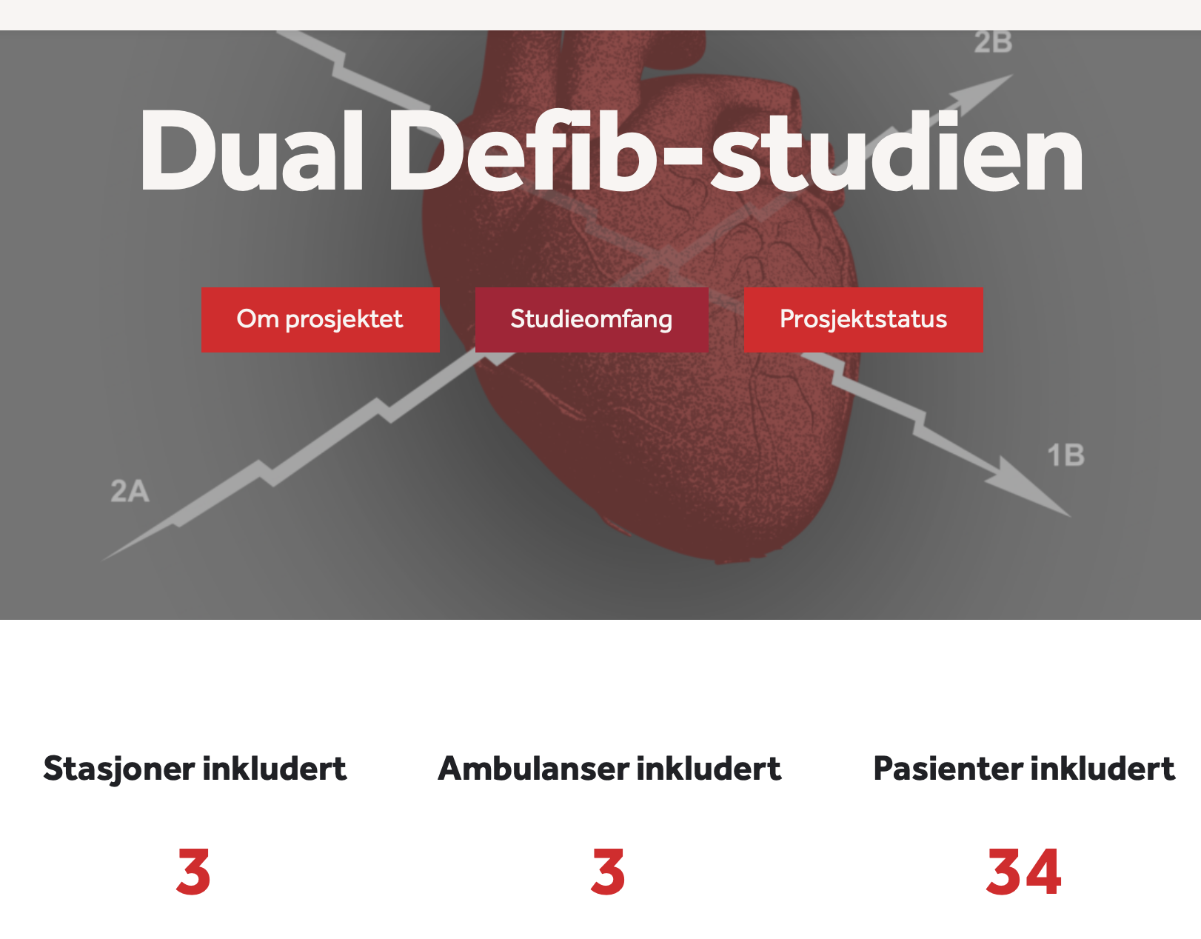
Ongoing pilot study
Pilot study 2025
Site: Trondheim, Norway (population 200,000)
Trained personnel: 75
Start: May 2025
End: December 2025?
Stations included
Ambulances included
Patients included

Slide 22
Discussion
Logistical challenges
Preparation of additional pads (Correct placement of AL pads)
Two defibrillators
Transportation
Implementation
Education
Research culture

Slide 23
Discussion
Differences between the trials
Design
Outcomes
Future perspectives
Other trials
  DoubleD-trial, DOSE-VF2
Guidelines

