Slide 1


Slide 2
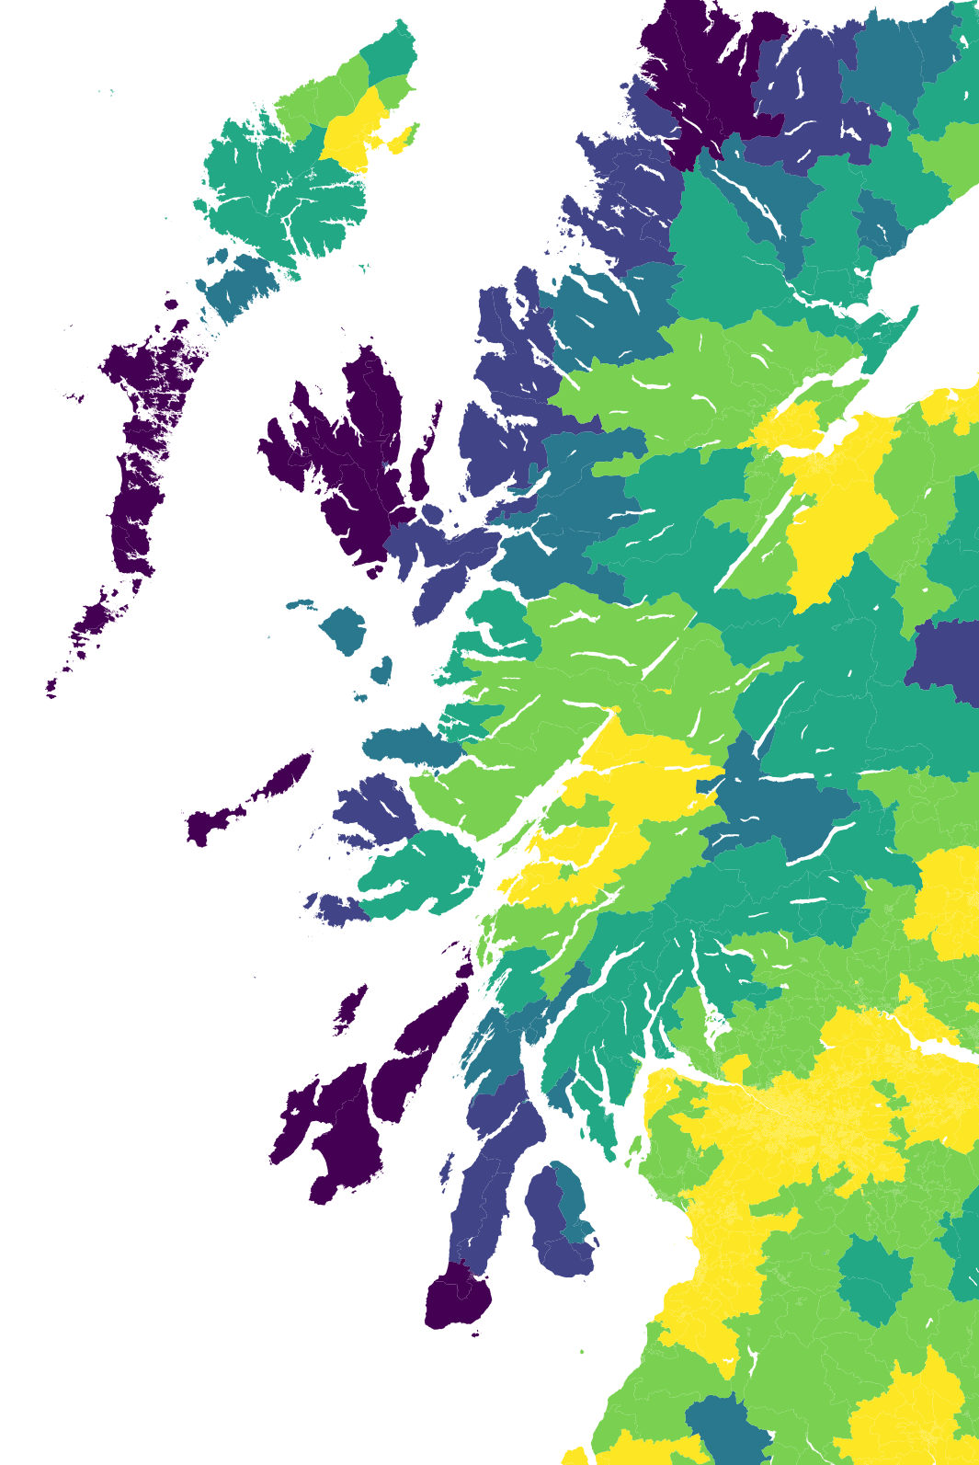


Deprivation,
Isolation
& Pre-Hospital Care
Dr Ryan McHenry
Clinical Research Fellow

Slide 3
Deprivation,
Isolation
& Pre-Hospital Care
Use, Outcomes, and Systems
Dr Ryan McHenry
Clinical Research Fellow

Slide 4
Deprivation,
Isolation
& Pre-Hospital Care
4 Years in 20 Minutes
Dr Ryan McHenry
Clinical Research Fellow

Slide 5
Notes:
And I’ll start with a very reasonable question. One that a lot of my colleagues asked me when I started to do this type of work.

Slide 6
Why?

Slide 7
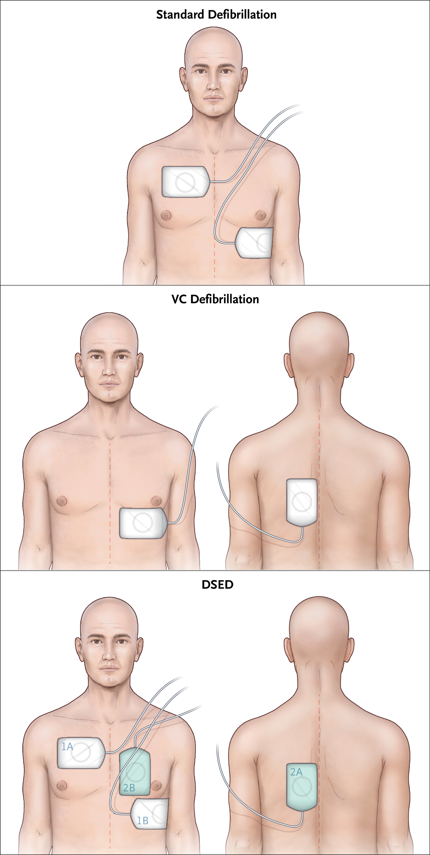
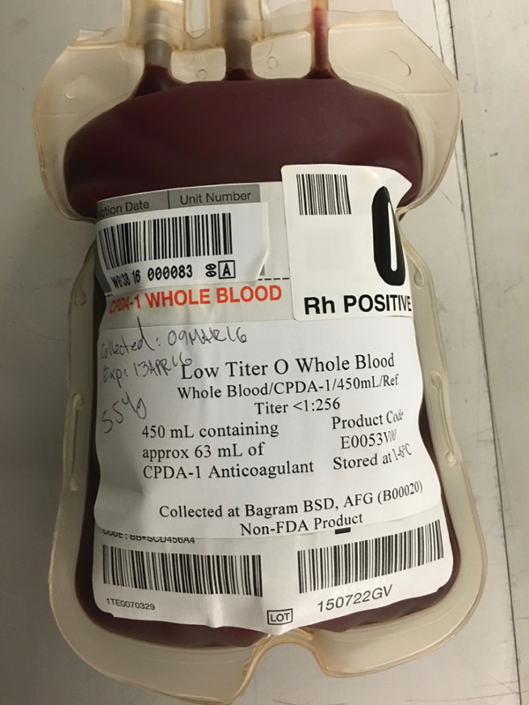
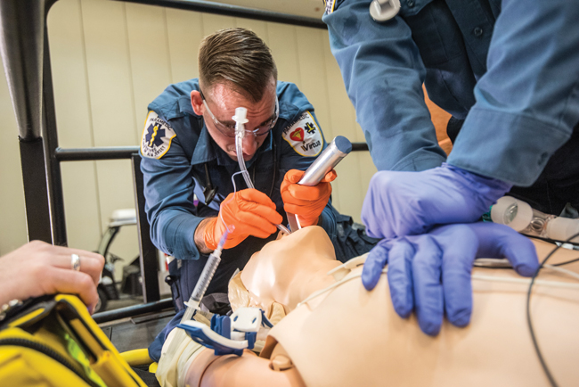
Why?
Notes:
Why, when you could be doing something useful.

Slide 8
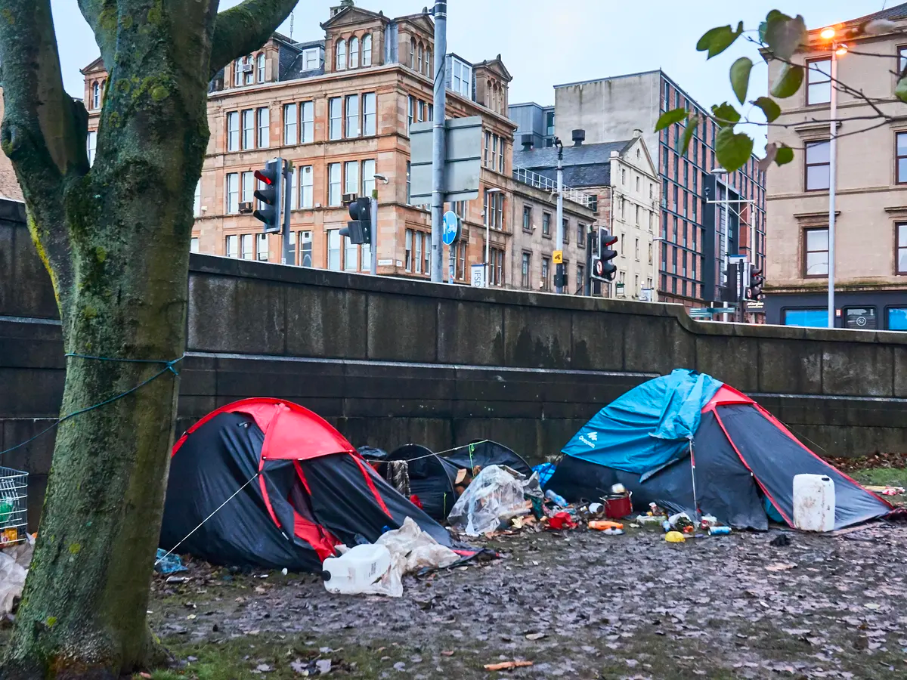
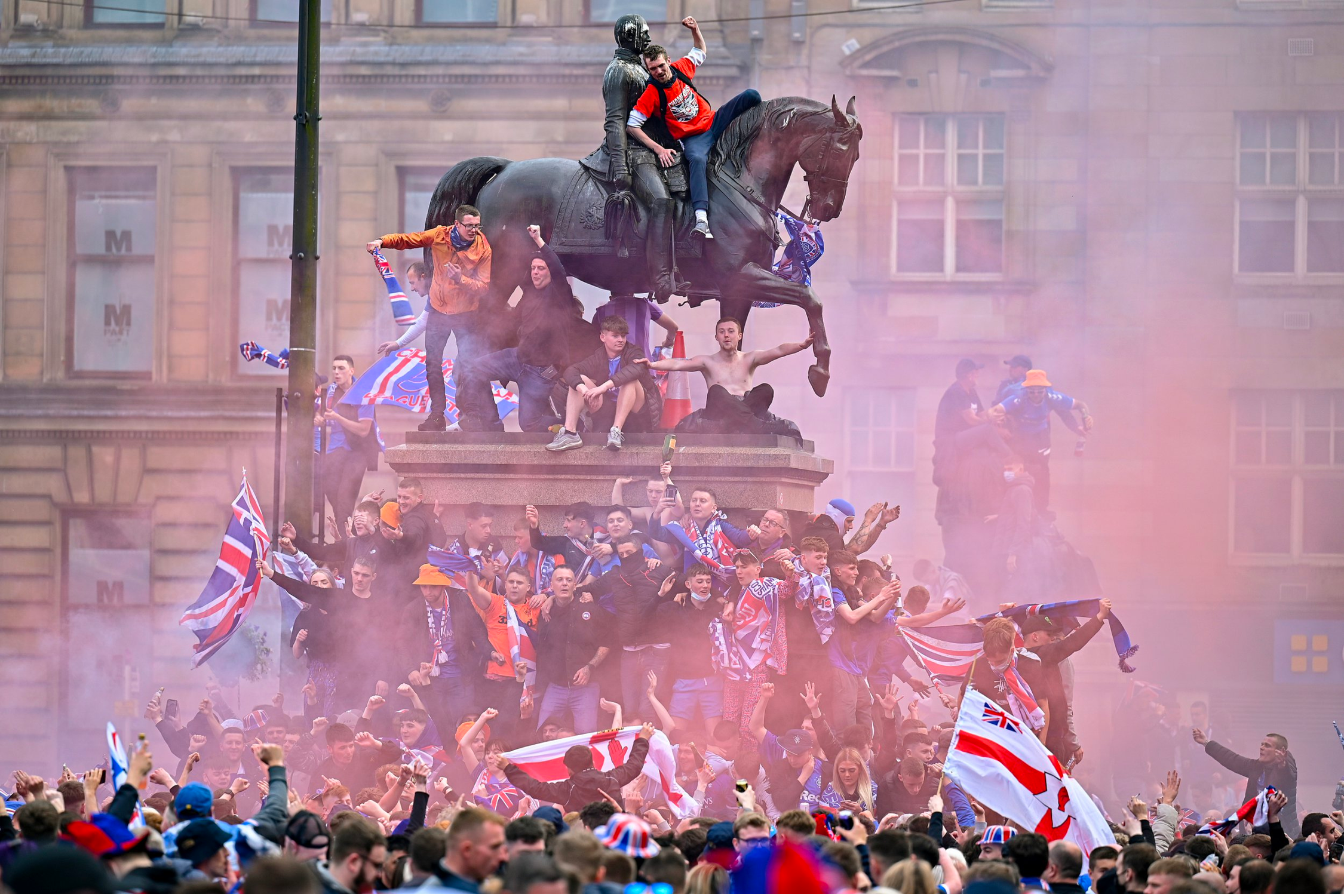
Why?
Notes:
Well, the why came from our front door, doing this work and seeing how much things beyond our control impacted on what we do.
How, very often, as pre-hospital care, all we did was respond to things that have happened as a result of peoples lives, the way they are lived - the effects of violence, homelessness,

Slide 9
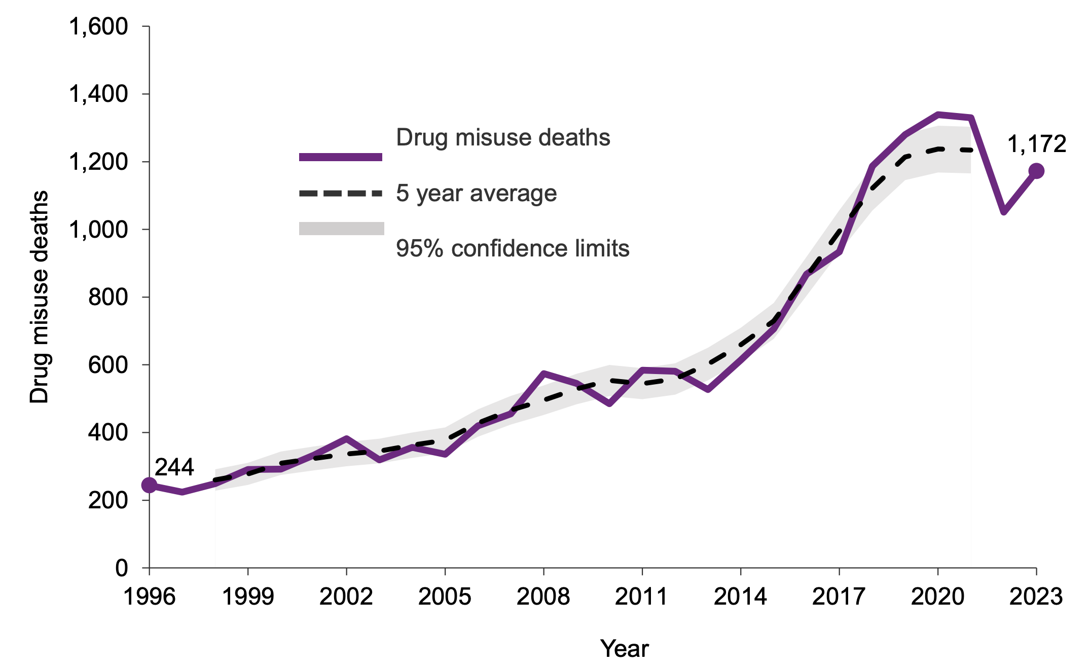
Notes:
Drug use – we have seen a crisis in drugs deaths

Slide 10
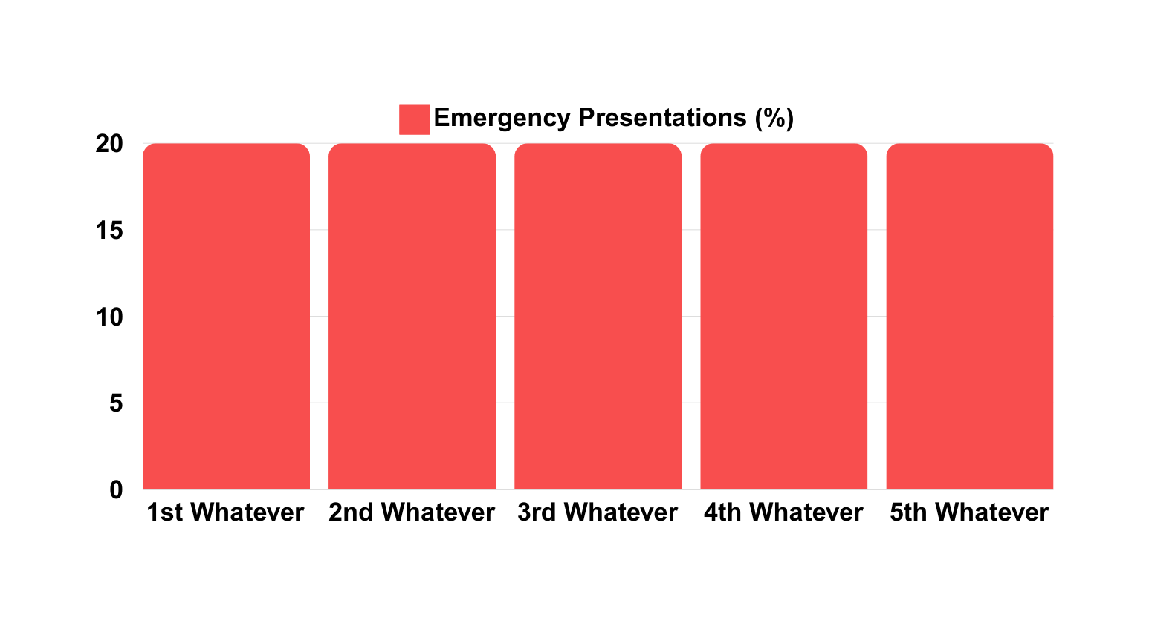
Emergency conditions are not equally spread
Notes:
And this central point.
This is what the public think. Your chance of having an emergency condition is roughly the same regardless of who you are. We should be available equally distributed across the population.

Slide 11
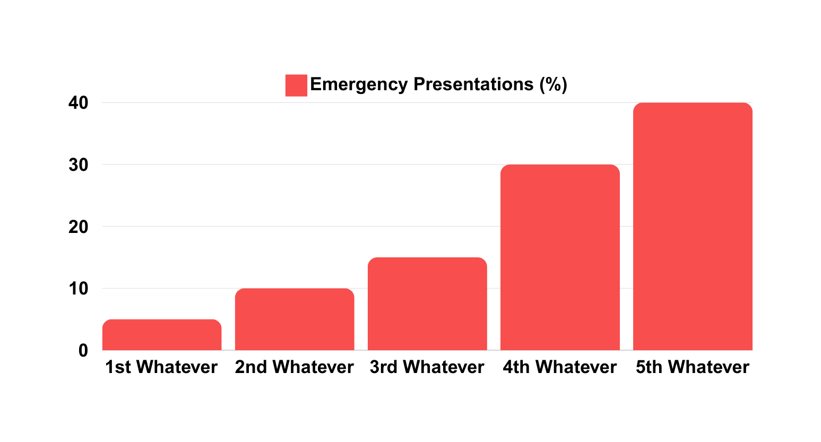
Emergency conditions are not equally spread
Notes:
But we know it’s not. We know, because we’re doing the work, that some might need us more than others.

Slide 12
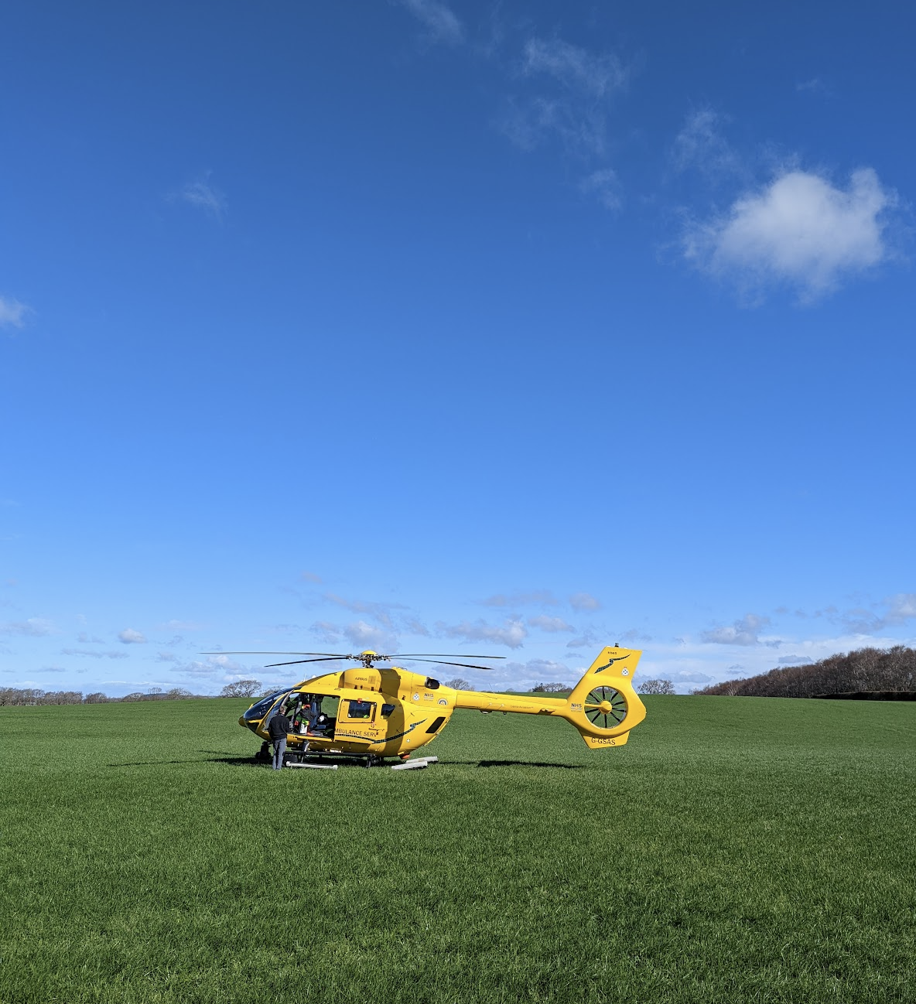
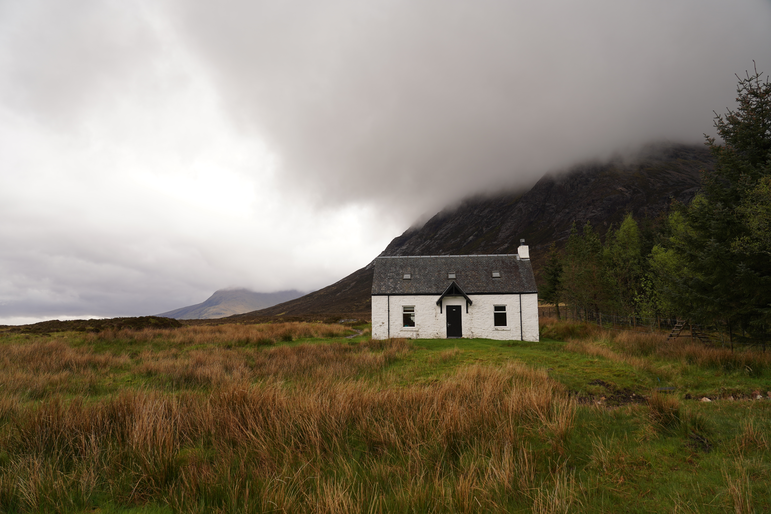
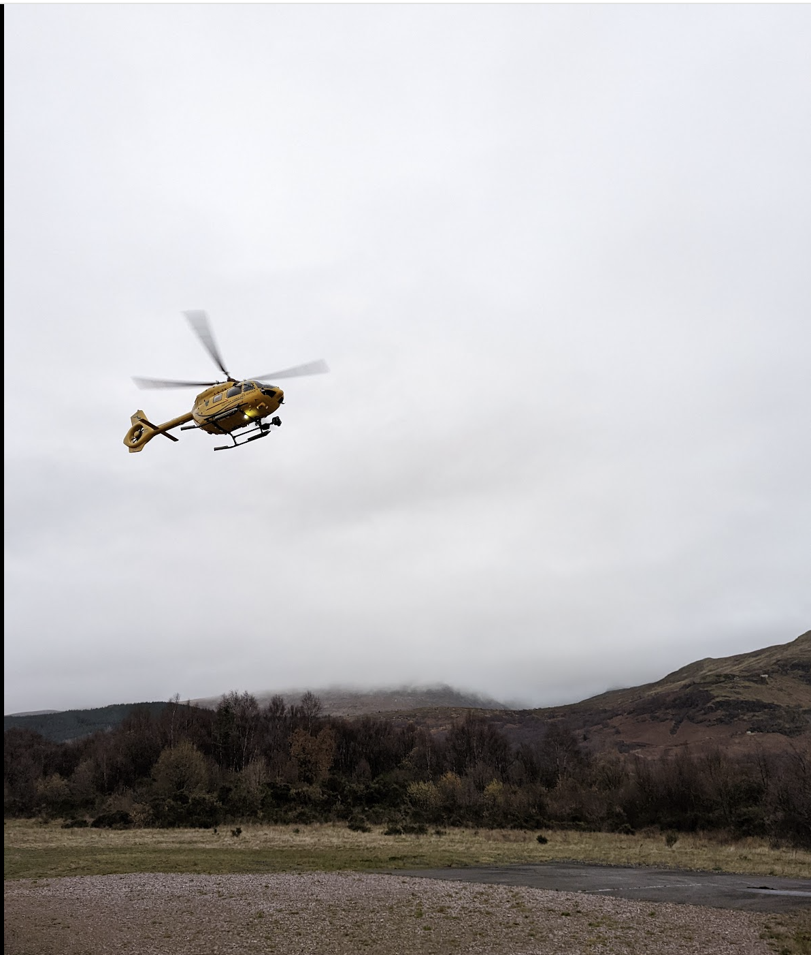
Why?
Notes:
And that other factors, outside our control, change how we do this work, for example

Slide 13
A tour of a ‘PhD’
Notes:
So I suppose this talk is a tour of what we’ve done over the last few years

Slide 14
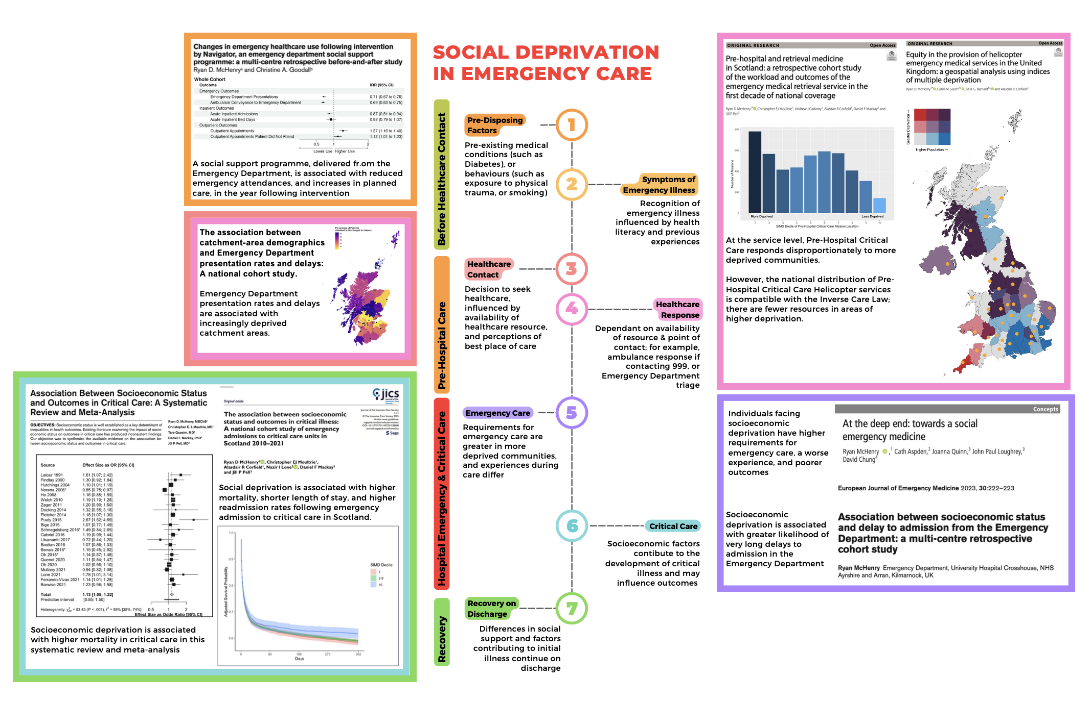
A tour of a ‘PhD’
Notes:
Exploring the impact of social deprivation

Slide 15
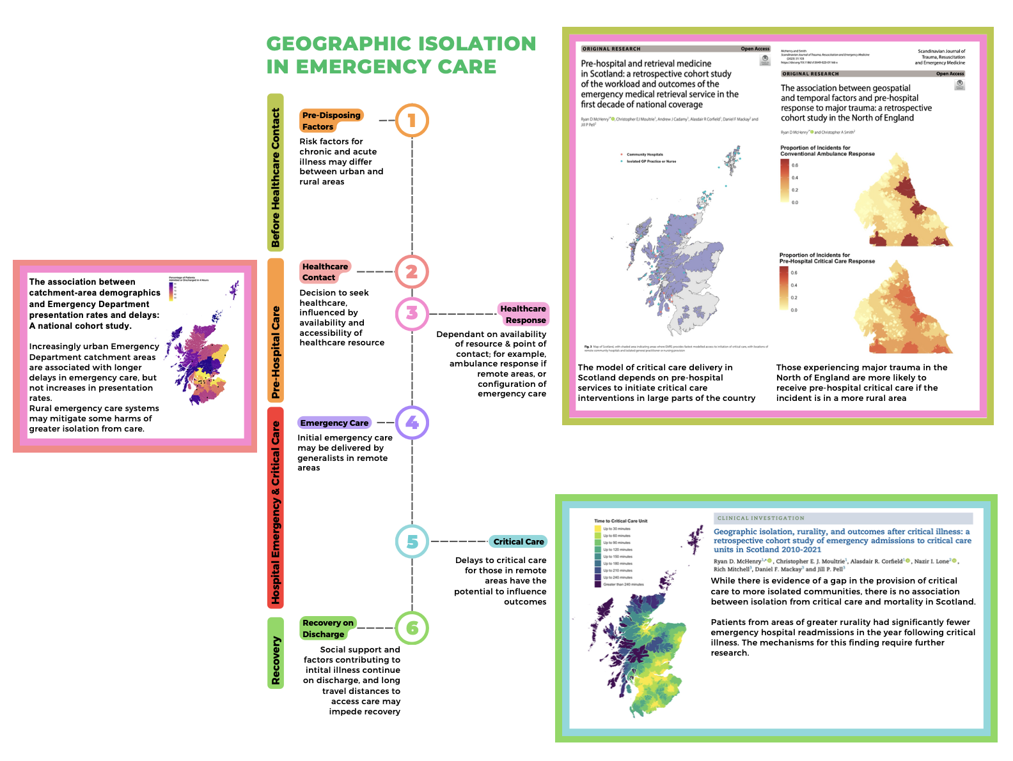
A tour of a ‘PhD’
Notes:
And that of geographic isolation, on the work we do.

Slide 16
How does social deprivation influence use of PHCC?

Slide 17
How does social deprivation influence use of PHCC?
11 Years
5,261 Taskings
Scottish Index of Multiple Deprivation
Notes:
So I suppose this talk is a tour of what we’ve done over the last few years

Slide 18
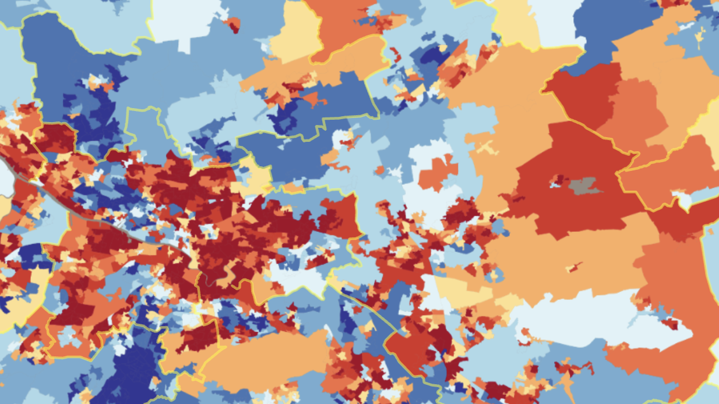

Slide 19
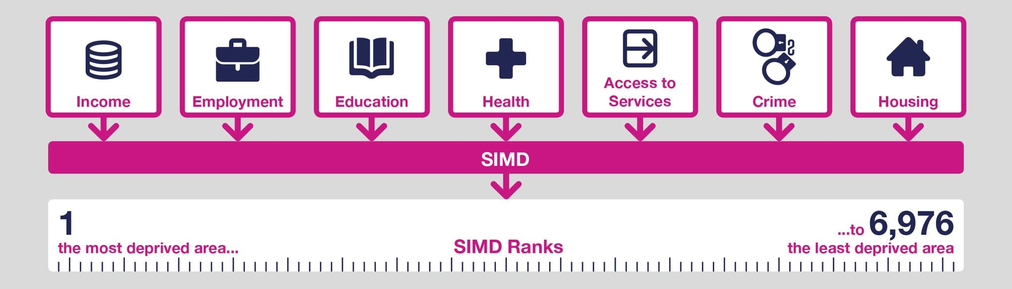

Slide 20
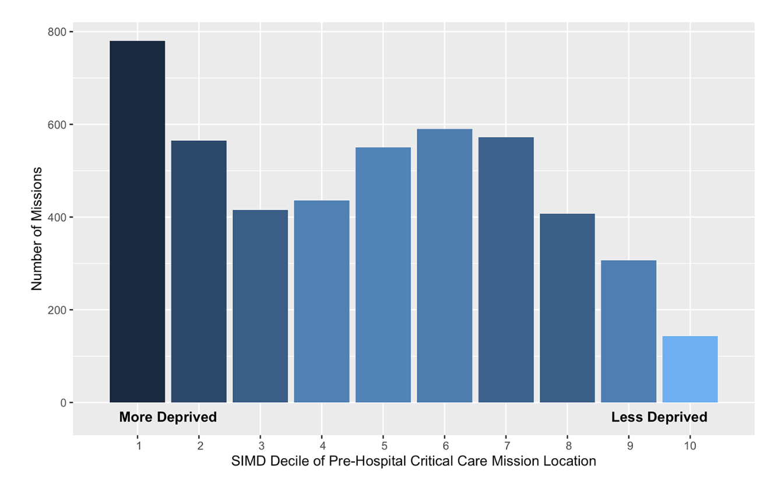
Notes:
Spearman’s rank correla-
tion, r(8)=-0.75, p
=
0.01

Slide 21
p=0.01
Notes:
Spearman’s rank correlation, r(8)=-0.75, p=0.01
No surprise when we know the kind of patients

Slide 22
Can we get a bigger picture?

Slide 23





Can we get a bigger picture?
Notes:
We ran into a problem. Many of you might be familiar.

Slide 24
Can we get a bigger picture?
Notes:
Extraordinary difficult to reliably track these patients through healthcare systems. Even in those supposedly joined-up healthcare systems

Slide 25

Can we get a bigger picture?
Notes:
But we do know that many of our patients end up in ICU

Slide 26
Can we get a bigger picture?
Notes:
And given that we’re in the business of providing critical care close to the onset of trauma or illness, this might be the population we’re looking for.

Slide 27


11 Years
50,914 Patients

Slide 28
How does social deprivation influence use of ICU?

Slide 30
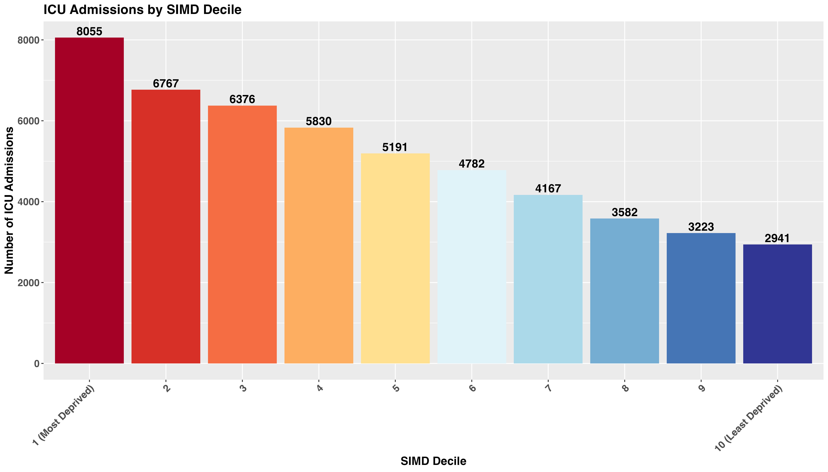
Notes:
More than 2.5x the ICU admissions in the most deprived 10%

Slide 31
How does geographic isolation influence use of ICU?

Slide 32
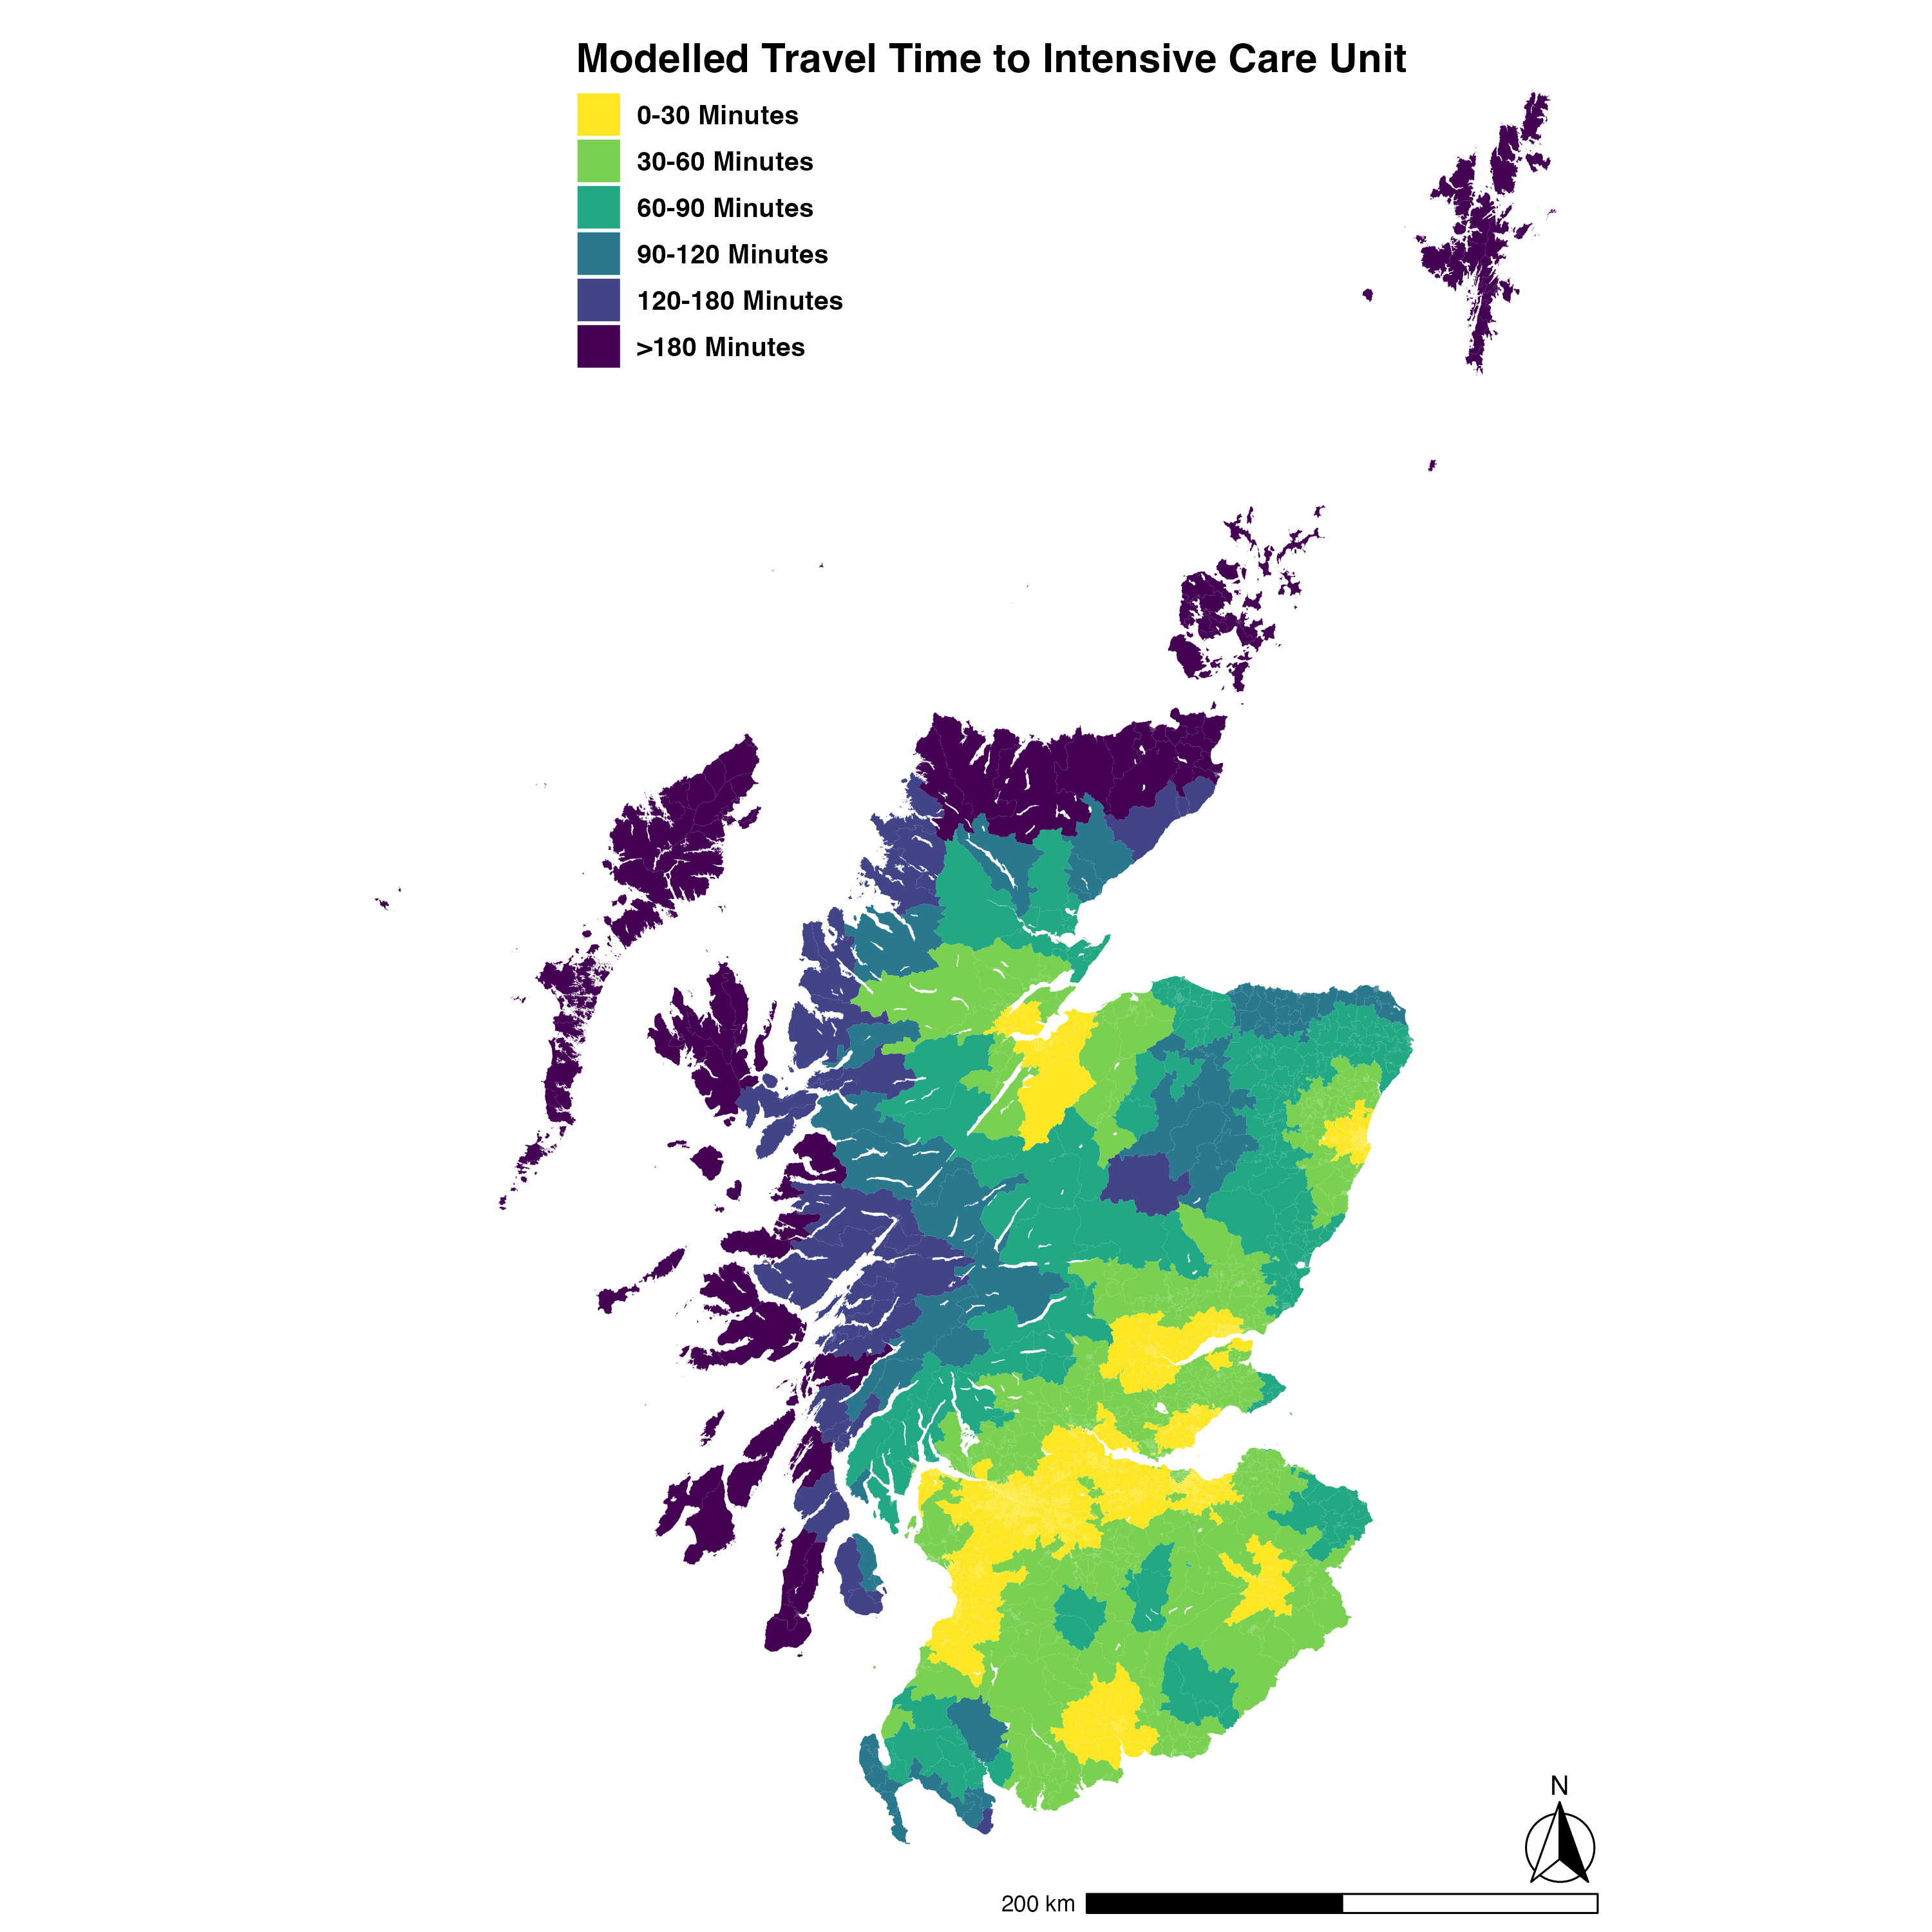

Slide 33
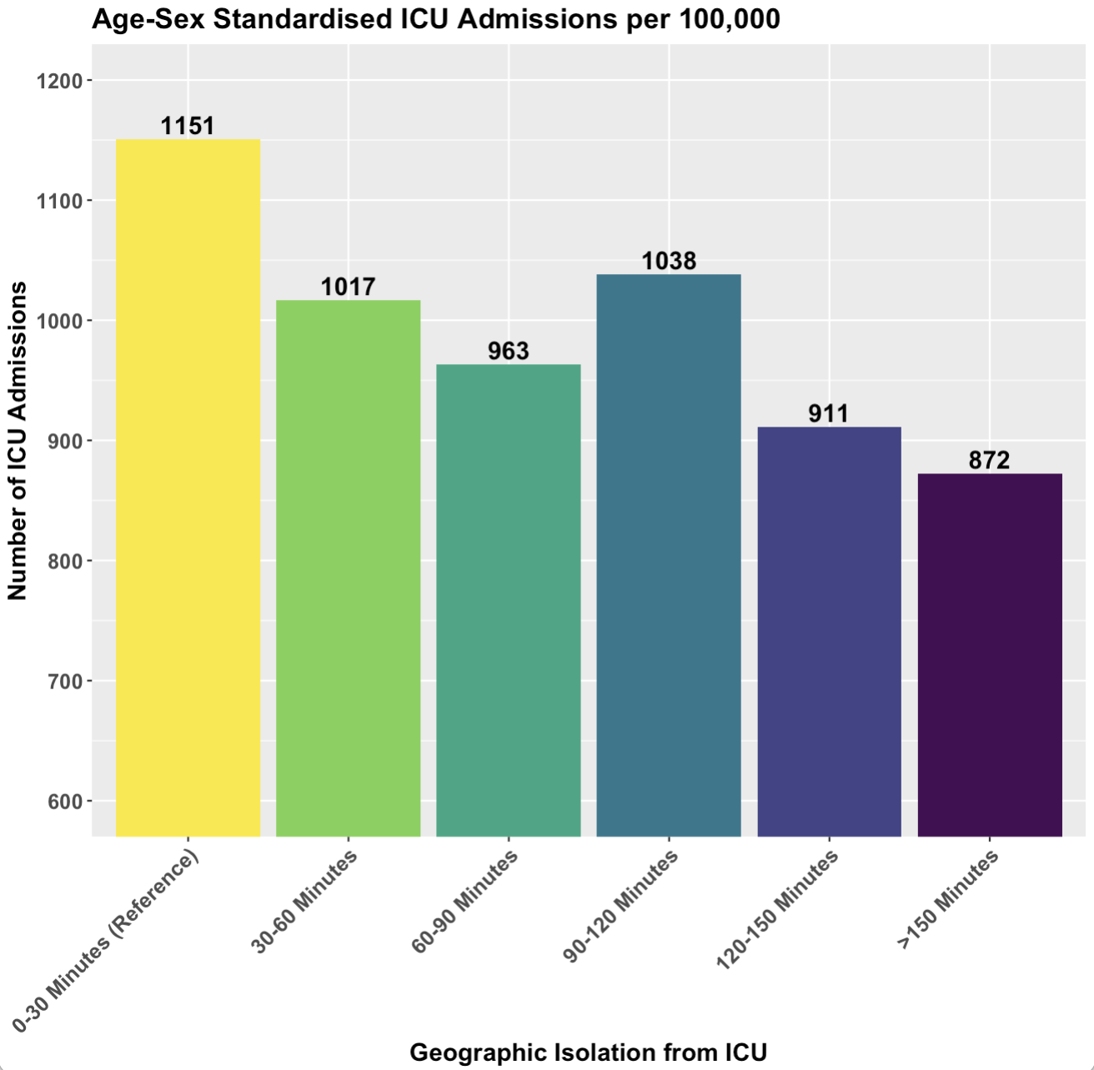

Slide 34
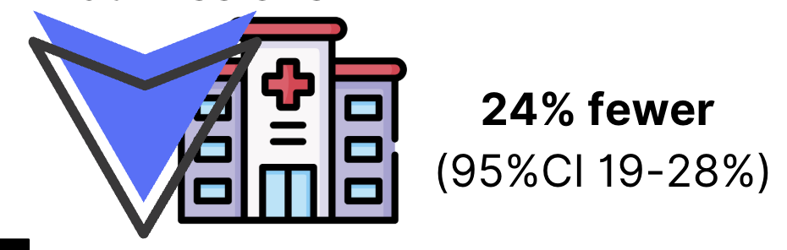
> 150 Minutes

Slide 35
Outcomes

Slide 36
How does social deprivation influence outcomes from ICU?

Slide 37
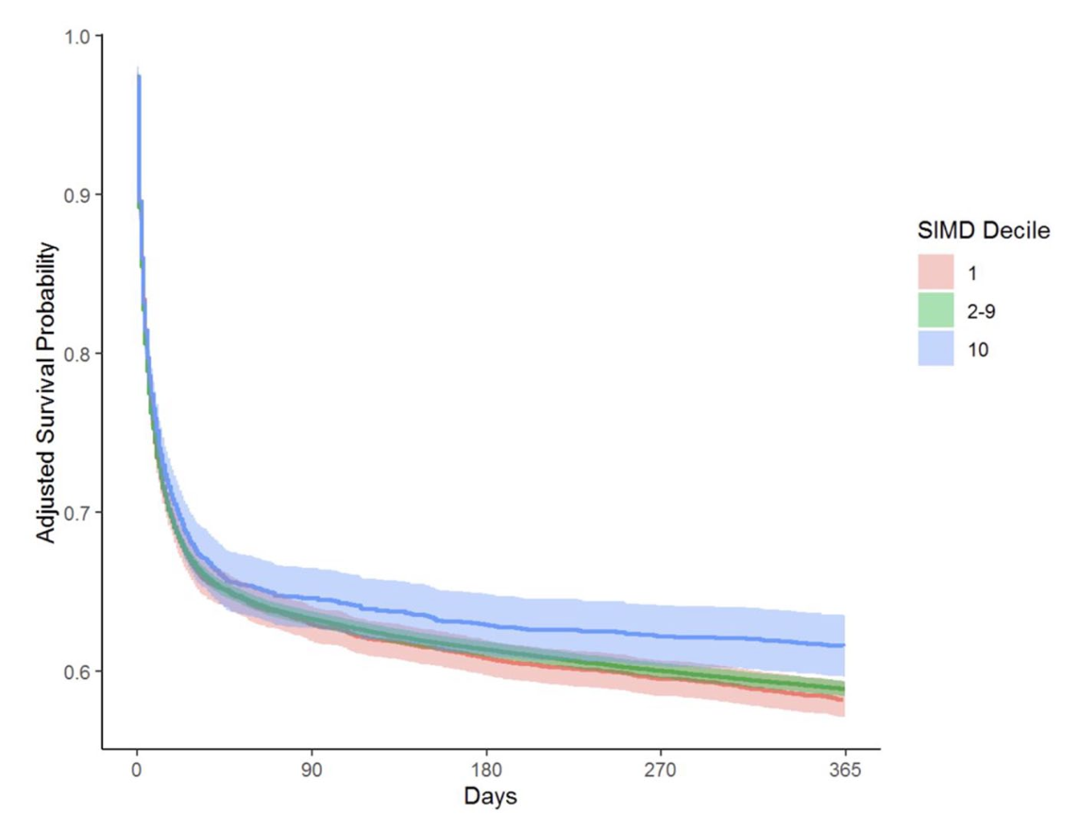
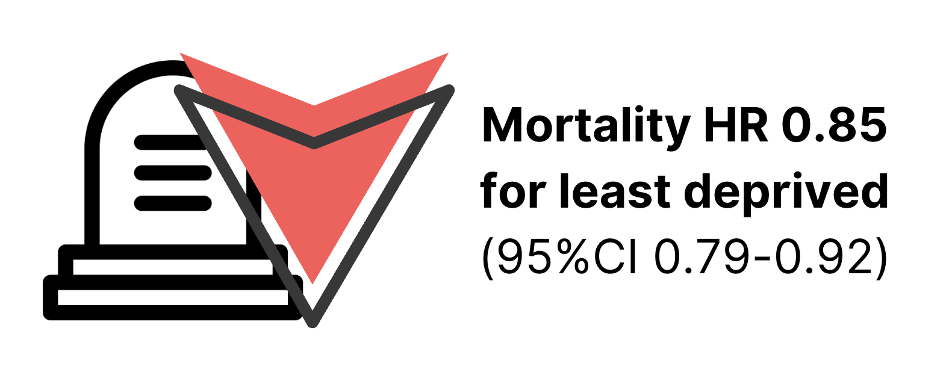

Slide 38
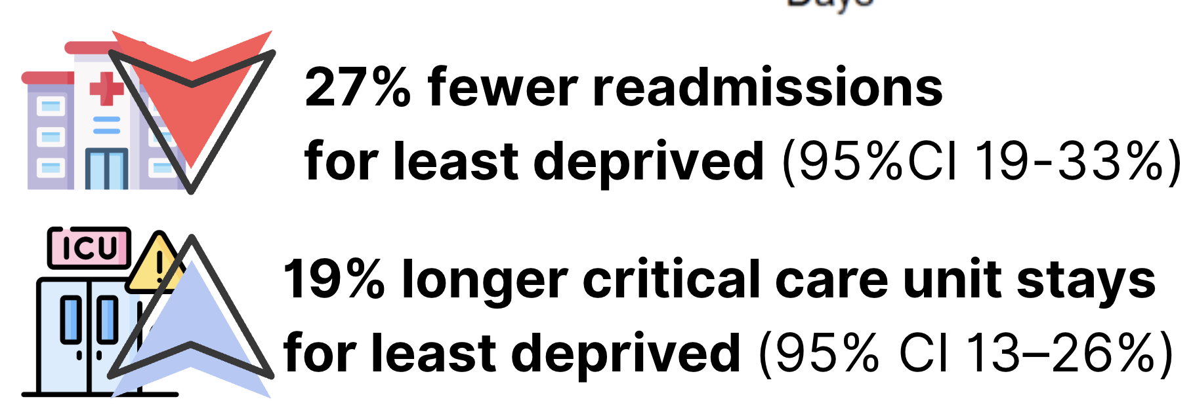

Slide 39
How does geographic isolation influence outcomes from ICU?

Slide 40
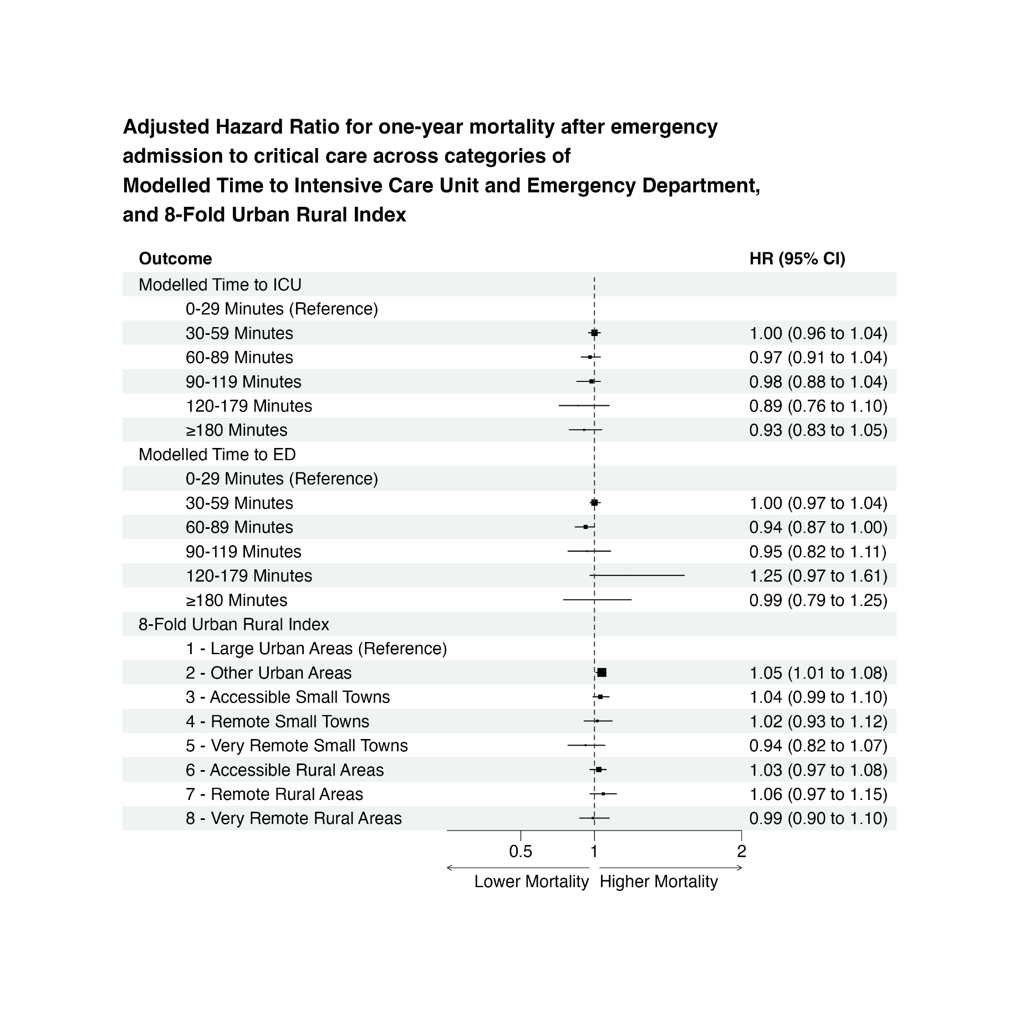

Slide 41



Slide 42
System Response
Notes:
We might think that our health systems are set up to deal with this, especially in public-funded universal access systems like those we have in the UK

Slide 43
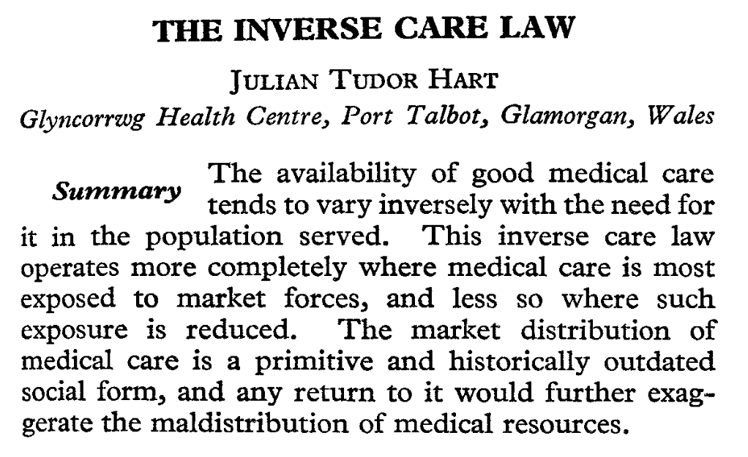

Slide 45
How does prehospital critical care respond to health inequalities?
Notes:
This isn’t just an ethnical good; it’s utilitarian too - if we want to maximise our impact, we need to be in the places that need us most.

Slide 46
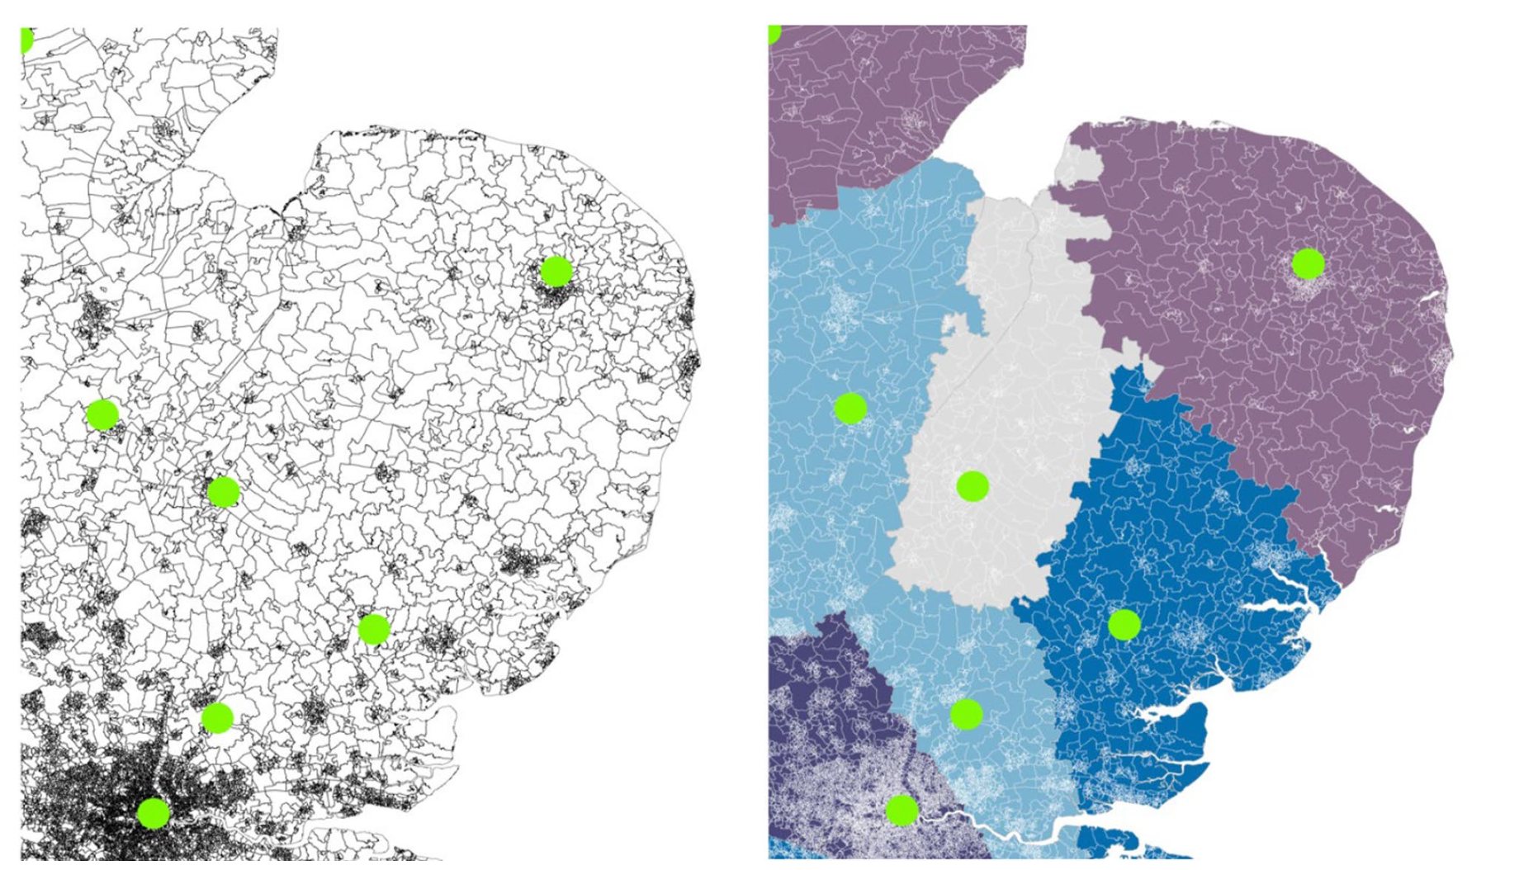

Slide 50
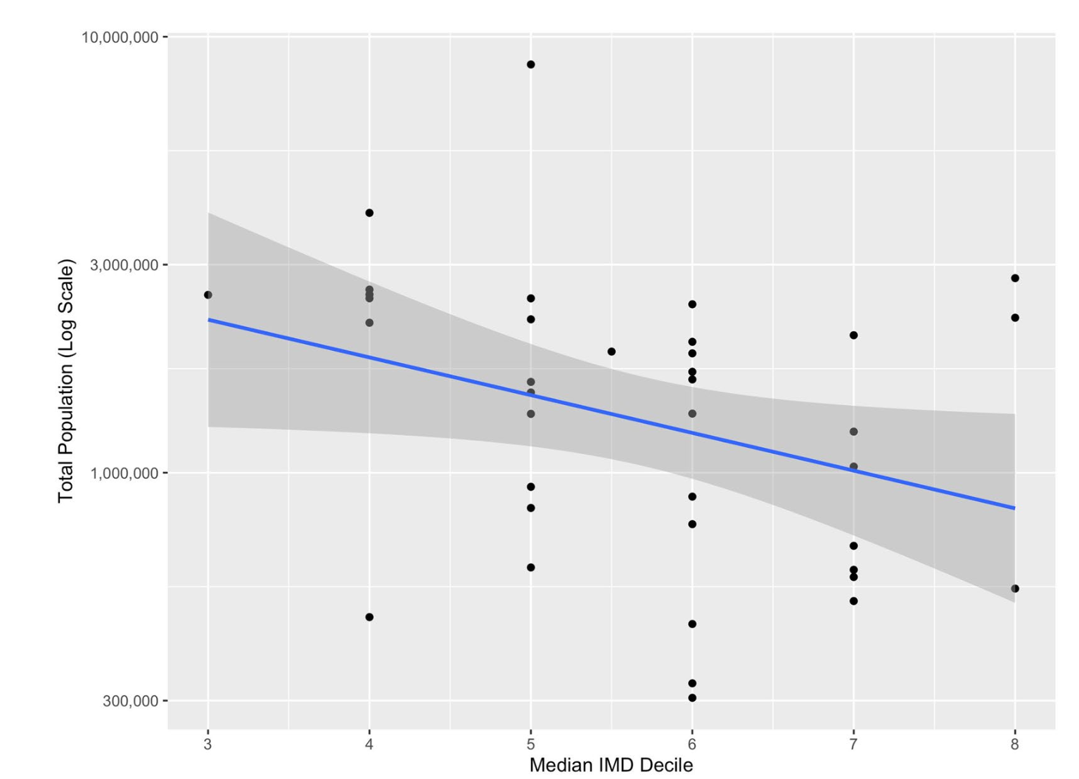
Notes:
And we might say that this is because the rich people don’t live in our inner cities, where it’s harder to fly a helicopter. This has two major flaws – one that most of these oerganisations deploy by both road and air, and that in our analysis, HEMS is not relatively more plentiful in sparsely populated areas.

Slide 51
How does prehospital critical care respond to geographic inequalities?
Notes:
And in the UK at least, this is better news.

Slide 52
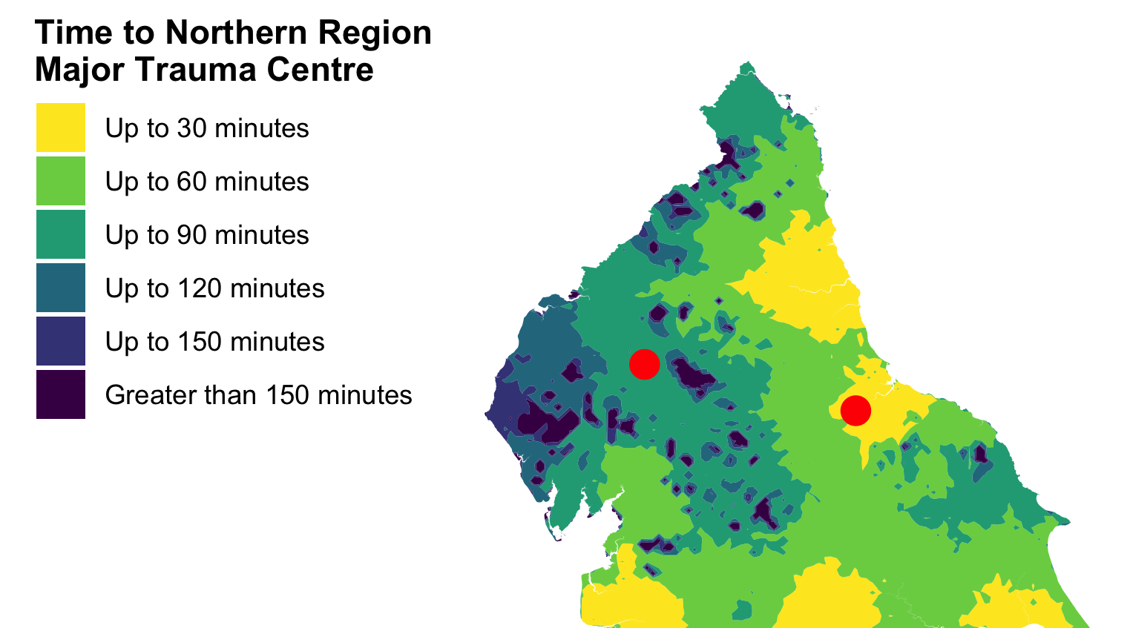

Slide 53
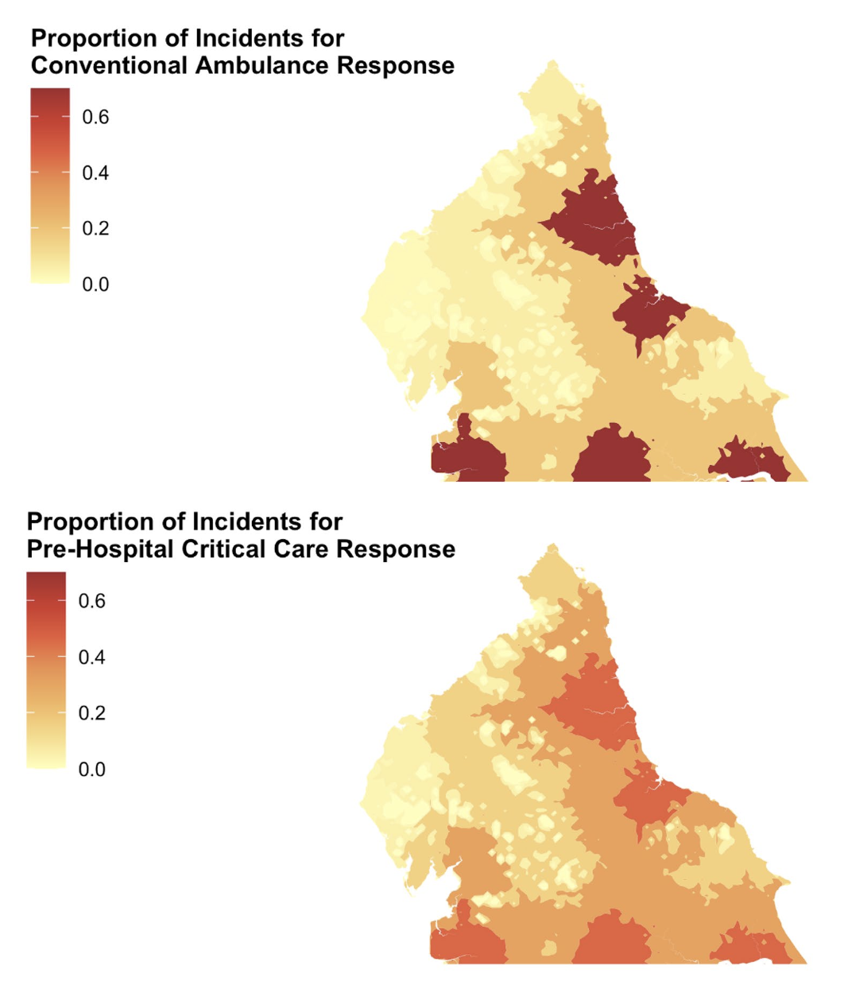
Proportion of Major Trauma Incidents
Conventional Ambulance
Pre-Hospital Critical Care

Slide 54
Social determinants matter

Slide 55
Social determinants matter (to us)

Slide 56
Social determinants matter (to us)
    Influence presentations
    Colour experience
    Define outcomes

Slide 57
Who are our patients?

Slide 58
Who are our patients?
Are they at risk?

Slide 59
Who are our patients?
Are they at risk?
How do our services respond?
Notes:
Understand how our services respond, but more than that, build services that respond to social and geographic inequalities – to be where we’re needed most.

Slide 60
Deprivation,
Isolation
& Pre-Hospital Care
Dr Ryan McHenry
Clinical Research Fellow
ryan.mchenry2@nhs.scot

Slide 61

Deprivation,
Isolation
& Pre-Hospital Care
Dr Ryan McHenry
Clinical Research Fellow
ryan.mchenry2@nhs.scot

