Slide 1
Normoventilation after prehospital emergency anesthesia (PHEA)
Jussi Tero / senior resident physician in anesthesiology, Helsinki University Hospital
Helsinki PRECISE research group
Notes:
I am going to talk about ventilation after PHEA and present to you a study we conducted regarding prehospital ventilation

Slide 2
Neurocritical care
Primary brain injury
    Ischemia
    Trauma
Secondary brain injury
    Ischemia
    Edema
    Elevated intracranial pressure (ICP)
Notes:
Why is normoventilation important
If we think about patients who require prehosital emergency anesthesia, many of them may be neurocritical patients. Many of them might have suffer from inadequate perfusion and iskemia to the brain or actiacl mechanical trauma, which may have caused primary brain injury.
We can’t do anything about the already happened insult, however we might be able to prevent secondary brain injury.
The causes and mechanisms are similar in both of these situations, so the prevention of brain ischemia and elevated intracranial pressure by intubation and normoventilation, among other interventions of course, might protect from secondary brain injury.
As we can’t measure icp in the prehospital phase.

Slide 3
Background
General anesthesia
Intubation
Stable hemodynamics
  i.v. fluids / blood
  Vasoactives
Sedation
Normoventilation
Airway
Aspiration
pO2 and pCO2
Reduce oxygen consumption
Maintain sufficient oxygen delivery
Prevent secondary brain injury
Notes:
Of course when we are performing PHEA, there are many things to concider.
-We put the patient under general anesthesia
-We intubate the patient
-We provide the patient with i.v. fluids or bloodproducts if needed to maintain stable hemodynamics
After PHEA
-We sedate the patient
-We ventilate the patient
What we are treating with this intervention is for example
-securing a compromised airway and reduce the risk of aspiration
-We maintain sufficient oxygen delivery and reduce oxygen consumption
-We ventilate the patient according to guidelines to maintain normocapnia
And ultimately try to prevent secondary brain injury
Impaired consciousness / inadequate airway and/or breathing
Trauma including TBI, infection, iskemia, intoxication.
Intubate the patients. Avoid hemodynamic instability by adequate drugs, fluids or bloodproducts and vasoactives such as noradrenaline.
After PHEA, the patient is sedated and ventilated according to guidelines.

Slide 4
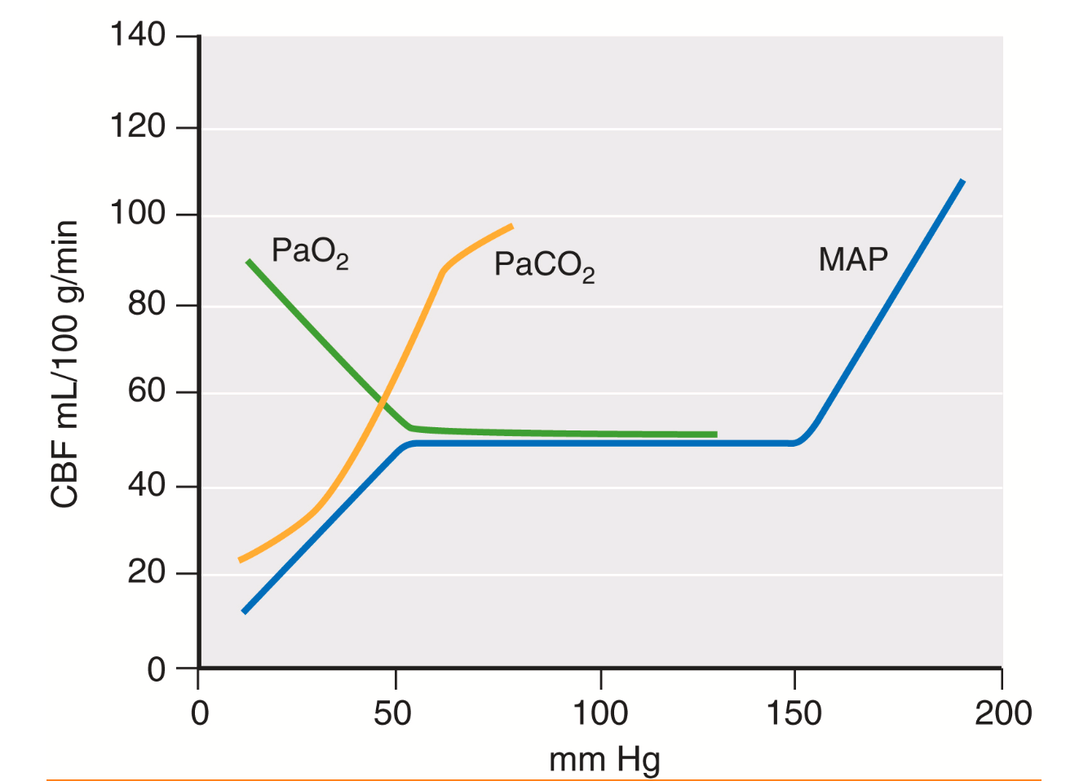
Nerissa UK And Engelhard K. Neurocritical Care. In: C.N. Gropper MA, Eriksson LI, Fleisher LA, Johnson-akeju S, Leslie K, Editors. Miller’s Anesthesia. Philadelphia: Elsevier; 2024. P. 2570-2595.
Notes:
The pathophysiology behind this may be seen in this figure from Miller’s anesthesia and it shows the influence of changes in the mean arterial pressure, arterial oxygen partial pressure and arterial carbon dioxide pressure upon cerebral blood flow. Now we focus on ventilation after intubation.
As we can see, hyperventilation reduces cerebral blood flow and lowers intracranial pressure but can cause inadequate perfusion and oxygenation
Hypoventilation increases CBF and can result in increased ICP
Both may result in secondary brain injury
By normoventilation we try to prevent secondary brain injury

Slide 5
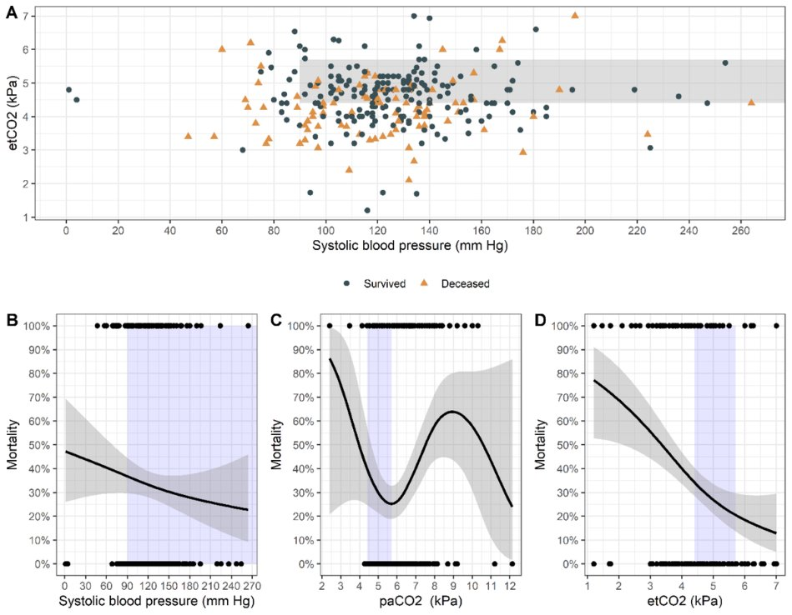
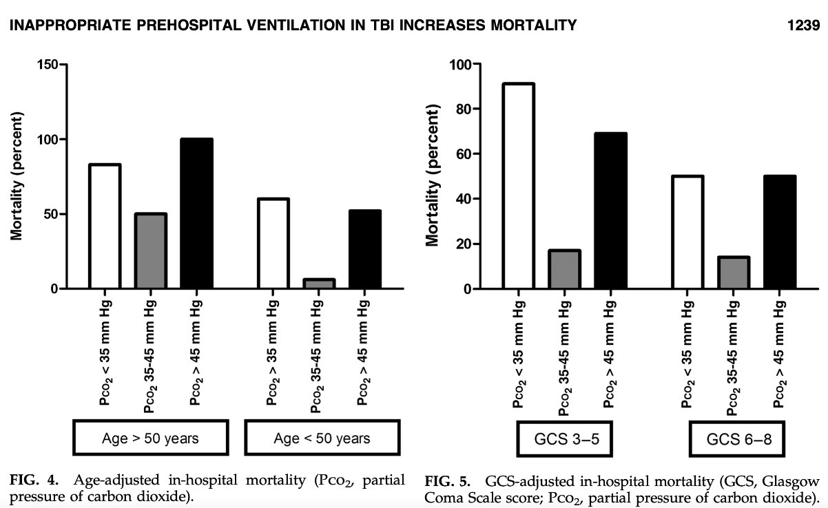
Traumatic brain injury
Dumont et al. 2010
Knapp et al. 2023​
Notes:
Especially with patients suffering traumatic brain injury, multiple studies, including Dumont et al in 2010 and Knapp et al in 2023, have shown an association with normoventilation and better outcomes.
In a study of 65 intubated tbi patients concucted by Dumont et al, hypo or hypercarbia in arterial blood gas analysis at hospital arrival were strongly associated with increased mortality
Similar results were shown in a study conducted by Knapp et al, and as we can see from the figure, the mortality risk is significantly higher in hypo or hypercapnia.

Slide 6
Traumatic brain injury
Dumont et al. 2010
Knapp et al. 2023​
30% normoventilated
33% normoventilated
Notes:
Especially with patients suffering traumatic brain injury, multiple studies, including Dumont et al in 2010 and Knapp et al in 2023, have shown an association with normoventilation and better outcomes.
In a study of 65 intubated tbi patients concucted by Dumont et al, hypo or hypercarbia in arterial blood gas analysis at hospital arrival were strongly associated with increased mortality
Similar results were shown in a study conducted by Knapp et al, and as we can see from the figure, the mortality risk is significantly higher in hypo or hypercapnia.

Slide 7
Kottmann A, Kruger AJ, Sunde GA, Roislien J, Heltne JK, Carron PN, Et Al., Establishing Quality Indicators For Pre-hospital Advanced Airway Management: A Modified Nominal Group Technique Consensus Process. Br J Anaesth, 2022. 128(2): P. E143-e150.
General
  EtCO2 4 to 6 kPa / PaCO2 4.67 to 6.67 kPa
Traumatic brain injury
  EtCO2 4 to 4.67 kPa / PaCO2 4.67 to 5.33 kPa
Notes:
In the current quality indicators for prehospital advanced airway management, kottmann et al recommend the following ventilatory targets.
For Patients with TBI, ventilation targets are more strict. But to achieve these targets, the gradient between Arterial CO2 and end tidal CO2 should be 0.67 kPa.
Recent litterature however indicates that the gradient is significantly higher, especially in the prehospital setting

Slide 8
Kottmann A, Kruger AJ, Sunde GA, Roislien J, Heltne JK, Carron PN, Et Al., Establishing Quality Indicators For Pre-hospital Advanced Airway Management: A Modified Nominal Group Technique Consensus Process. Br J Anaesth, 2022. 128(2): P. E143-e150.
General
  EtCO2 4 to 6 kPa / PaCO2 4.67 to 6.67 kPa
Traumatic brain injury
  EtCO2 4 to 4.67 kPa / PaCO2 4.67 to 5.33 kPa
              PaCO2-EtCO2 gradient (GAP) 0.67 kPa
Notes:
In the current quality indicators for prehospital advanced airway management, kottmann et al recommend the following ventilatory targets.
For Patients with TBI, ventilation targets are more strict. But to achieve these targets, the gradient between Arterial CO2 and end tidal CO2 should be 0.67 kPa.
Recent litterature however indicates that the gradient is significantly higher, especially in the prehospital setting

Slide 9
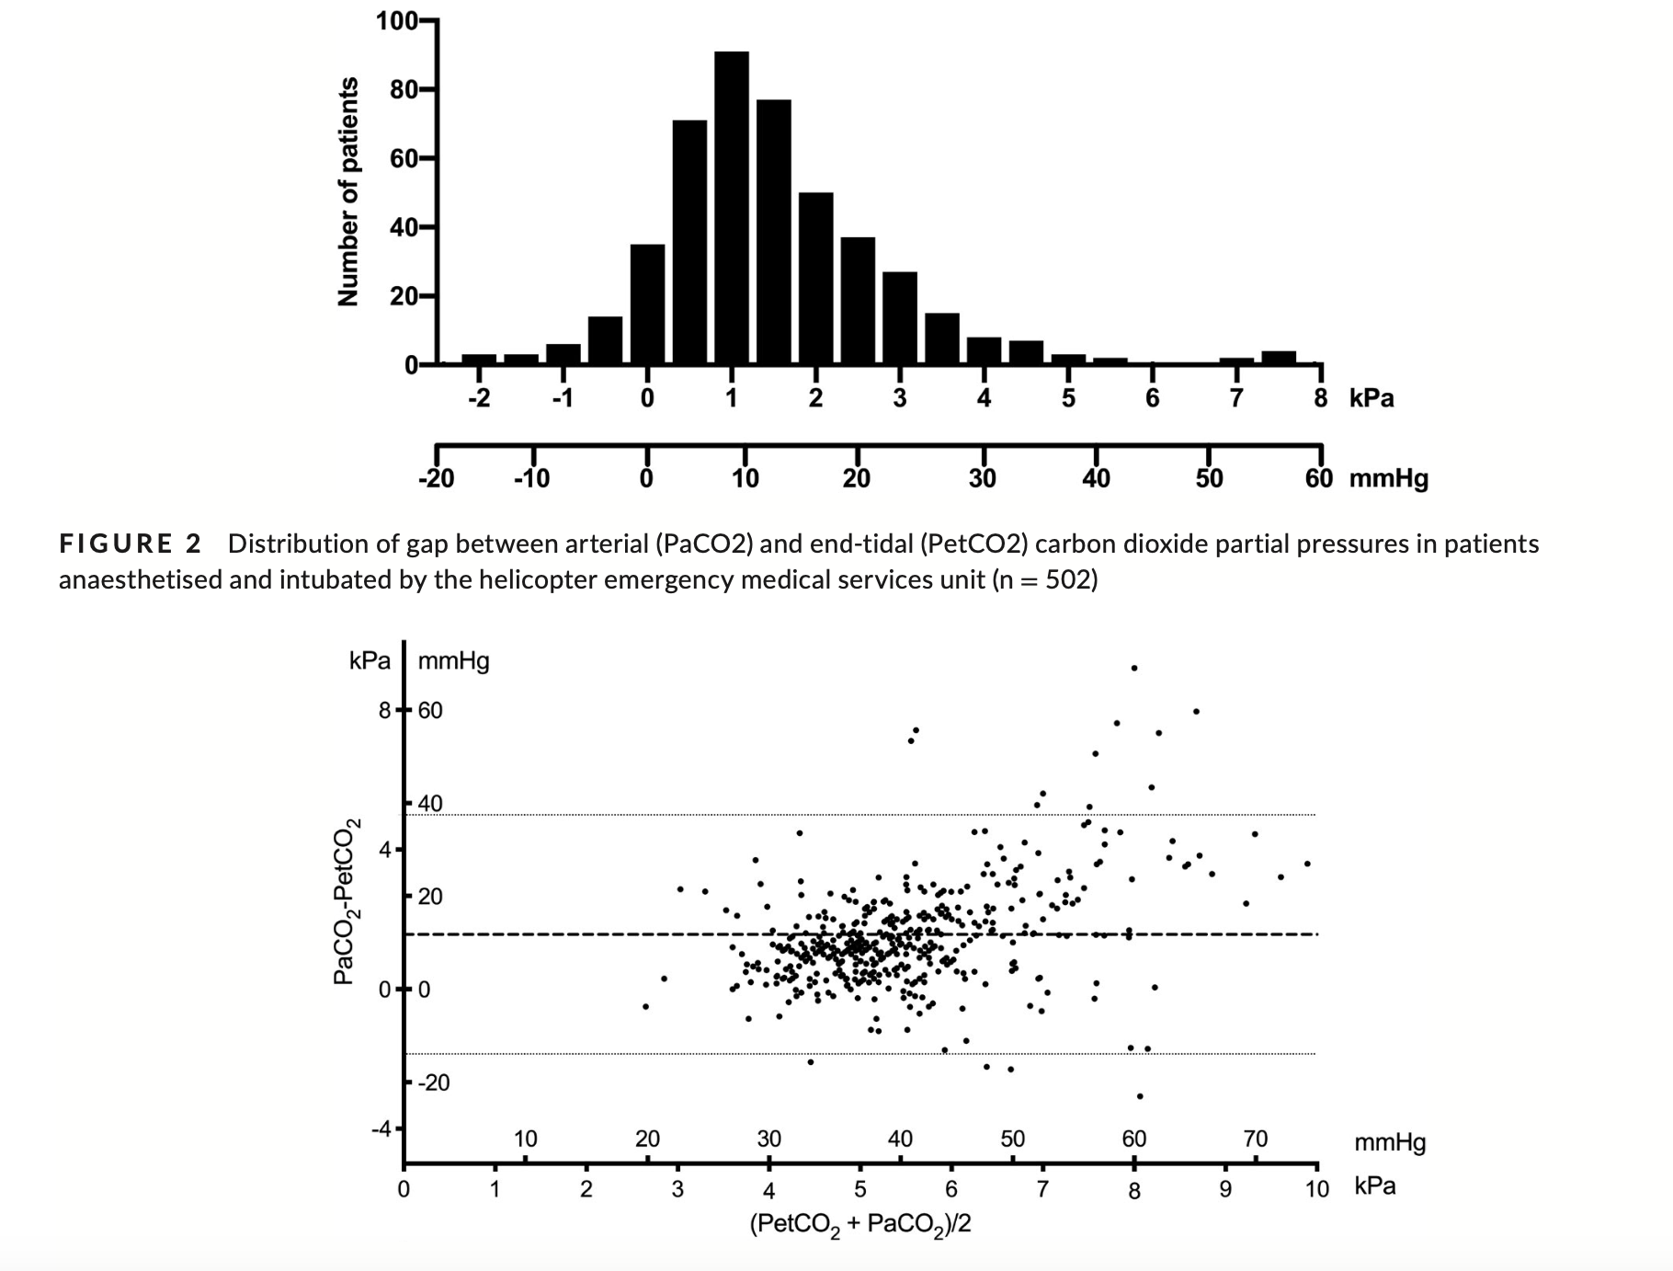
Harve-rytsälä et al 2020 (FinnHEMS10)
503 patients
Mean bias 1.6 kPa
Notes:
In the study conducted by Harve-Rytsälä and colleagues in FinnHEMS 10, they described a prevalence of a high PaCO2-EtCO2 gradient in the prehospital phase, The study had 503 patients and the mean bias was 1.6 kPa, which is of course significantly higher, than the quality indicators assume
The fact that the gradient is higher is already known, however it is highly variable, and the effect of different clinical situations to the gradient is not known.

Slide 10
Prehospital normoventilation in critically ill anaesthetised patients cannot be reliably monitored by capnography – A retrospective observational study
Jussi Tero, Jussi Pirneskoski, Harry Ljungqvist, Juri Laamanen, Jouni Nurmi
Notes:
That is why we conducted a study with Jussi, Harry, Juri and Jouni, where we analysed the effect of different clinical diagnosis to the CO2 gradient after intubation by FH10. The study was retrospective and is yet to be published

Slide 11
Aim
Assess the agreement between PaCO2 and EtCO2 in different patient groups during prehospital care using Bland & Altman analyses
  Reliability of capnography to guide ventilation
Overall proportion of patients with a higher PaCO2-EtCO2 gradient than 0.67 kPa

Slide 12
Data sources
FinnHEMS database (FHDB)
  Tracks all HEMS missions in Finland
  Most of the details are entered manually by the physician after each mission
Electric prehospital records
Notes:
As we have quite a comprehensive

Slide 13
Methods
Included all patients anaesthetised and intubated by FH10 with measured arterial blood gases after intubation
  Jan 1 2014 to Dec 31 2021
  670 (2203) patients were included
Patients were divided into 5 patient groups based on clinical diagnosis by HEMS physician
  OHCA
  Trauma (including TBI)
  Neurological conditions (including stroke)
  Intoxication
  Other
Notes:
During the study period. This added up to 670 patients.
The patients were divided

Slide 14
results
Patients intubated by HEMS
n = 2203​
No ABG analysis n = 1533​
Patients included in study
n = 670​
OHCA
n = 221​
GAP > 0.67 kPa
n = 186 (84.2%)​
Trauma
n = 104​
GAP > 0.67 kPa
n = 85 (81.7%)​
Neurological conditions
n = 197​
GAP > 0.67 kPa
n = 146 (74.1%)​
Intoxication
n = 99​
GAP > 0.67 kPa
n = 75 (75.8%)​
Other
n = 49​
GAP > 0.67 kPa
n = 38 (77.6%)​
GAP, PaCO2-EtCO2 gradient

Slide 15
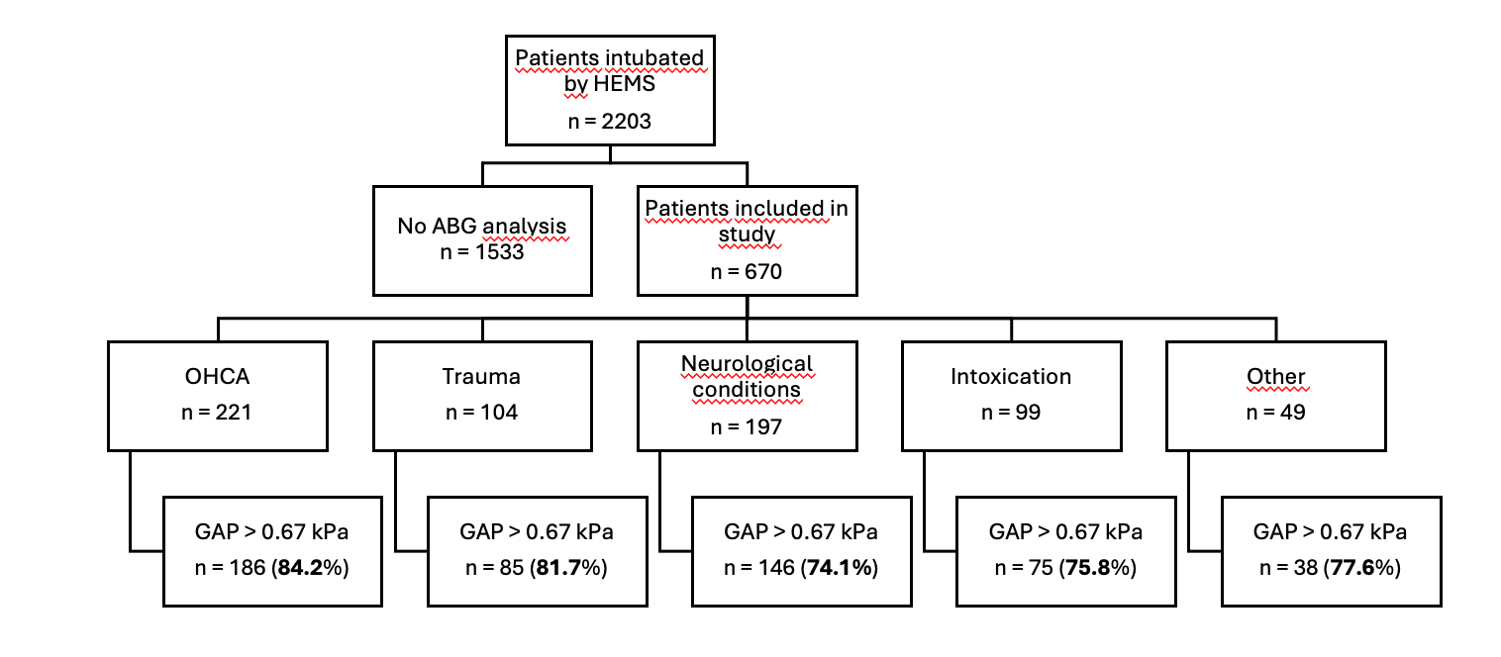
RESULTS
Notes:
In the study we found, that in every patient group, the gradient was higher than 0.67 in approx. 80% of patients. This equals to 4 out of 5 patients with a risk of unintentional hypoventilation without an abg analysis

Slide 16
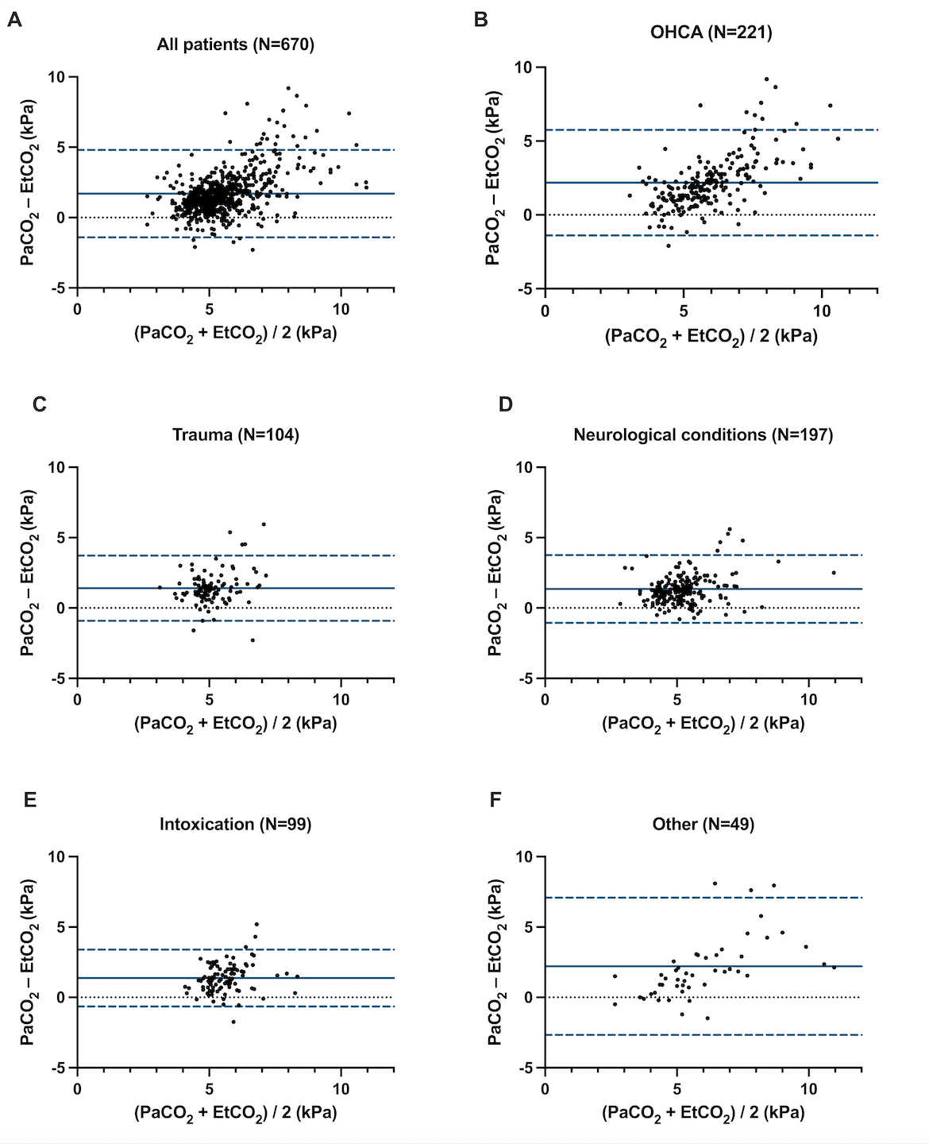
results
Overall bias 1.7 kPa
(-1.4 to 4.8 kPa)
PaCO2-EtCO2 gradient was higher than 0.67 kPa in 530 (79.1 %) patients
Bias 1.3 to 2.2 kPa
Notes:
The overall bias was 1.7 kPa with limits of agreement of -1.4 to 4.8 kPa
In the patient groups the bias ranged from 1.3 to 2.2 kPa.
As we can see from this figure, the limits of agreement are wide, showing a high variation in the biases.
Additionally the gradient was higher than 0.67 kPa in 79% of patients.
Our results indicate, that capnography is not reliable to guide ventilation in the prehospital care, regardless of the clinical diagnosis.

Slide 17
Conclusion
Capnography is not reliable to guide ventilation, regardless of the patient group
ABG analysis should be performed during prehospital care,
especially with patients suffering from TBI

Slide 18
Future implications
Increasing the ability to perform ABG analyses in the prehospital setting
Studies analyzing PaCO2 and outcomes should be conducted
  Earlier studies have mainly used capnography in prehospital care
Notes:
Since the gradient is larger with high variability, that our study supports, ems units should increase the ability to perform abg analyses

Slide 19
Automatic closed-loop ventilation
EtCO2
PaCO2
Vt
Vt, minute ventilation
Notes:
In addition, future implications include feasibility of automatic ventilation in the prehospital phase. Here the patients minute ventilation is guided by CO2 gradient corrected end-tidal capnography TARGETS which could lead to higher incidence of normoventilation and reduced work load for the physician.

Slide 20
references
Kottmann A, Kruger AJ, Sunde GA, Roislien J, Heltne JK, Carron PN, et al., Establishing quality indicators for pre-hospital advanced airway management: a modified nominal group technique consensus process. Br J Anaesth, 2022. 128(2): p. e143-e150.
Dumont TM, Visioni AJ, Rughani AI, Tranmer BI, and Crookes B, Inappropriate prehospital ventilation in severe traumatic brain injury increases in-hospital mortality. J Neurotrauma, 2010. 27(7): p. 1233-41.
Knapp J, Doppmann P, Huber M, Meuli L, Albrecht R, Sollid S, et al., Pre-hospital endotracheal intubation in severe traumatic brain injury: ventilation targets and mortality-a retrospective analysis of 308 patients. Scand J Trauma Resusc Emerg Med, 2023. 31(1): p. 46.
Notes:
presentation

Slide 21
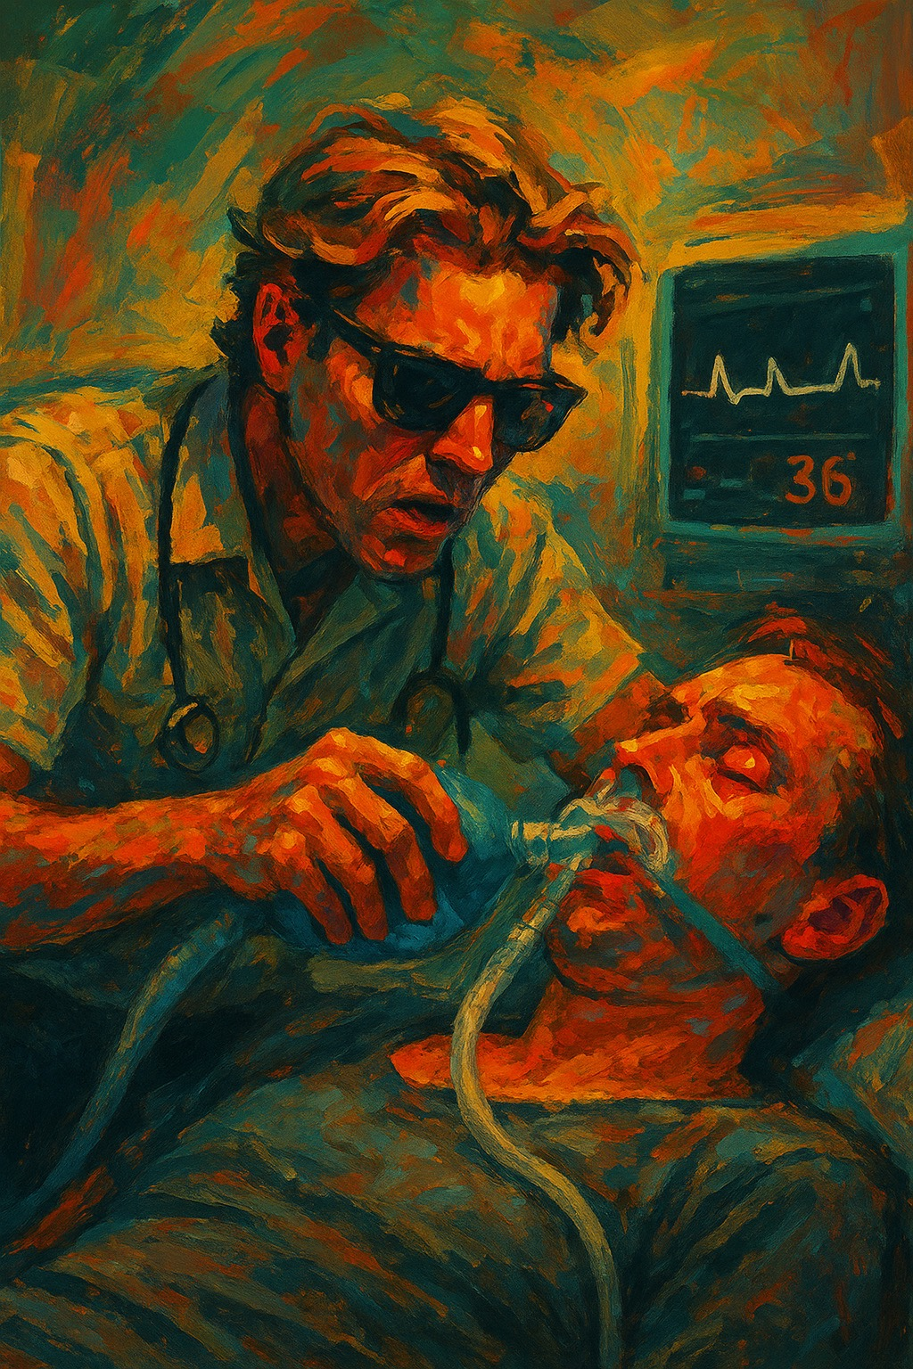
Thank you
Jussi Tero
jussi.tero@hus.fi
HEL-PRECISE research group
26th EUPHOREA, Helsinki

