Slide 1
Drugs for the PHEA of a TBI patient
Juri Laamanen, PhD student, Helsinki PRECISE study group

Slide 2
Background - Dissertation
Three studies looking at effects of anaesthetics and fentanyl on vital functions and long-term outcomes of patients with traumatic brain injury treated by FinnHEMS
Haemodynamics and mortality with anaesthetics
Haemodynamics and mortality with fentanyl
Regional cerebral oxygenation (rSO2) and neurologic recovery with anaesthetics and fentanyl
Discussed in this presentation

Slide 3
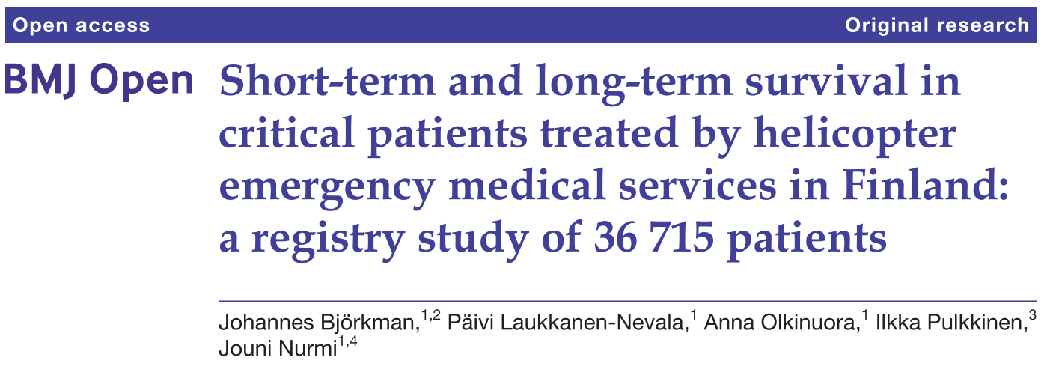
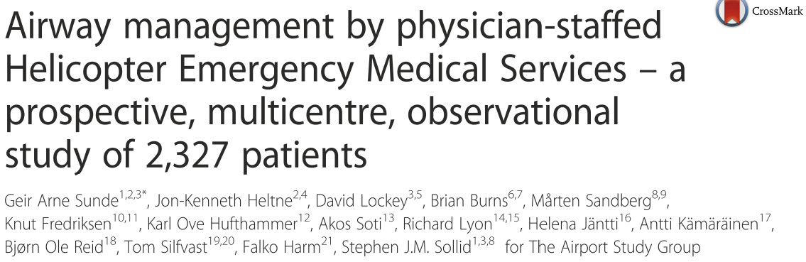
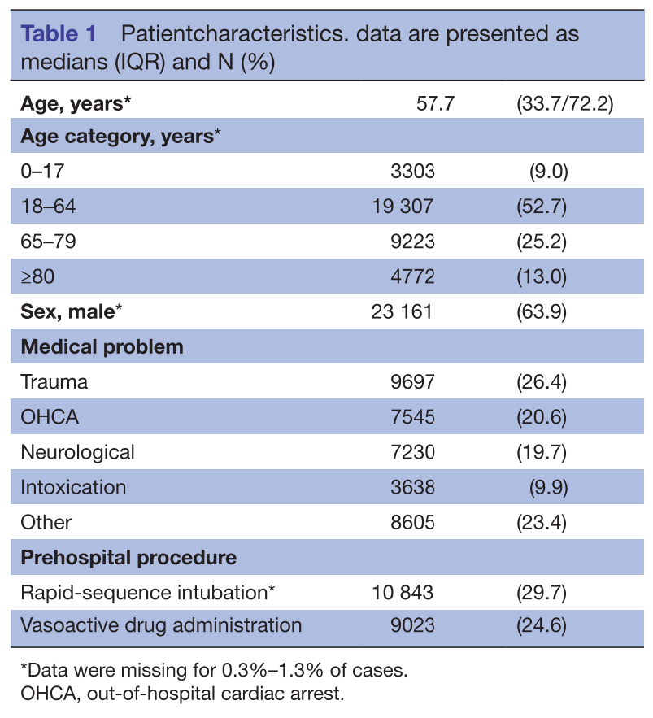
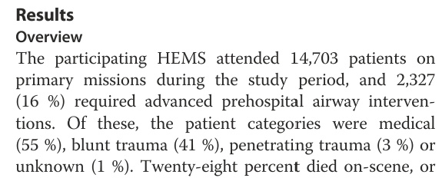
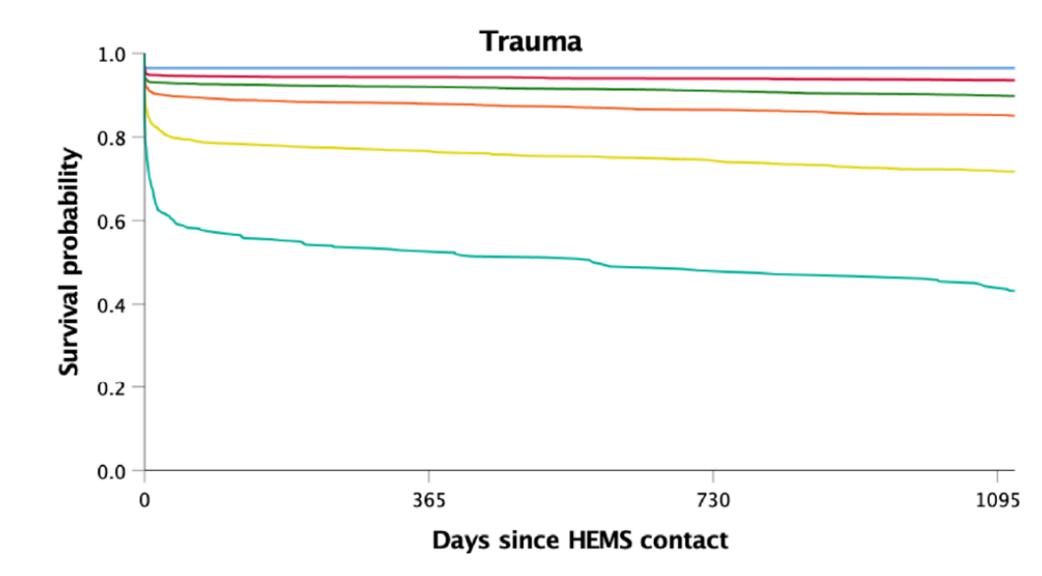
Background
Notes:
Trauma is a varyingly common reason for HEMS involvement in treatment. In Finnish data around one fourth of patients are primarily treated for trauma. Out of those that receive advanced prehospital airway interventions, around 17-18% have suffered traumatic brain injury.
This of course varies between providers based on different protocols and usually when numbers are reported, all trauma is reported as one without differentiating TBI. In a similar paper by Sunde and others in 2015 looking at 21 HEMS units, in 7 western countries, all trauma combined counted for 44% patients that received advanced prehospital airway interventions.
As is well established, the mortality after TBI remains high in the days following the incident, despite best efforts, especially in the elderly and those with higher comorbidities. Even in those that survive the initial incident, neurological deficits are common.

Slide 4
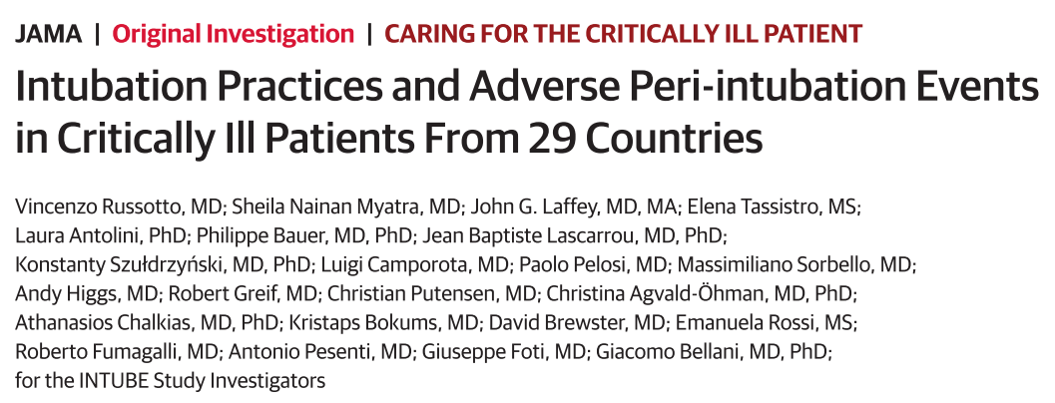
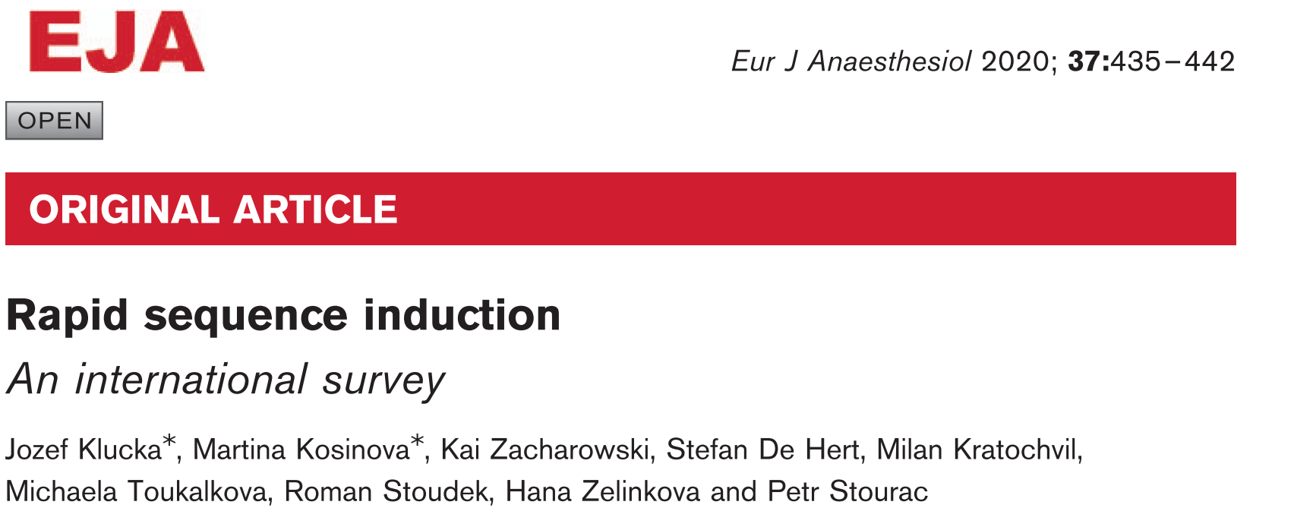
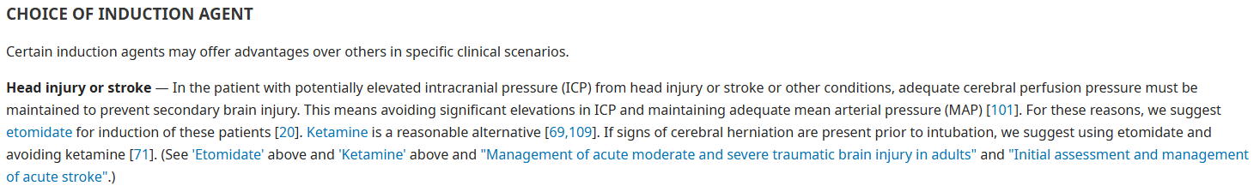
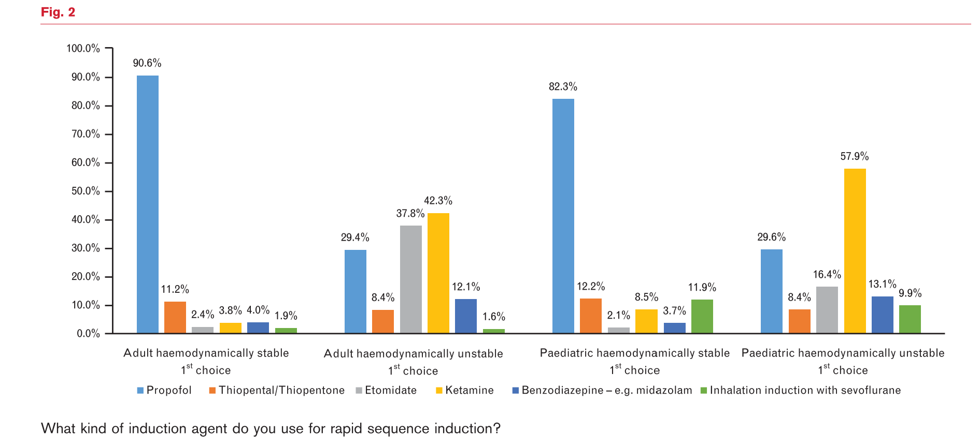
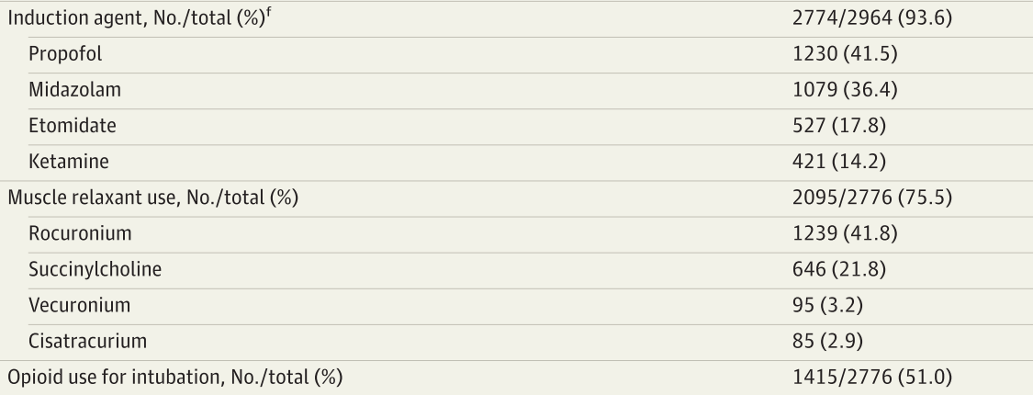
Variations in drug usage
Notes:
Then on to the problem:
There is no consensus currently on drug use across providers
Generally propofol is most commonly used, especially common in haemodynamically stable or hypertensive patients. No good reviews specifically on TBI patients. Less common in haemodynamically unstable patients, risk of hypotension is a reason for some providers to avoid
Esketamine has gained popularity with several providers in the last 10 years, for example in German HEMS (Wafaisade et al. 2019).
Etomidate and midazolam are unpopular in Finland, etomidate due to concerns over adrenal insufficiency and midazolam due to concerns over hypotension. Still especially etomidate is very popular amongst some providers.
Out of interest i checked the UptoDate website this week to see their recommendation for induction in head injury patients and their answer would have been to primarily use etomidate, which atleast in Finland as far as i know is not used anywhere. So this just shows the lack of consensus currently with TBI patients.

Slide 5
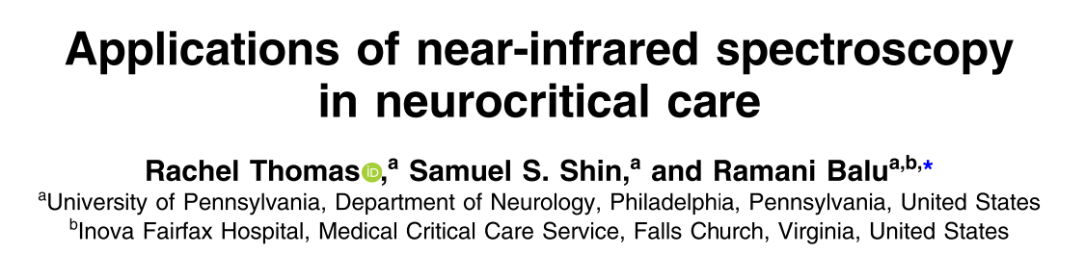
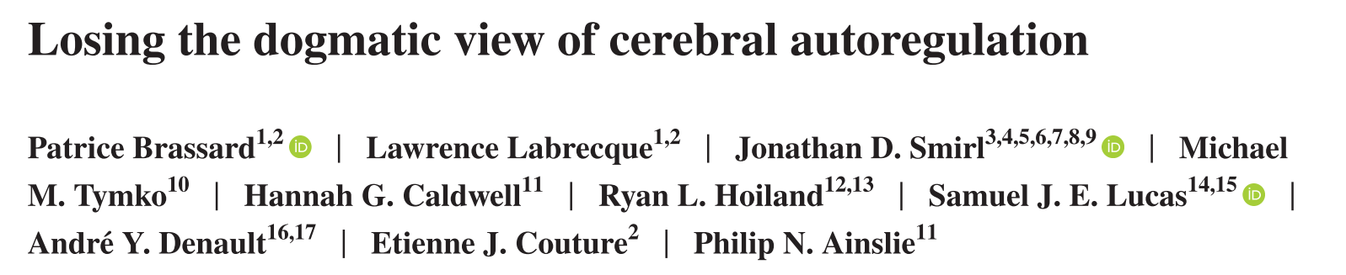
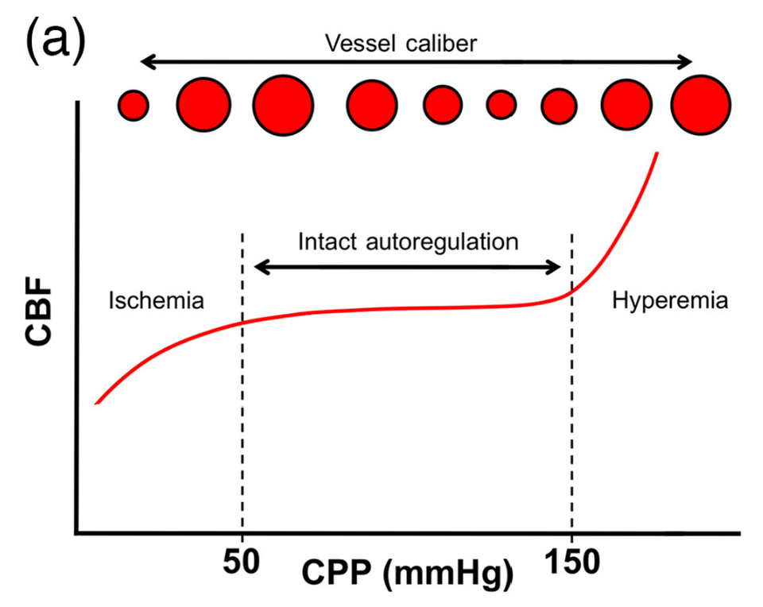
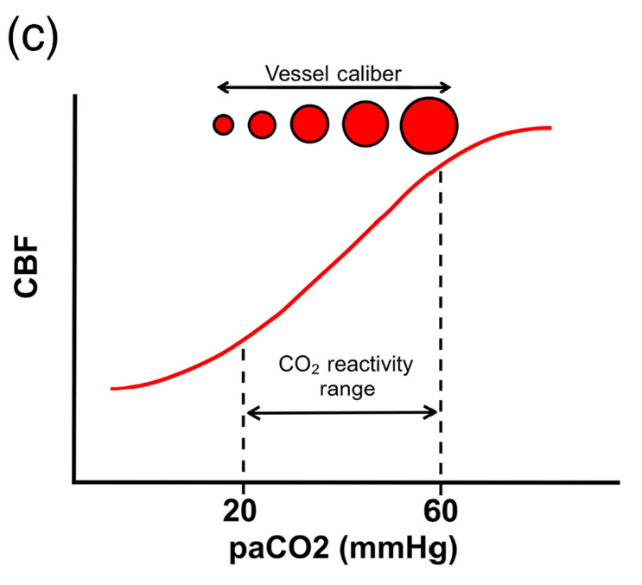
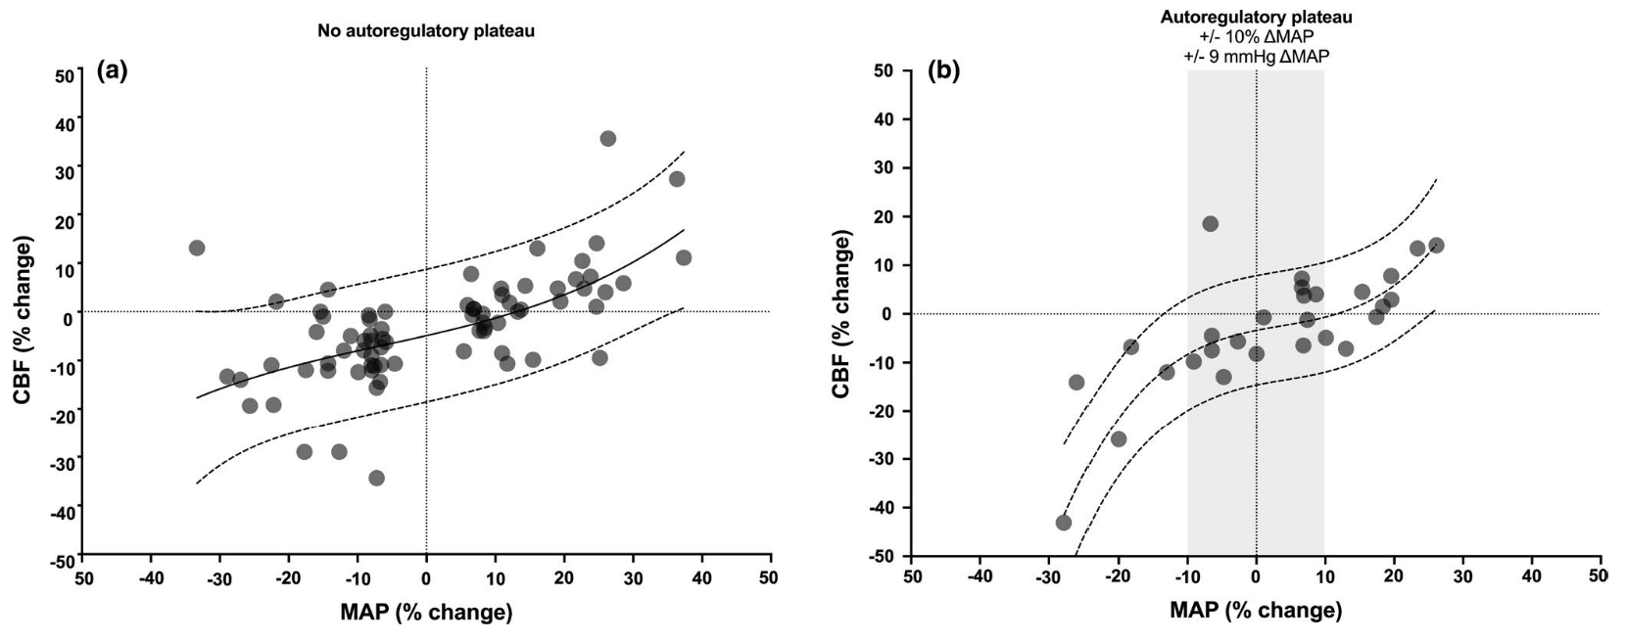
Protecting the injured brain when it’s unable to
Notes:
So when focusing on the core problem in patients with TBI, our main challenge is to preserve adequate cerebral perfusion, avoiding both ischemia and hyperemia as we know well that both hypo- and hypertension worsen outcomes
In the background for normal cerebral blood flow we have a model of three systems regulating normal cerebral autoregulation: hemodynamic autoregulation, cerebrovascular reactivity to gases (especially CO2) and neurovascular coupling
These three systems together result in a relatively stable cerebral blood flow in neurologically healthy patients despite constant fluctuations in blood pressure.
While we can somewhat influence this system by controlling ventilation, the most relevant way we have available is by affecting systemic haemodynamics, as CPP (cerebral perfusion pressure) is roughly the difference between mean arterial pressure and intracranial pressure
Importantly, while the combination of these three systems is possibly our best choice for modelling normal autoregulation, we now know that it’s a simplification: We know that the plateau isn’t as wide as was previously thought and that several other factors influence it, for example the speed of the change in haemodynamics and the use of vasoactives (picture 2, a beautiful study by Brassard et al which showed a plateau only when no vasoactives were used and no plateau when they were used)

Slide 6
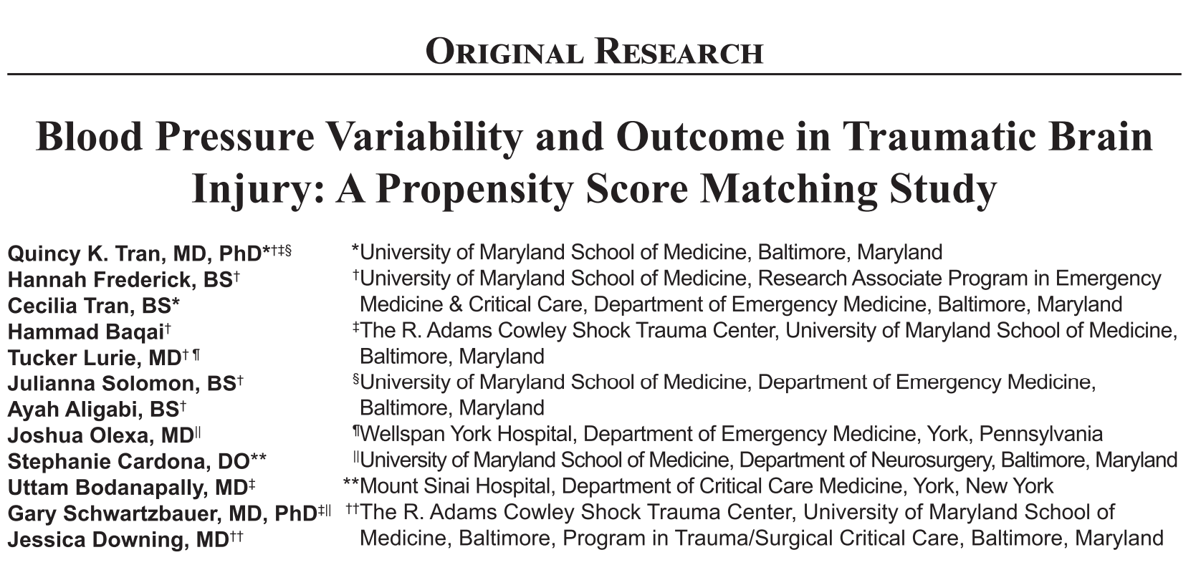
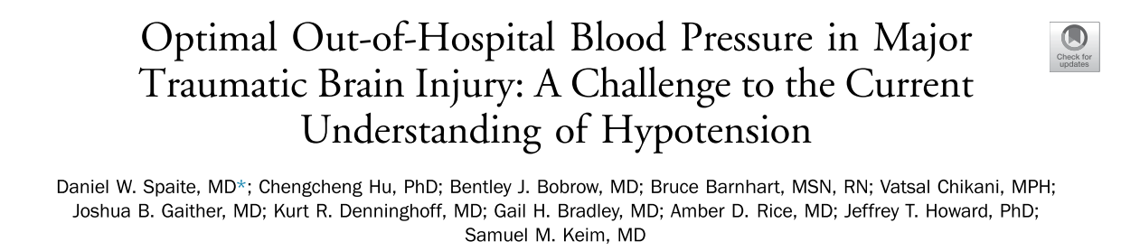
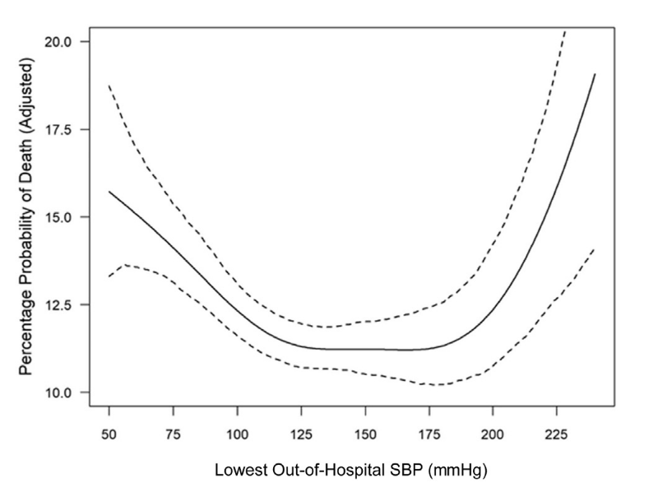
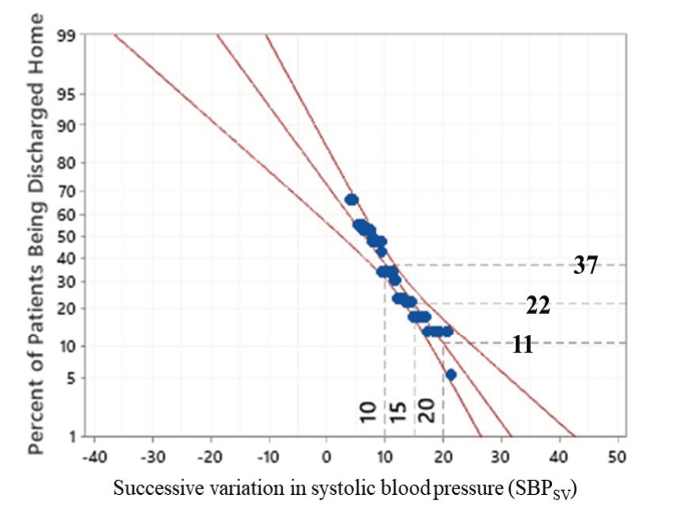
Protecting the injured brain when it’s unable to
Notes:
Focusing on the haemodynamic side, we essentially have two mechanisms of action that will worsen the secondary brain injury. Firstly, we think that a systolic blood pressure outside a range of around 130-180mmHg will worsen outcomes. Secondly as i mentioned that the speed of change affects cerebral autoregulation, we know that higher blood pressure variability in itself increases mortality. This might be related to the cerebral vascualture not keeping up with the change, worsening autoregulation.
So to recap, we need to keep the haemodynamics 1. stable and 2. stable within a range where we believe the cerebral perfusion might be adequate
Again, this is not as simple as we might like it to be. While we have average ideal ranges, we also know that each patient will have their own personal optimal blood pressure target, affected by several factors such as initial blood pressure, amount of blood loss and patient related factors such as previous comorbidities.

Slide 7
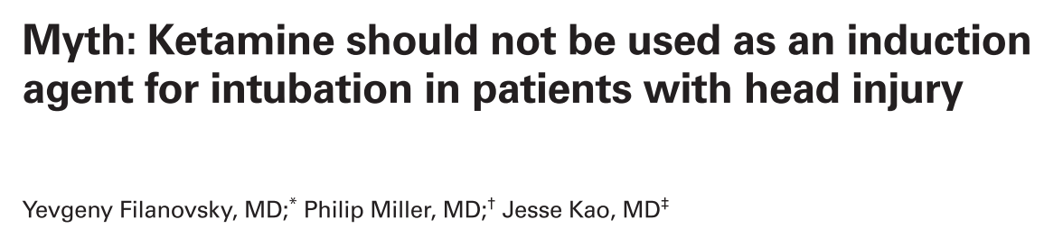
Conciderations regarding use of (es)ketamine or propofol In tbi
(Es)ketamine used to be avoided in patients with traumatic brain injury due to concerns over increased ICP, nowadays this has been debunked. Seems to provide good haemodynamic support.
When used, propofol has been a popular choice especially in hypertensive patients, but some have concerns over its use in haemodynamically unstable patients.

Slide 8
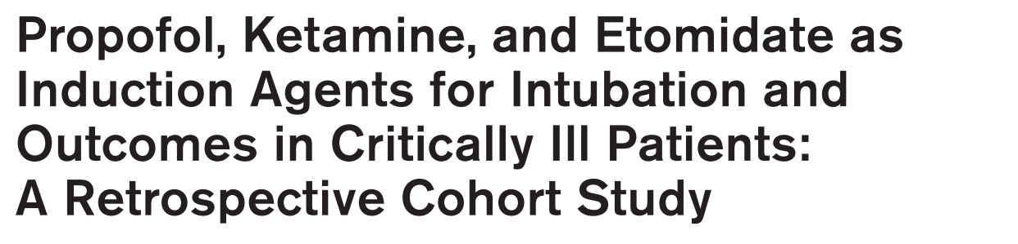
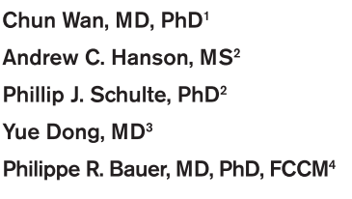
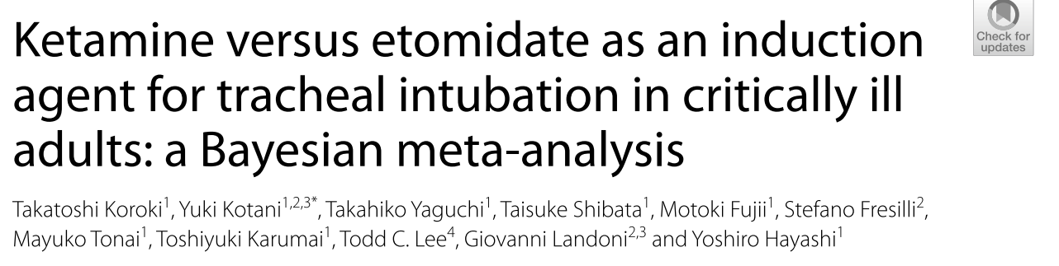
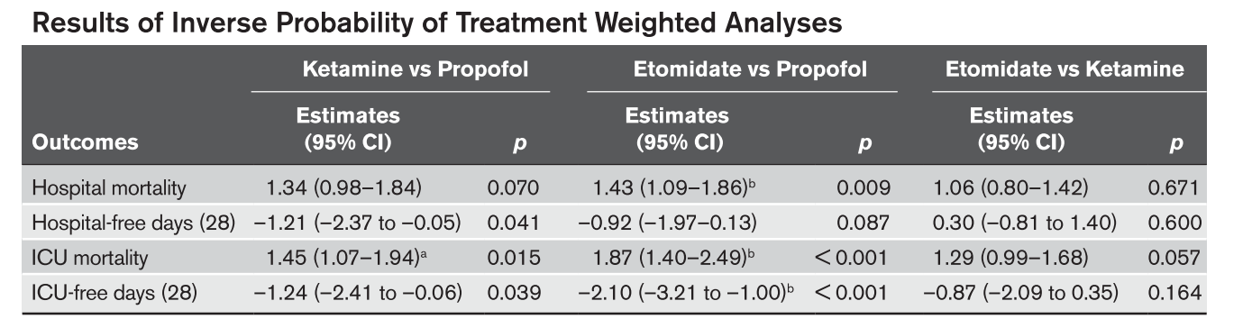
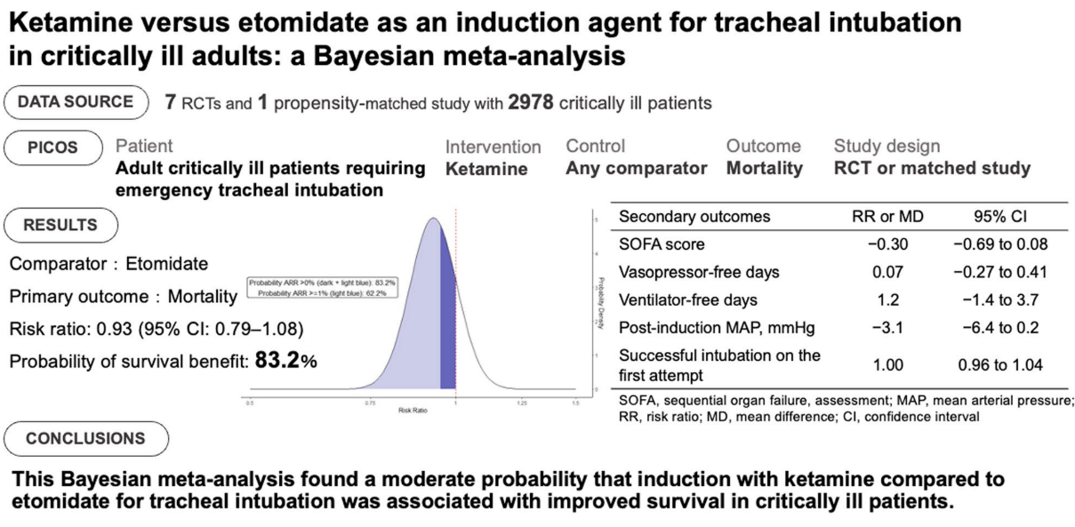
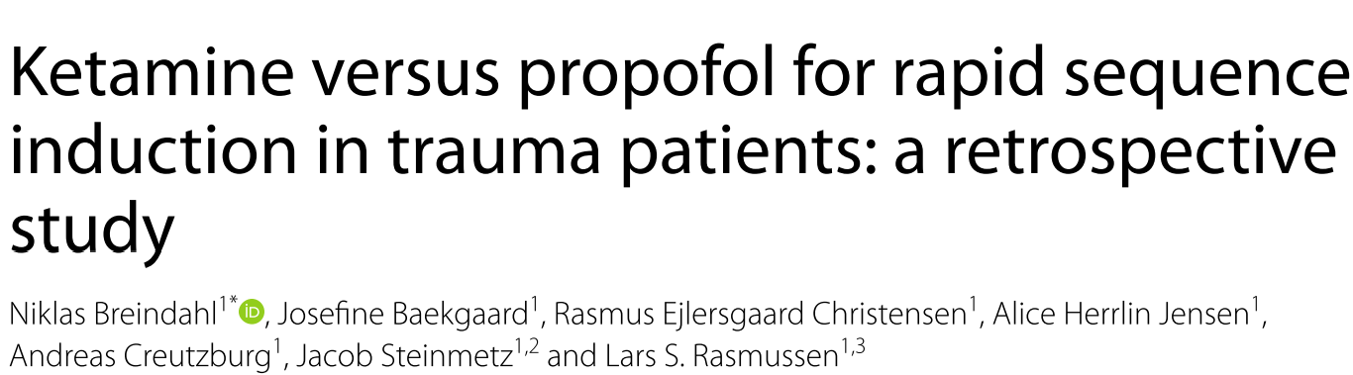
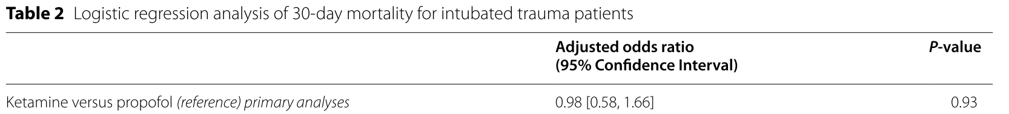
Literature on the use of esketamine and propofol in tbi
Notes:
Looking at the previous literature, the most abundant data we have usually uses etomidate as the control, particularly comparing esketamine with etomidate. A recent bayesian meta-analysis showed a 83.2% probability that induction with ketamine compared to etomidate was associated with improves survival in critically ill patients.
The literature comparing ketamine and propofol is limited and inconclusive. In the few studies that exist, no consistant trend has been seen in favor of either of the drugs.

Slide 9
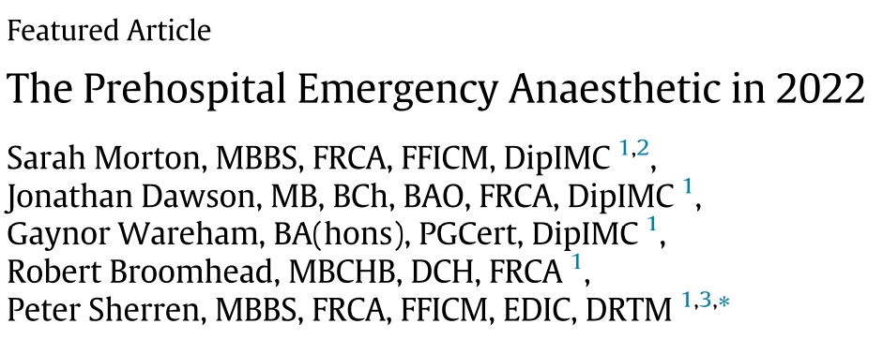
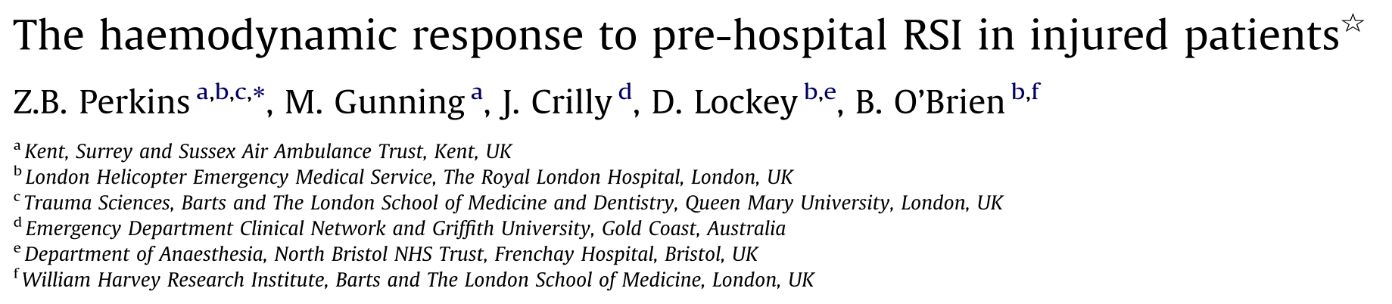
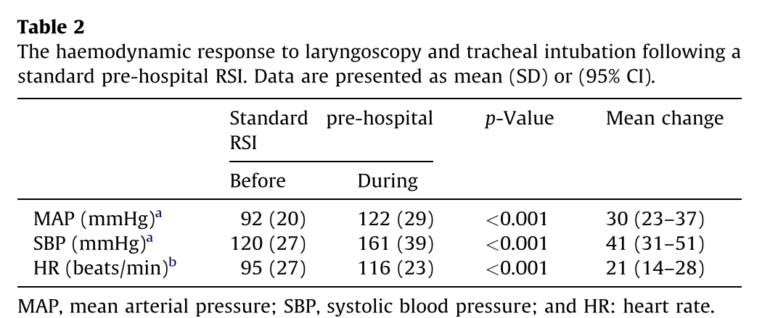
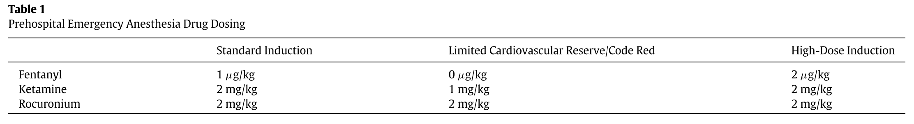
The double-edged sword of using fentanyl in tbi
Notes:
So moving on to fentanyl, its effects on a TBI patient can be seen as a potential double-edged sword. The rationale of using fentanyl is based on its ability to dampen the sympathetic response to tracheal intubation. As we know that blood pressure variability as well as hypertension can both be detrimental, this might be benefitial to the patient
On the other hand we also think that the use of fentanyl probably increases the risk of post-intubation hypotension, which could also prove detrimental to patients.
The current compromise seems to be that fentanyl is recommended routinely in patients with stable haemodynamics. In those with either unstable hameodynamics or limited cardiovascular reserve fentanyl is usually either recommended at a smaller dosage or avoided altogether.

Slide 10
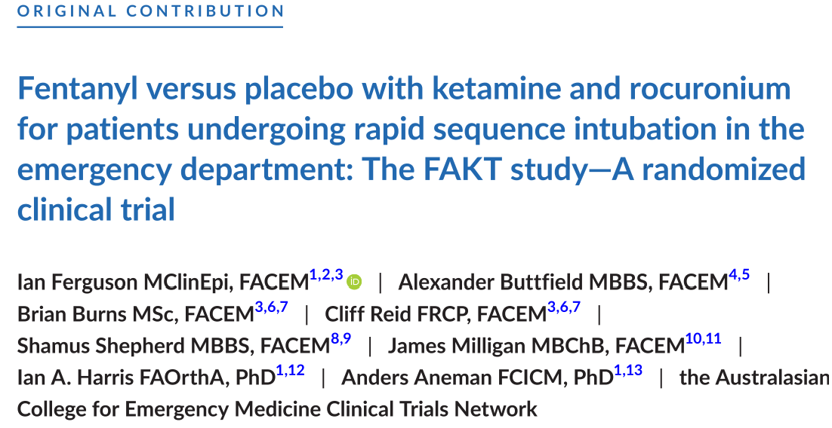
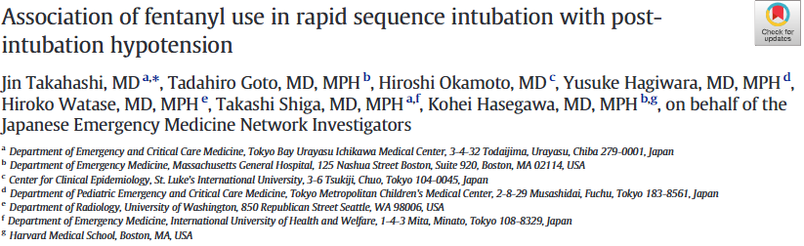
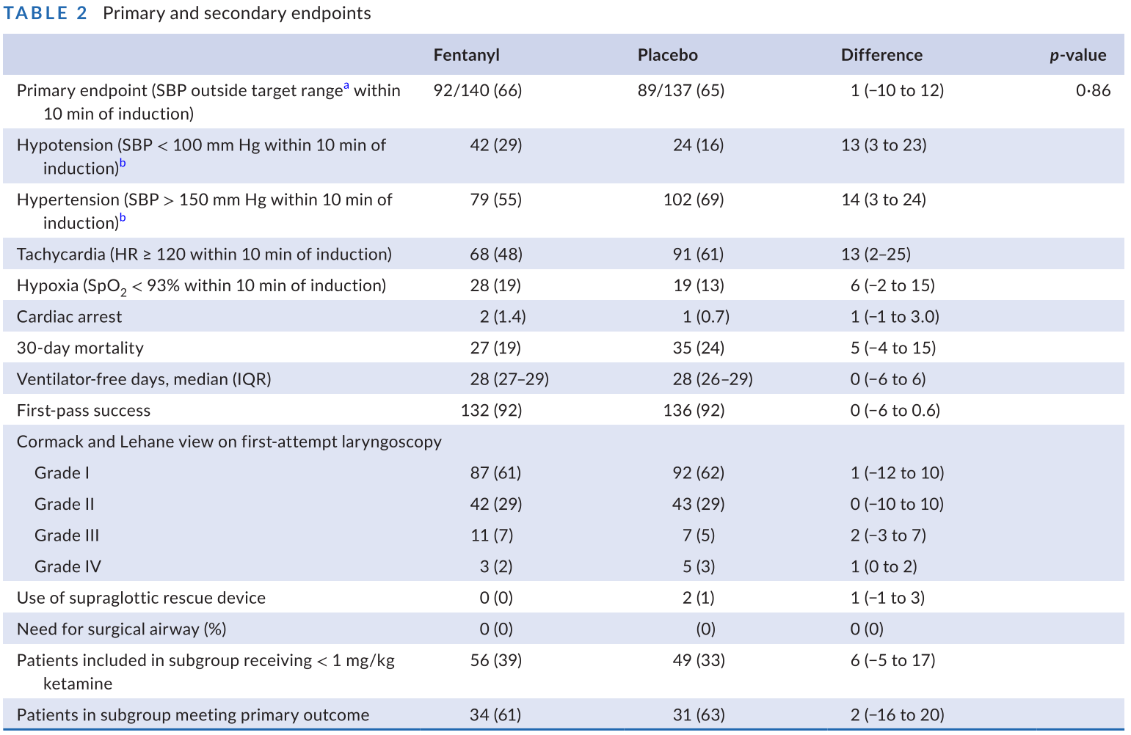
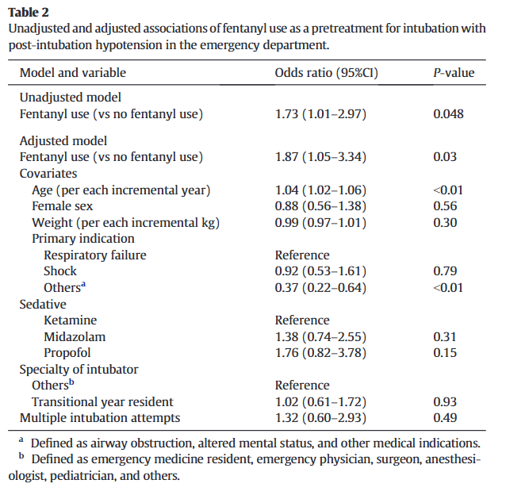
The double-edged sword of using fentanyl in tbi
Notes:
- With fentanyl we unfortunately have even less data on its overall effect. Most of the research has focused on the haemodynamic effects of fentanyl and especially the increased rate of post-intubation hypotension as shown in this study by Takahashi and others.
Possibly our best data right now comes from Ferguson et al. Who performed a randomised clinical trial with 277 patients in 2022. T hey demonstrated an increased rate of hypotension and a decreased rate of hypertension when using fentanyl, although similar number of patients left the predesignated target range of 100-150mmHg. Although not a primary endpoint, they also reported 30-day mortality which was did not have a statistically significant difference.

Slide 11
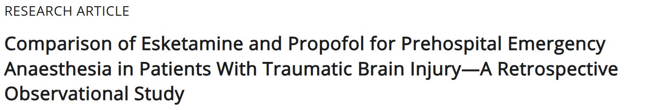
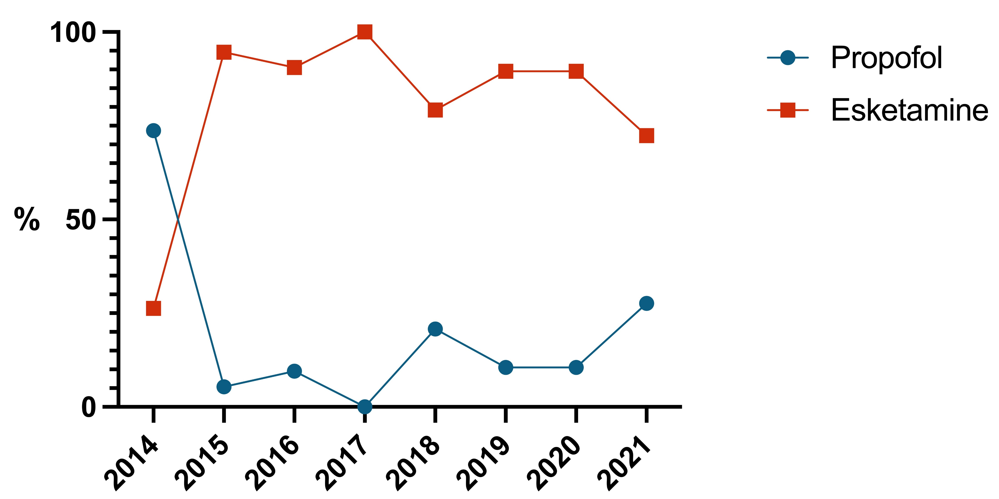
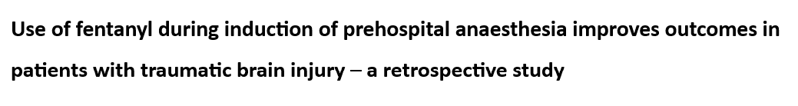
Our studies
Acta anaesthesiologica scandinavica, 2025
(Unpublished)
Notes:
We performed two studies, first looking at the use of esketamine and propofol and then at the use of fentanyl in TBI.

Slide 12
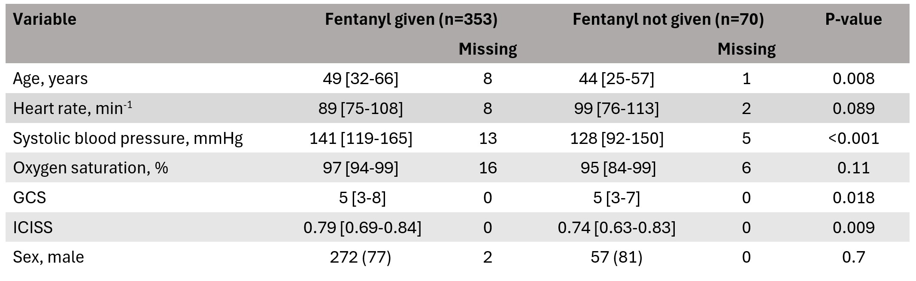
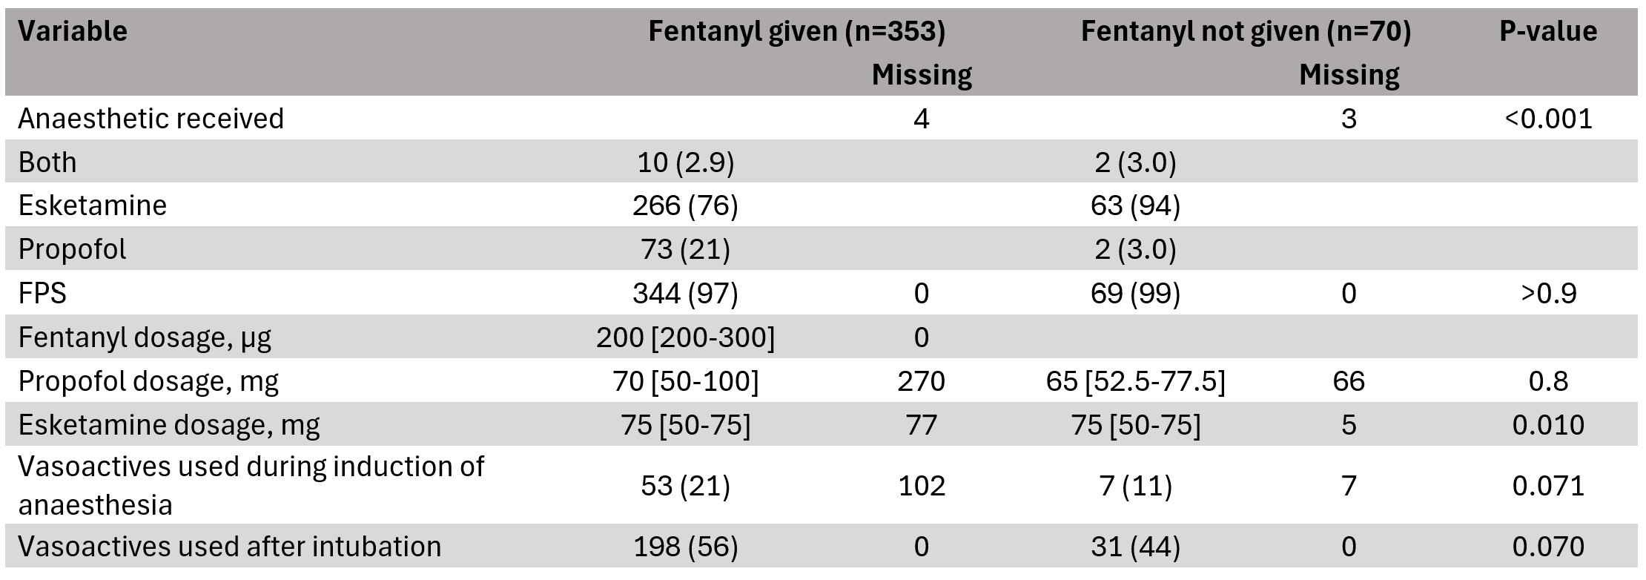
Methods and aims of the studies
Looking at all patients receiving PHEA by FinnHEMS 10 unit between 2014 and 2021 (2022) after sustaining traumatic brain injury
Enabled by FinnHEMS database, a combination of data recorded by clinicians after each mission and patient medical records collected afterwards
Primary outcome: death before hospital discharge
Secondary outcomes: haemodynamic changes like new hyper- or hypotension and blood pressure exiting the ”preferred” 130-180mmHg range
Notes:
Here we have a summary of the patients from the fentanyl study, in which the base population is very similar to the anaesthetic study. As we can see from the ICISS score, these patients had sustained quite severe trauma and were initially critically ill.
Again, contrary to most of the patients that we have data on, these are unstabilised prehospital patients. They have not been prepared for the anaesthesia, treated in unideal locations, although with high level of care
The most common drug combination was receiving esketamine as anaesthetic and receiving fentanyl as adjuvant. Importantly i’d also point out that the doses used by FinnHEMS are quite large compared to previous studies in which averages have been around 1-2 micrograms whereas FinnHEMS uses almost 3 micrograms per kilo on average.

Slide 13
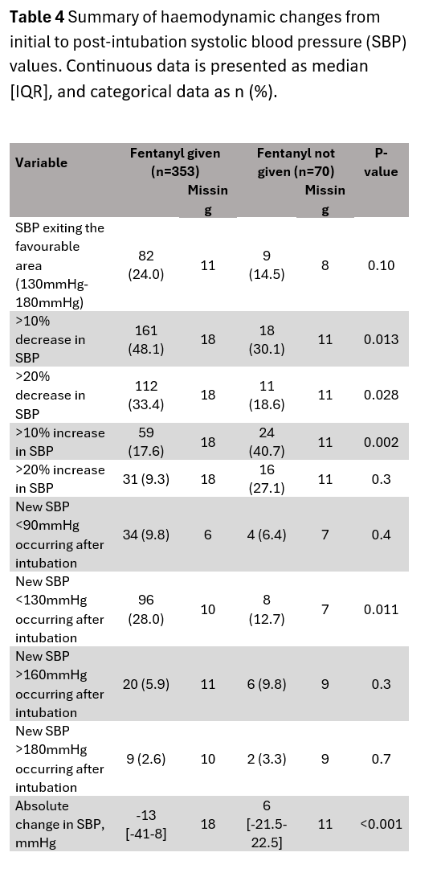
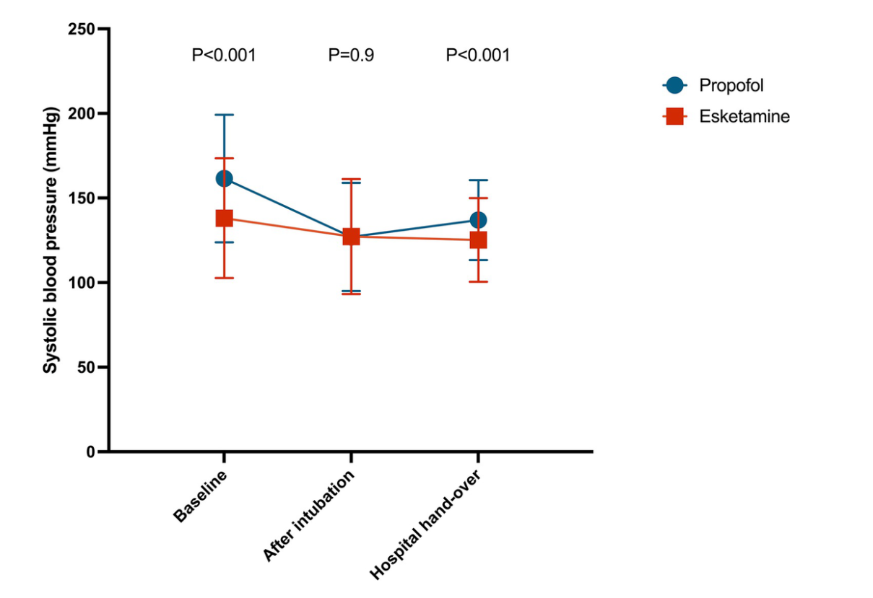
Results: haemodynamics
Notes:
In haemodynamic effects our results were unsurprising and largely in line with previous knowledge.
Patients treated with propofol did have a greater drop in blood pressure after induction but due to their initial blood pressure being higher the post-induction vitals were very similar.
When looking at these numbers it is important to note that according to the new protocol, propofol is mainly recommended for patients in which elevated intracranial pressure (ICP) is suspected, so it should be expected that they are initially more hypertensive
Those treated with esketamine had more stable haemodynamics with very small changes from baseline up until hospital hand-over
With fentanyl we observed a significant drop in absolute systolic blood pressure as well as an increase in the occurrence of blood pressure drops after intubation. Conversely there was significant decrease in the occurrence of hypertensive spikes occurring after intubation.
FHDB, metodeista enemmän, figure 1
Enemmän kuvien selittämistä
Lääke vs anaesteetti
Painottamista siihen että tää on just ensihoidon dataa, esim, hemodynamiikkadiassa konteksti siitä että hypertensiiviset valikoituu propofolille ->
Mainitse alkuun väitöskirjakokonaisuudesta mainitsemista ja tuoda esiin se kolmas tutkimus vaikka ei ookaan julkastu ja mukana tässä

Slide 14
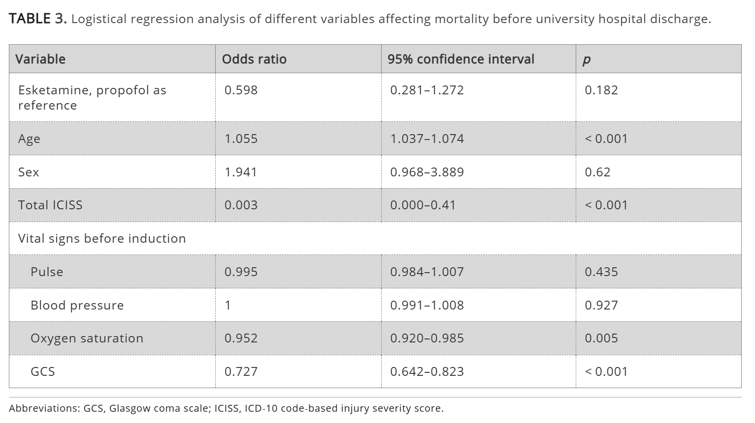
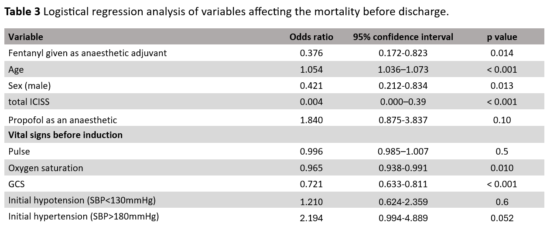
Results: mortality
Notes:
- Summing up our primary endpoints: with anaesthetics we found no statistically significant difference in mortality, only a nonsignificant trend favouring esketamine. The unadjusted mortality did significantly favour the use of esketamine but this seems to have been in large part due to the esketamine group having been younger.
However, in our second study we did find a statistically significant difference favouring the addition of fentanyl.
While we did not specifically look at the mortality effect of either hypertension or hypotension, we did include those as covariables in our model. Therefore this effect might be irrespective of the initial blood pressure.

Slide 15
Our conclusions
Esketamine seems to be viable for PHEA in patients with TBI, providing good haemodynamic stability with no observed additional risks
Overall fentanyl seems to reduce mortality when used as adjunct in PHEA
This comes with reductions in post-induction hypertensive spikes but also an increased risk of post-induction hypotension
The possible effect of fentanyl is most likely dose-related with FinnHEMS using relatively large doses compared to other providers
Further reseach should be done, possibly utilising more sophisticated surrogates for cerebral perfusion (e.g measuring sRO2) and looking at more delicate endpoints (e.g neurologic recovery) -> our third study

Slide 16
Thank you
Juri Laamanen
Helsinki PRECISE study group
Juri.laamanen@helsinki.fi

