Slide 1




Assessing International Readiness for Maternal Air Medical Assistance
An International Survey on Helicopter Emergency Medical Services for Maternal Transfers
Federico Moro & Lorenzo Gamberini
Intensive Care Unit – Trauma Centre
Pre-Hospital Critical Care
HEMS Bologna
HEMS Pavullo nel Frignano

Slide 2



Slide 3

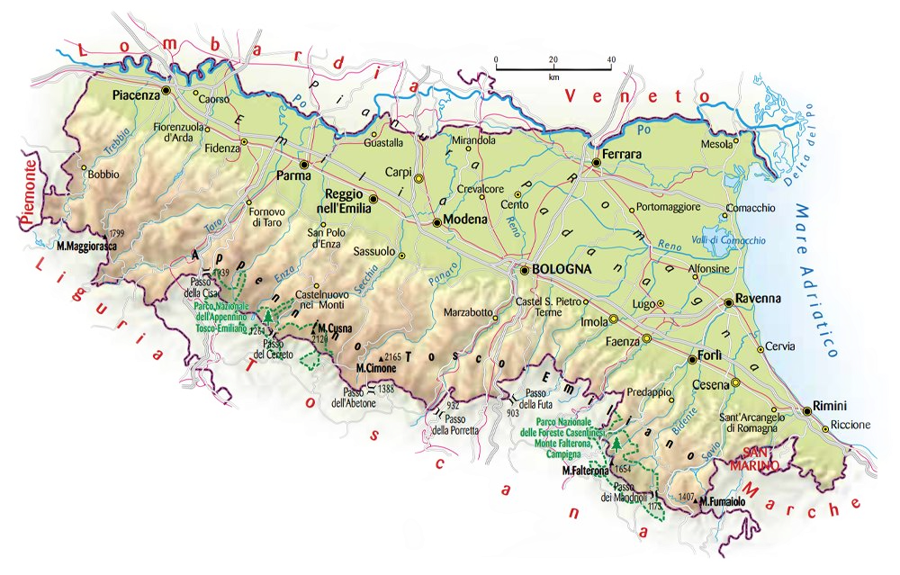
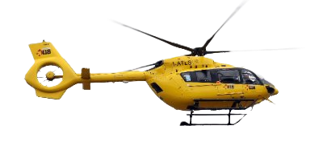

Slide 4
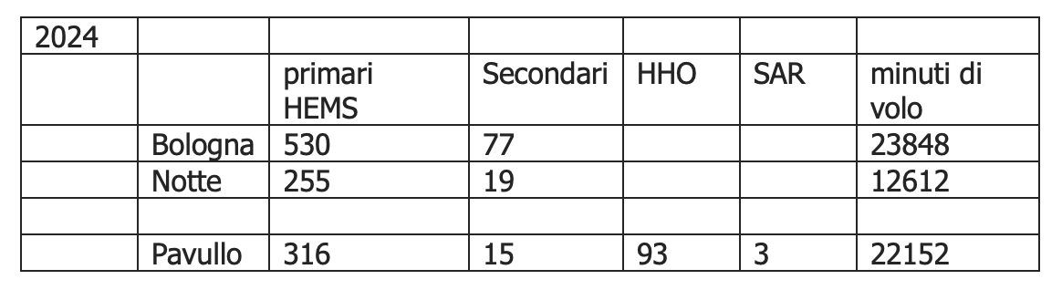
HEMS Bologna
24/7 with NVG H145D3 "I-ATLS"
2 pilots (Avincis)
2 nurses (1 clinical and 1 HCM/TCM)
1 Intensive Care Physician
REBOA & Red Blood Cell

Slide 5
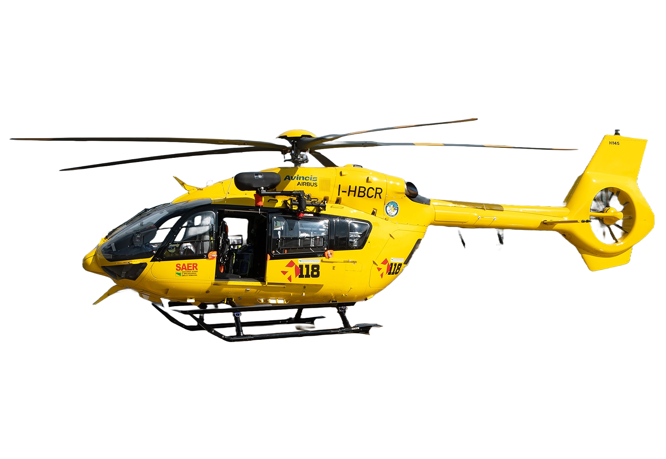

HEMS Pavullo nel Frignano
Daytime H145D3 "I-HBCR" whit SpecOps
1 pilot (Avincis)
1 TCM/HHO
1 Intensive Care Physician / Emergency Physician
1 Alpin Rescuer
REBOA & Red Blood Cell

Slide 6
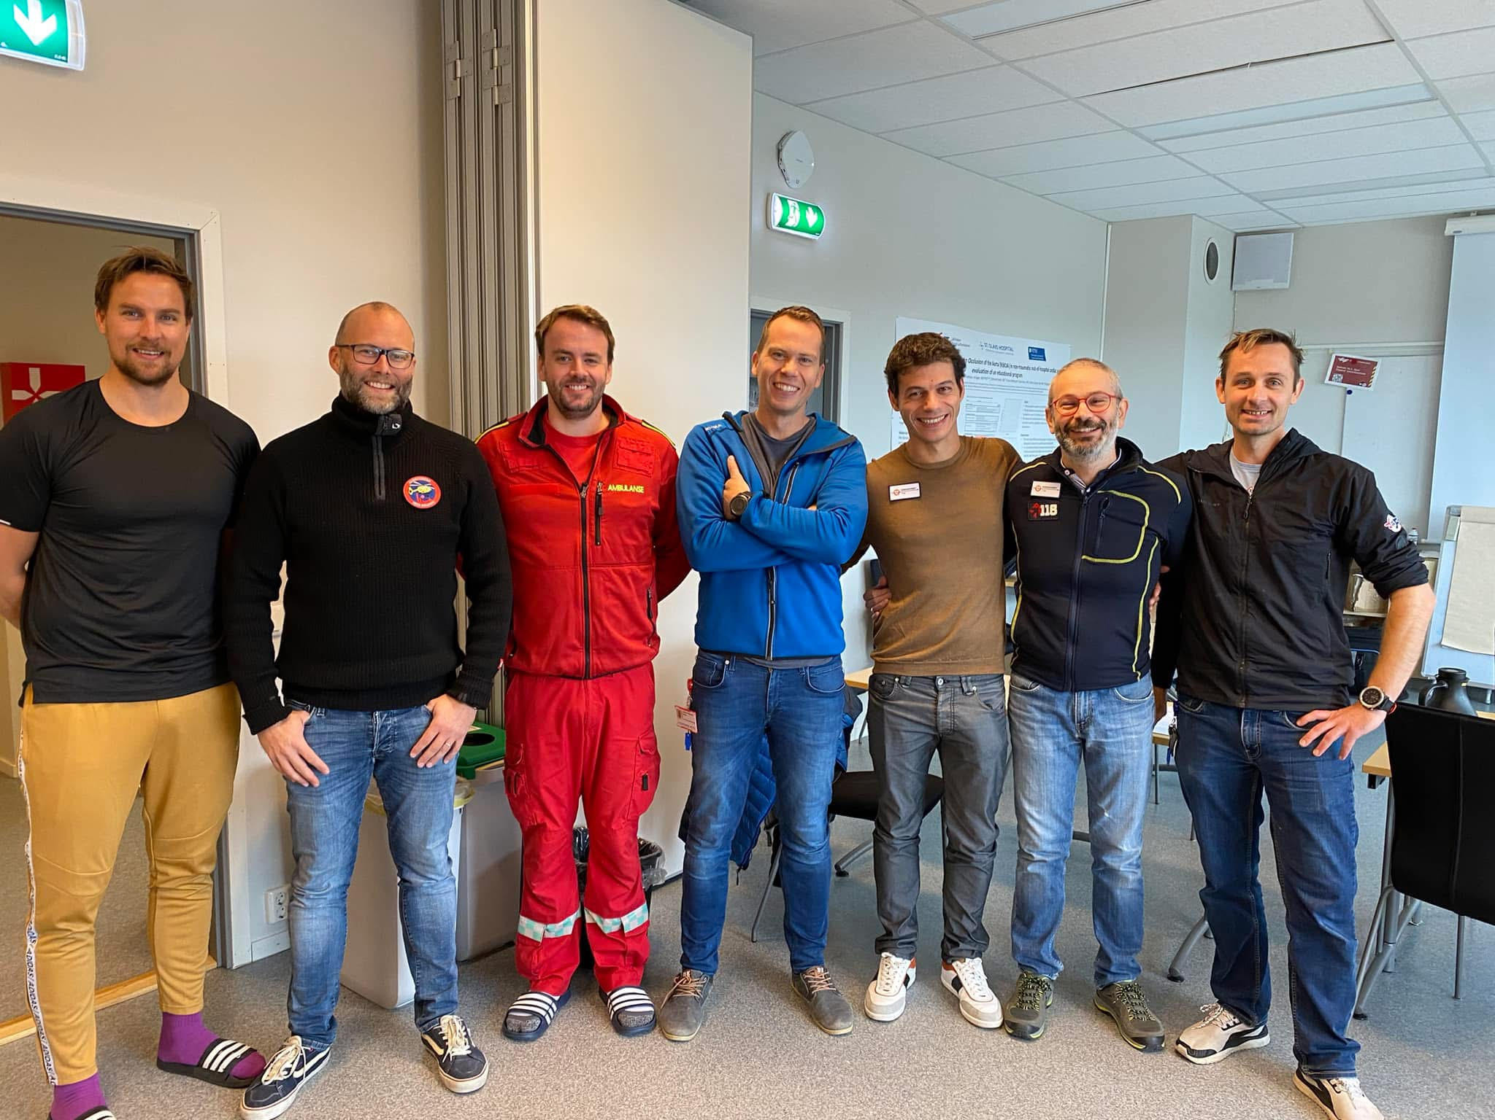


Slide 7
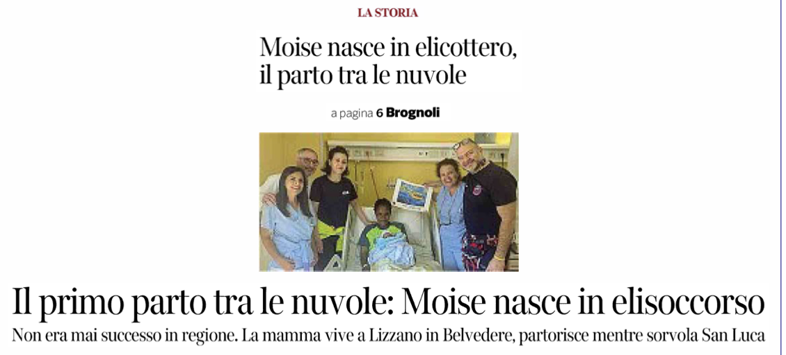
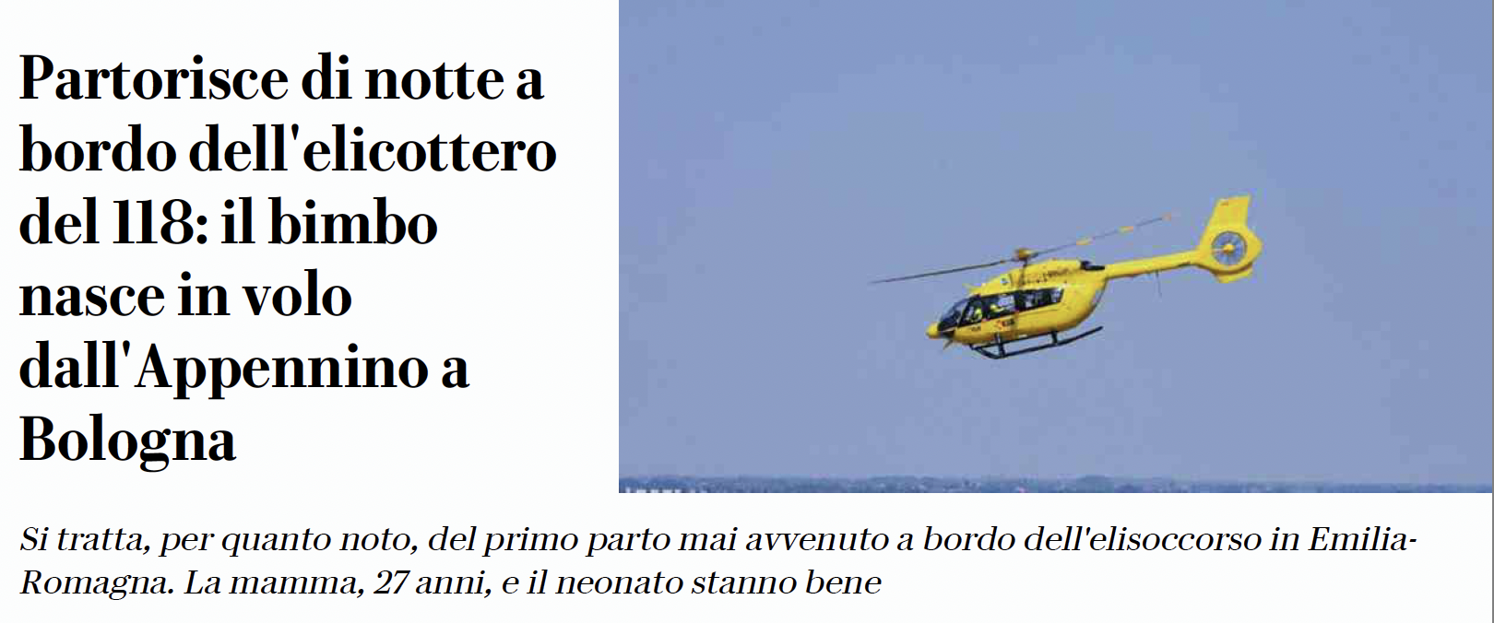
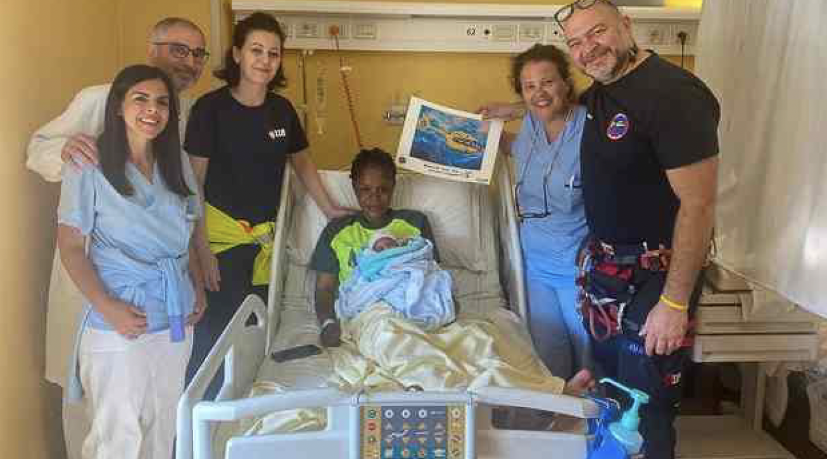
The first birth among the clouds: Moise is born during an air rescue mission

Slide 8
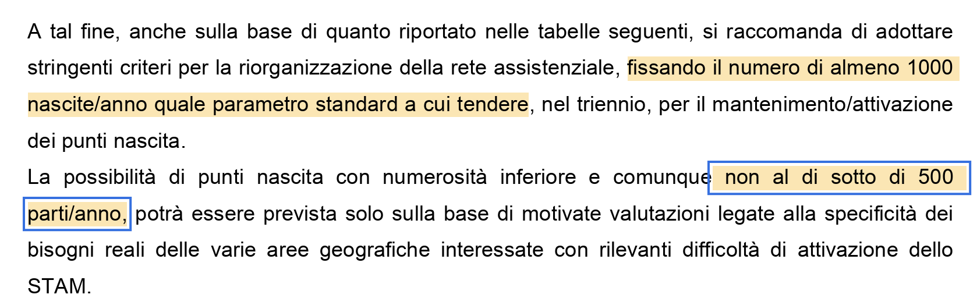
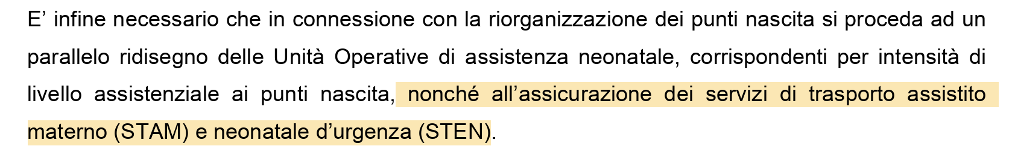
Background
setting the number of at least 1,000 births per year as the standard parameter to be achieved, within a three-year period, for the maintenance or activation of birth centers.
The possibility of birth centers with a lower number of deliveries — in any case not below 500 births per year — may be considered only on the basis of well-founded assessments related to the specific needs of the various geographical areas
ensuring the provision of maternal (STAM) and neonatal emergency transport (STEN) services.

Slide 9



REGIONALIZED PERINATAL CARE
Regionalized maternal care is intended to maintain and increase access to care by developing, strengthening, and better defining relationships among facilities within a region. In turn, this should facilitate consultation and transfer of care when appropriate so that low- to moderate-risk women can stay in their communities while pregnant women with high-risk conditions receive care in facilities that are prepared to provide the required level of specialized care.
Each facility should have a clear understanding of its capability to handle increasingly complex levels of maternal care and should have a well-defined threshold to transfer women to health care facilities that offer a higher level of care.

Slide 10
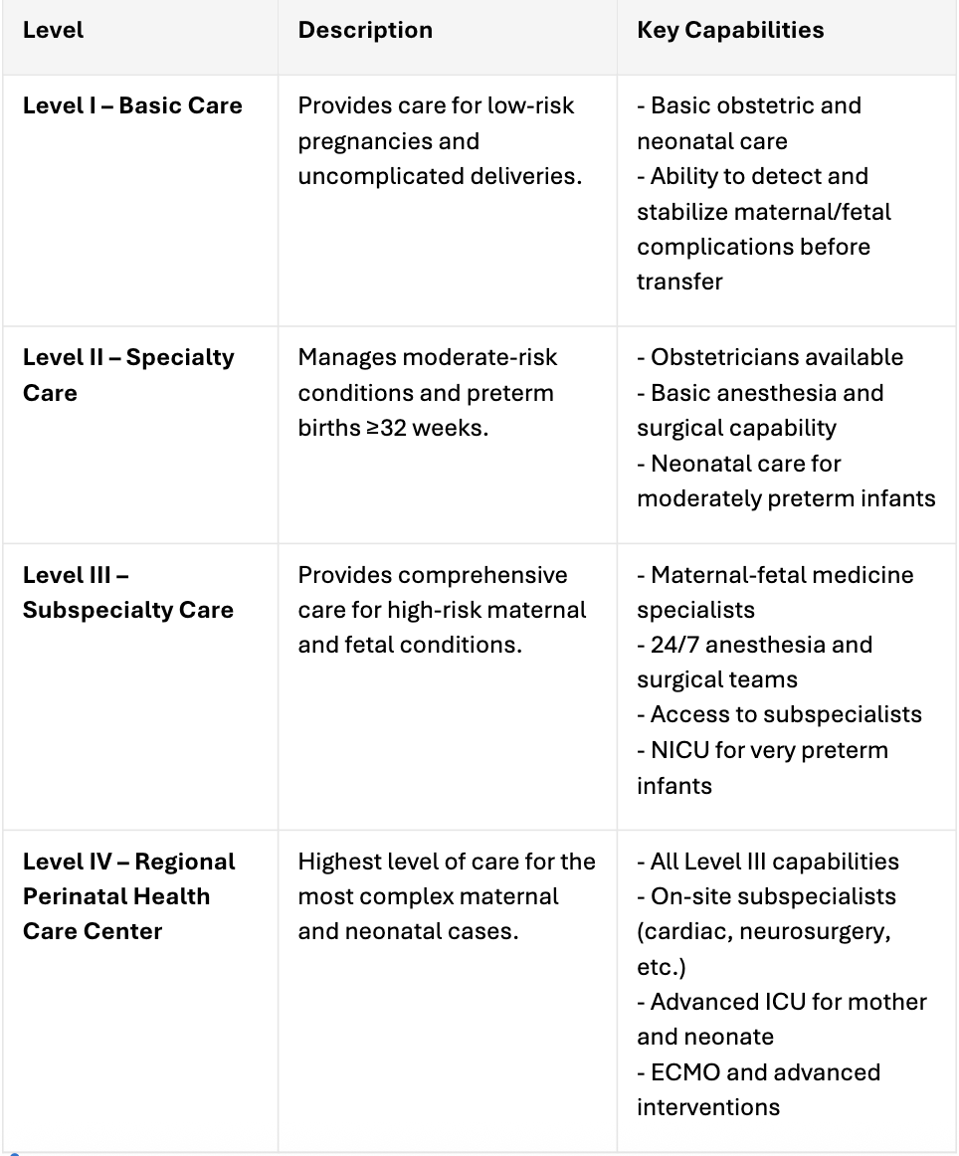
LEVELS OF MATERNAL CARE (ACOG/SMFM)

Slide 11
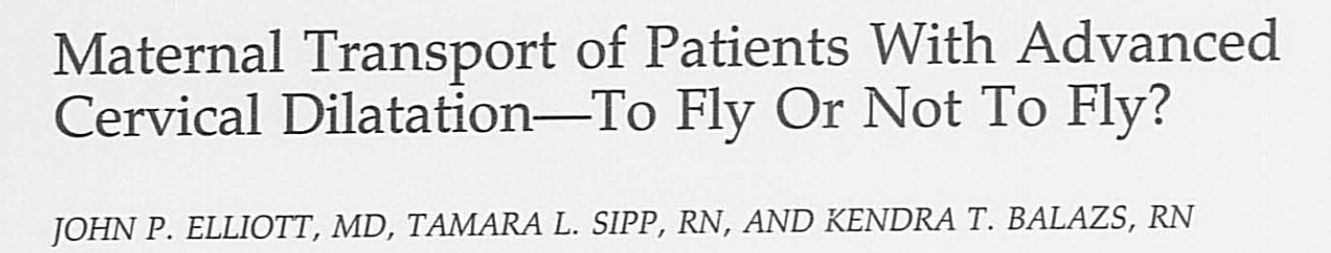
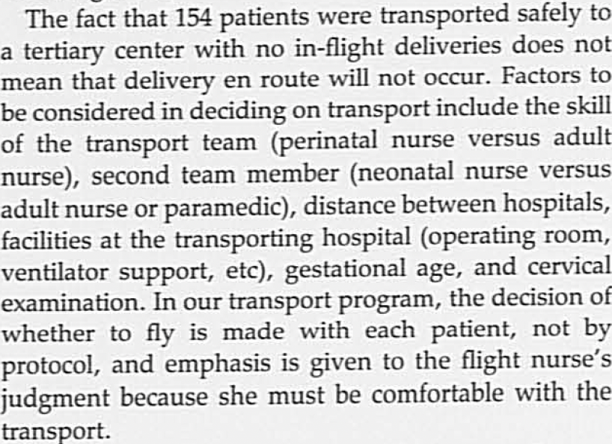
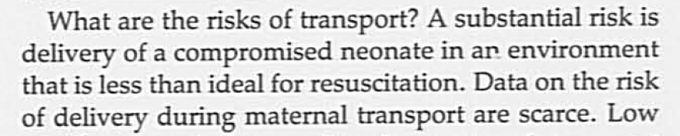
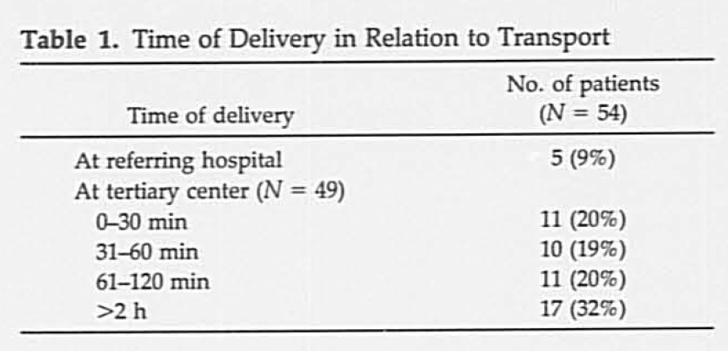
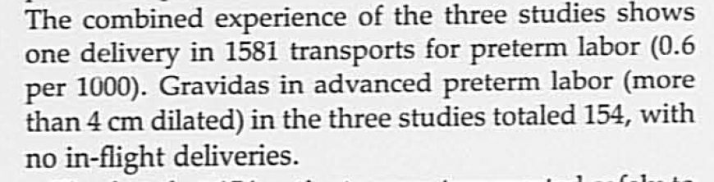
1991
1743 pregnant women transported
54 > 7 cm dilated at time of transport

Slide 12
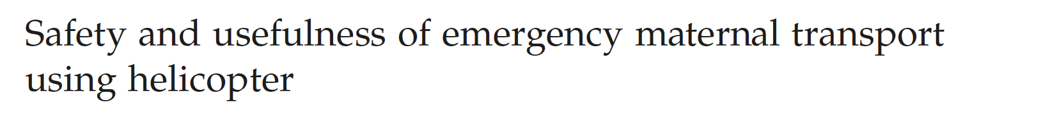
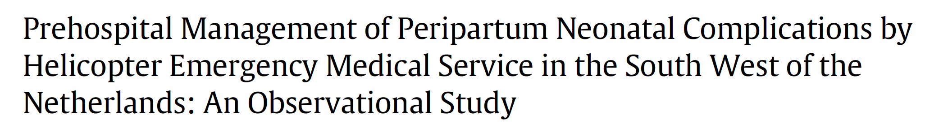




Slide 13
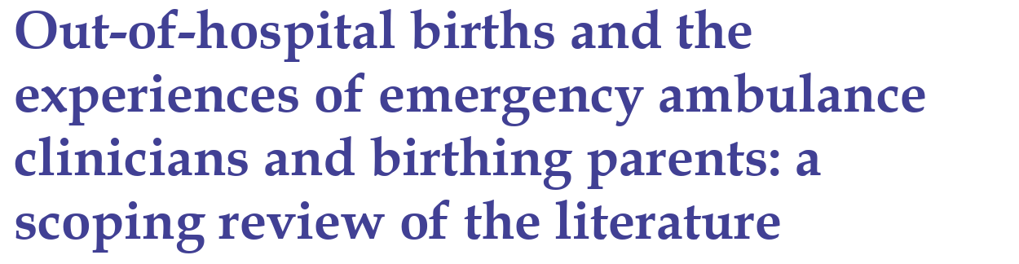
Emergency medical services (EMS) play a key role in ensuring timely and appropriate delivery of maternal-fetal dyads to appropriate healthcare facilities, and maternal transport has become a structural activity of Emergency Medical Services (EMS), with an incidence of imminent birth callouts for ambulance services ranging from 0.5% to 0.6% and actual out-of-hospital births rate of 0.02%–0.3%​. These numbers should be added to calls for maternal prebirth and peripartum complications, for planned home deliveries.

Slide 14
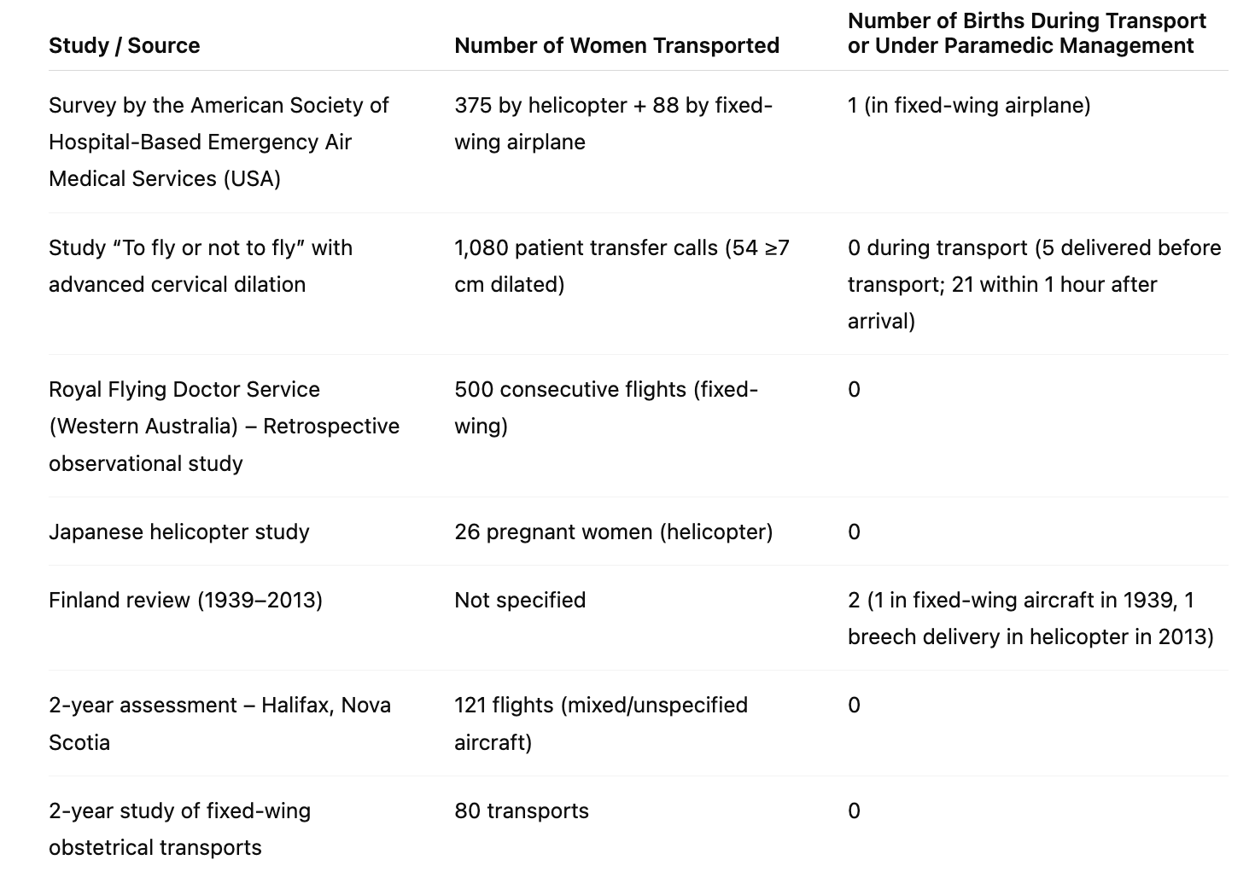

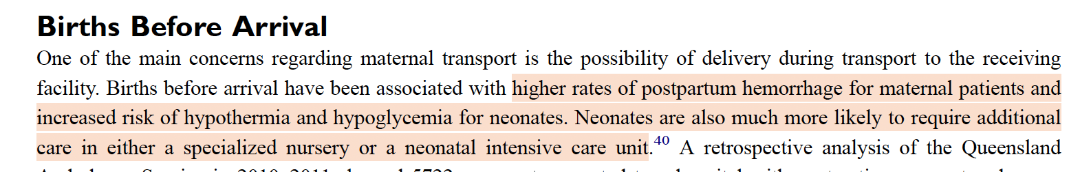

Slide 15

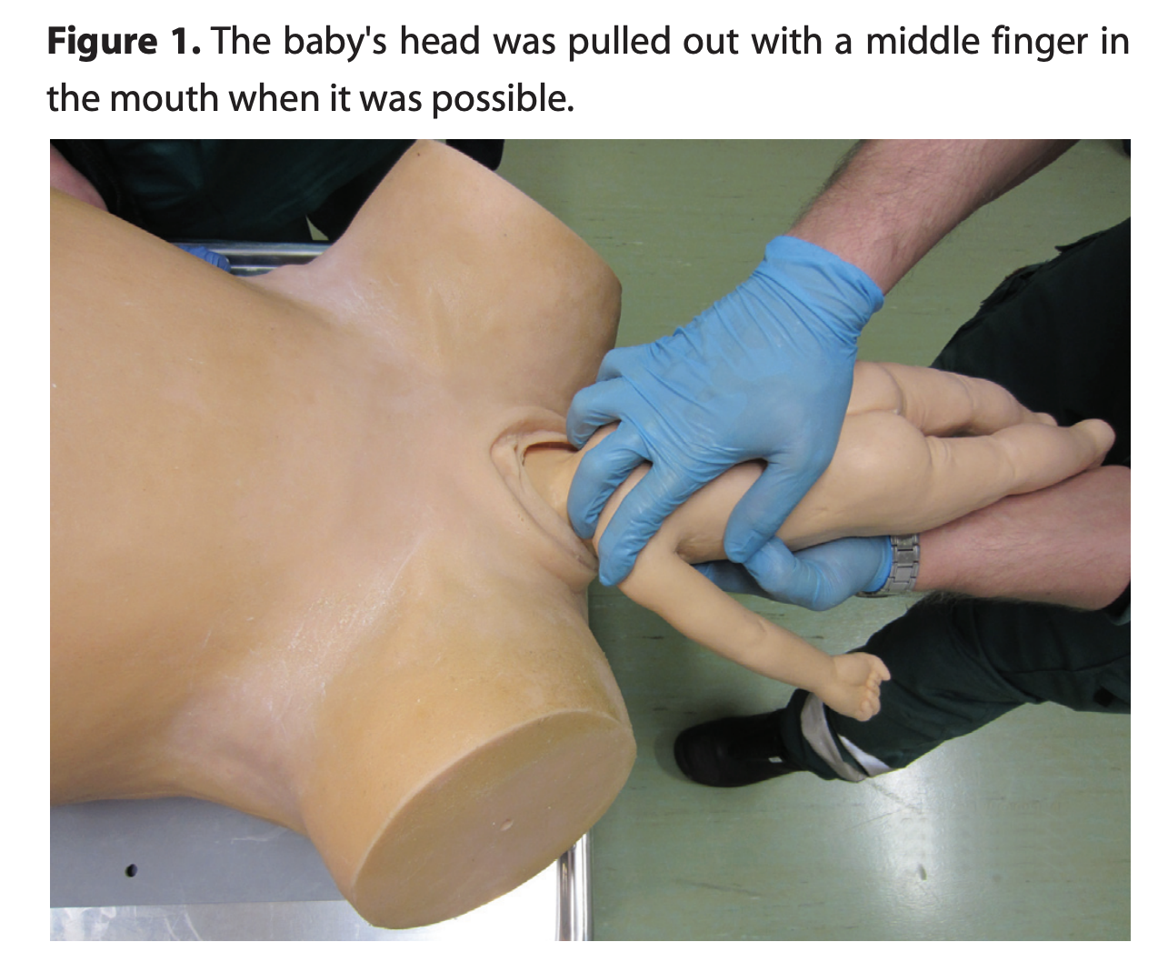
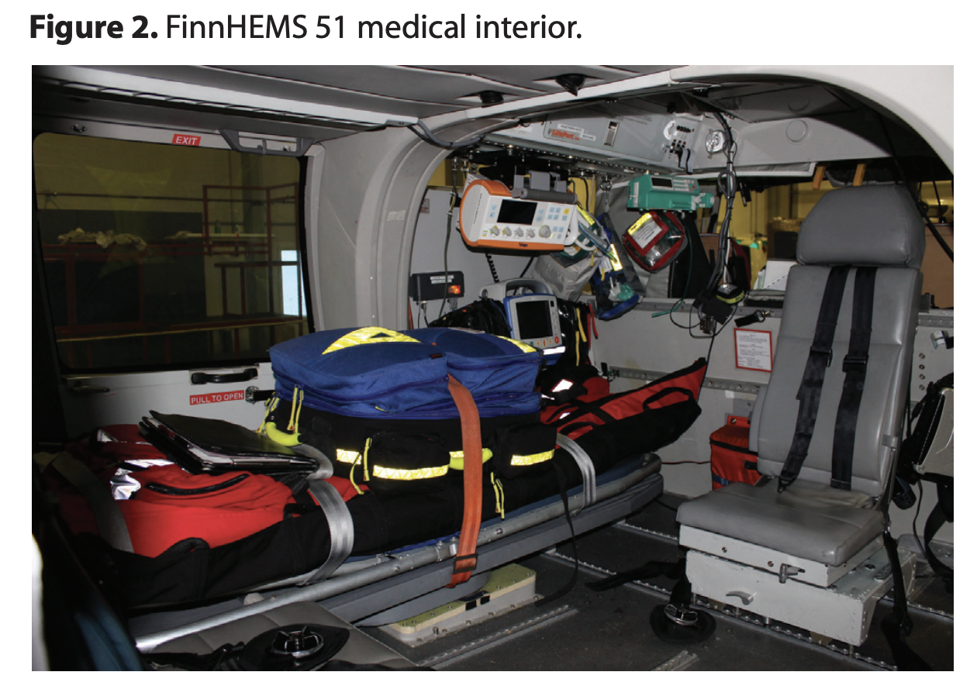
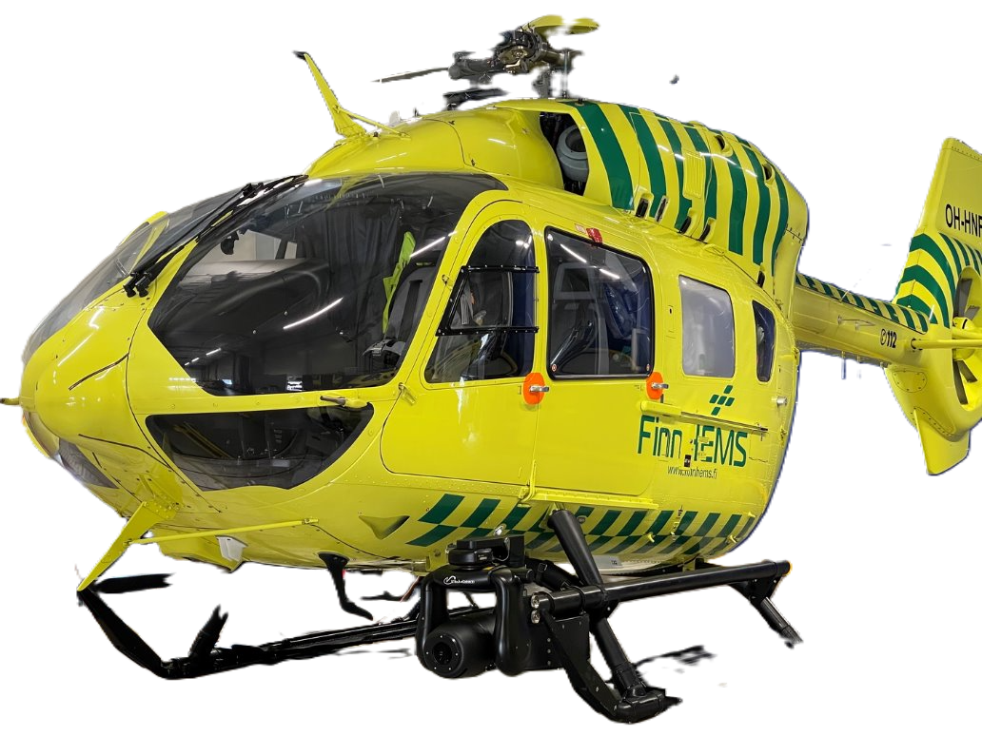

Slide 16
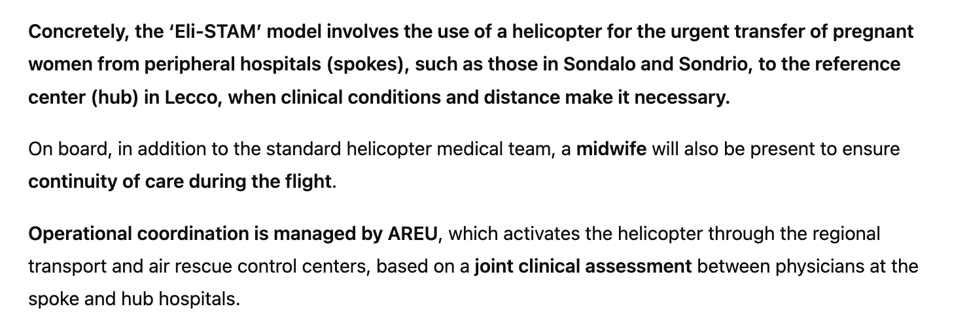
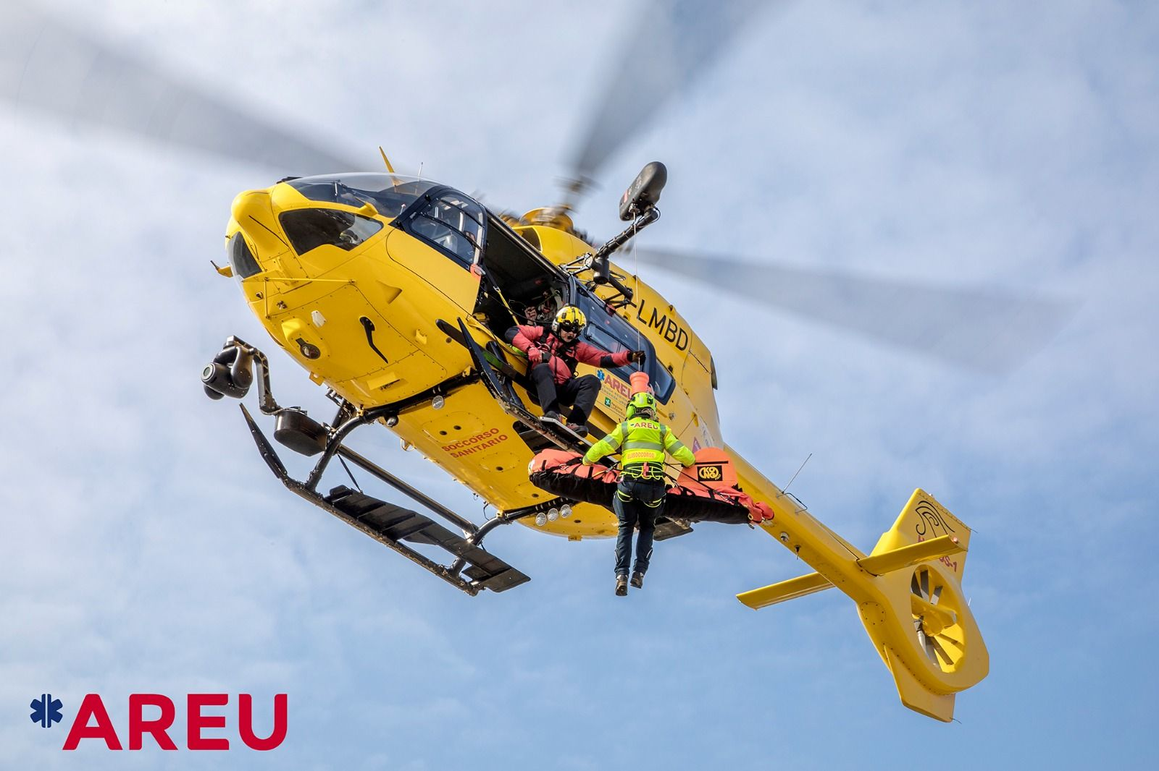
AREU introduces Italy’s first helicopter service dedicated to Assisted Maternal Transport (Eli-STAM)

Slide 17
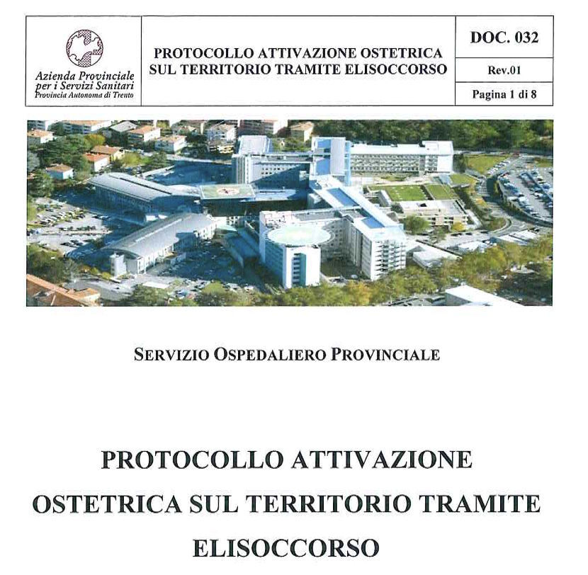

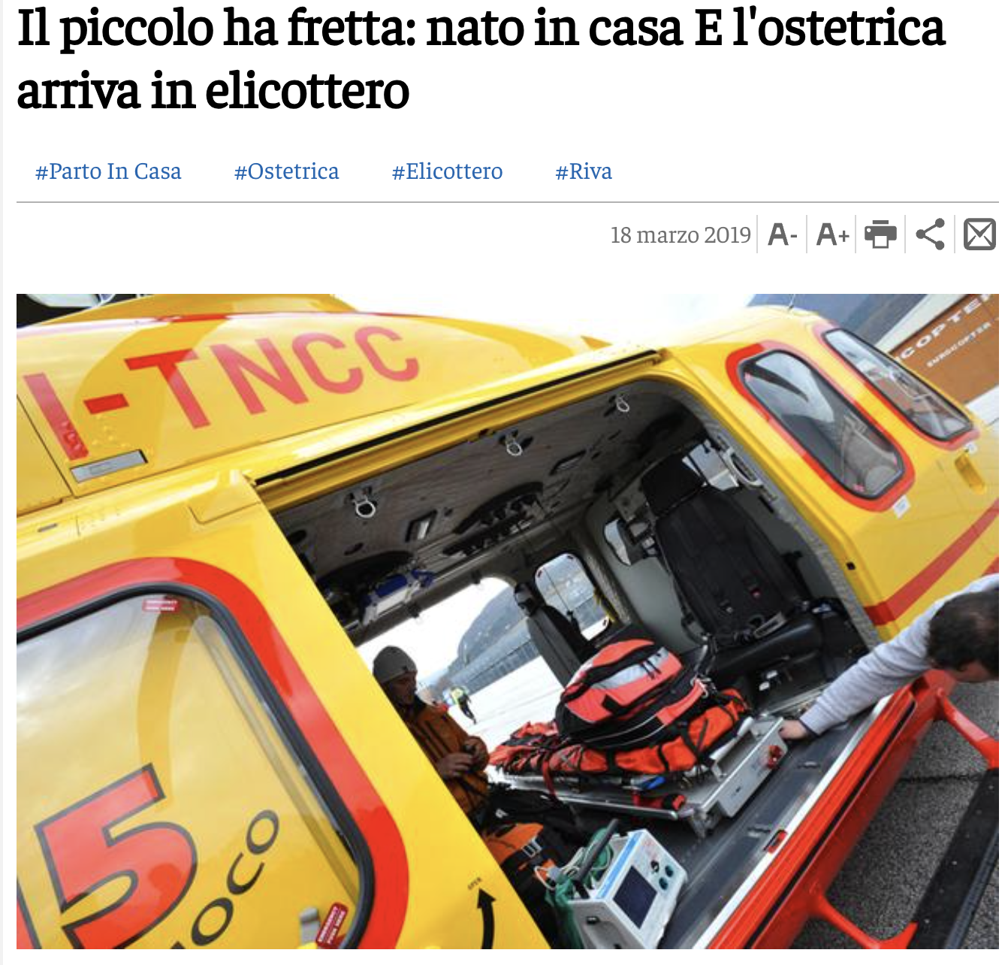

Slide 18

Research gap: what we don’t know
Recognized importance of maternal air transfer (inter-hospital)
Increasing HEMS dispatch to maternal-obstetric primary missions
Little is known about how European HEMS services organize these missions
  Activation criteria, crew composition, equipment, training, treatment capabilites
Generate evidence to:
  Guide future research
  Define optimal models of care
  Promote standardized best practices for HEMS maternal transport (EU-level) -> BCP? Guidelines? Consensus?

Slide 19
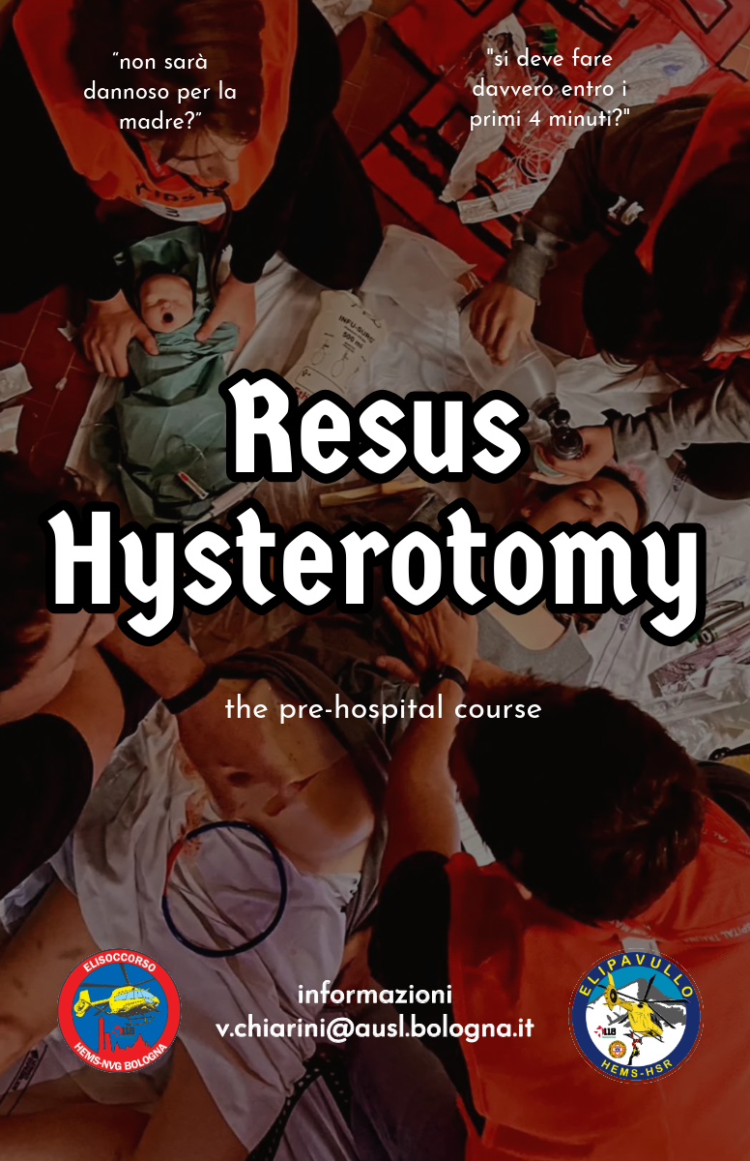

Formazione Gravida in HEMS
ResusHysterotomy
International Survey
In progress
Prospettico Osservazione
“Registro”
Consensus Delphi
BPC

Slide 20
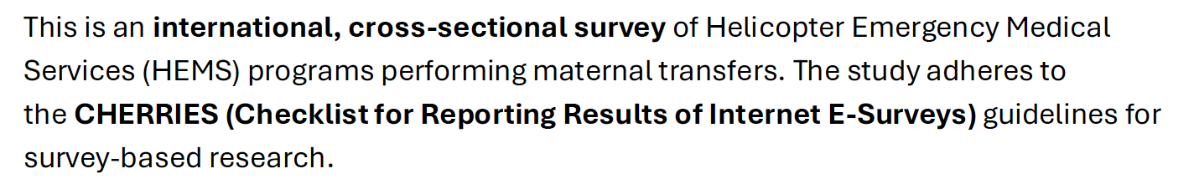
Assessing International Readiness for Maternal Air Medical Assistance
An International Survey on Helicopter Emergency Medical Services for Maternal Transfers

Slide 21

Steering Committee

Slide 22


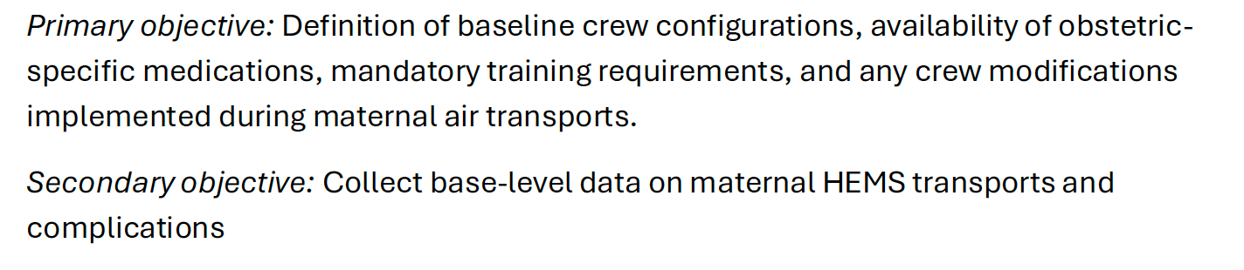
AIM: map how HEMS handles pregnant patients worldwide
Scope: intefacility and primary missions; organizational, clinica, and logistical aspects
OUTCOME: evidence to inform future research, models of care and consensus/guidelines

Slide 23
Crew & Training
(Configuration, case mix, OB/GYN input, neonatal capability, simulation, certifications)
Activation & Dispatch (site configuration, indications, contraindications, governance, weather/ETAs)
Equipment
(Delivery kits, meds incl. tocolytics/oxytocics, blood, REBOA, ResusHys kit)
Survey Domains: what we’ll ask?
Clinical Protocols (analgesia, hemorrhage, preterm labor, seizure, complications)
Safety & Logistics (airframe constraints, hoist/winch, win-win alternatives)

Slide 24

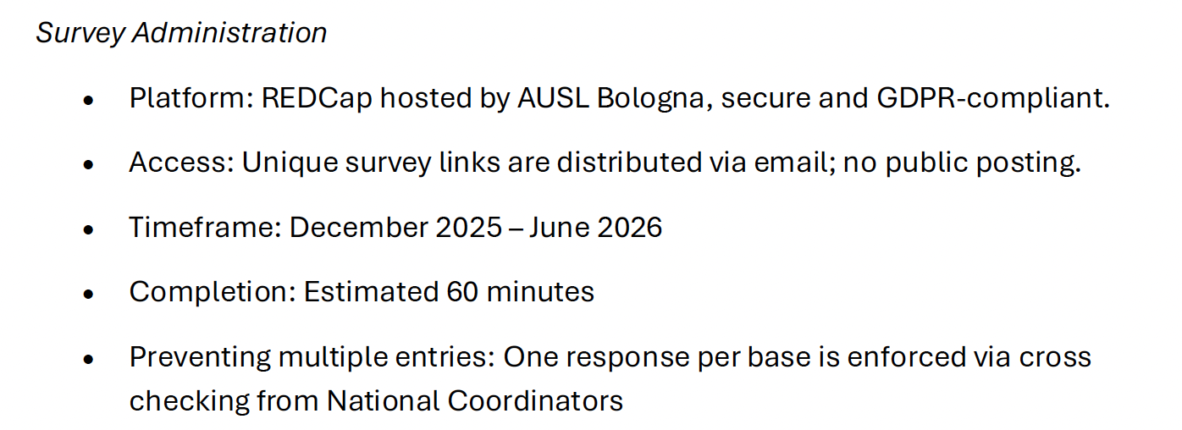

Slide 25
timeline & milestones
NETWORK
SETUP
NOV 25 - JAN 26
DATA COLLECTION
JAN 26 - JUN 26
ANALYSIS
JUN 26 - SEP 26
MANUSCRIPT SUBMISSION
OCT 26 - DEC 26

Slide 26
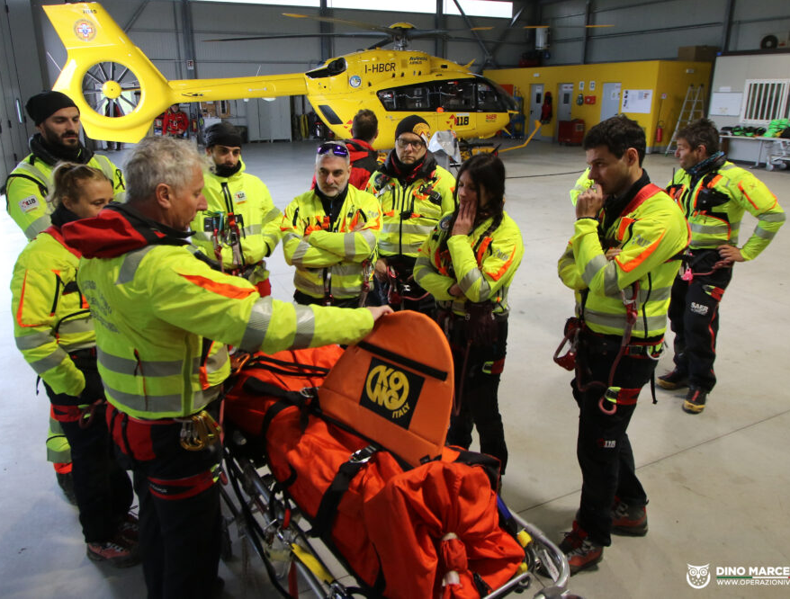
Recruitment process
ELIGIBILITY:
hems bases performing maternal transfer
RECRUITMENT
NC’s disseminate the survey to eligible bases
with the help of social networks, media and congress
RESPONDENTS
Medical directors, HEMS base leads, senior clinicians with maternal care experience

Slide 27

National Coordinators Recruitment
ONE PER COUNTRY
DISSEMINATE
THE
SURVEY
VERIFY LOCAL ETHICS/APPROVAL/NOTIFICATIONS
IDENTIFY ELIGIBLE BASES/SERVICES
FOLLOW-UP
TO
MAXIMIZE RESPONSE
TRANSLATIONS OR ADAPTATION IF NEEDED

Slide 28

Support translation/adaption
Recruit ≥70% of eligible sites in their country
Ensure data completeness and accuracy
Contribute to interpretation
Contribute to manuscript writing/review

Slide 29
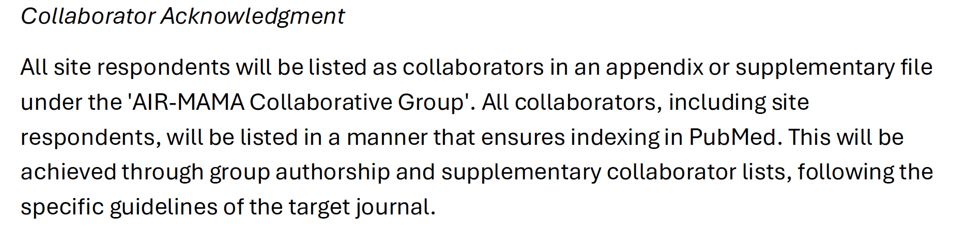
Collaborator Acknowledgment
AIR-MAMA as a community effort, not a top-down project

Slide 30
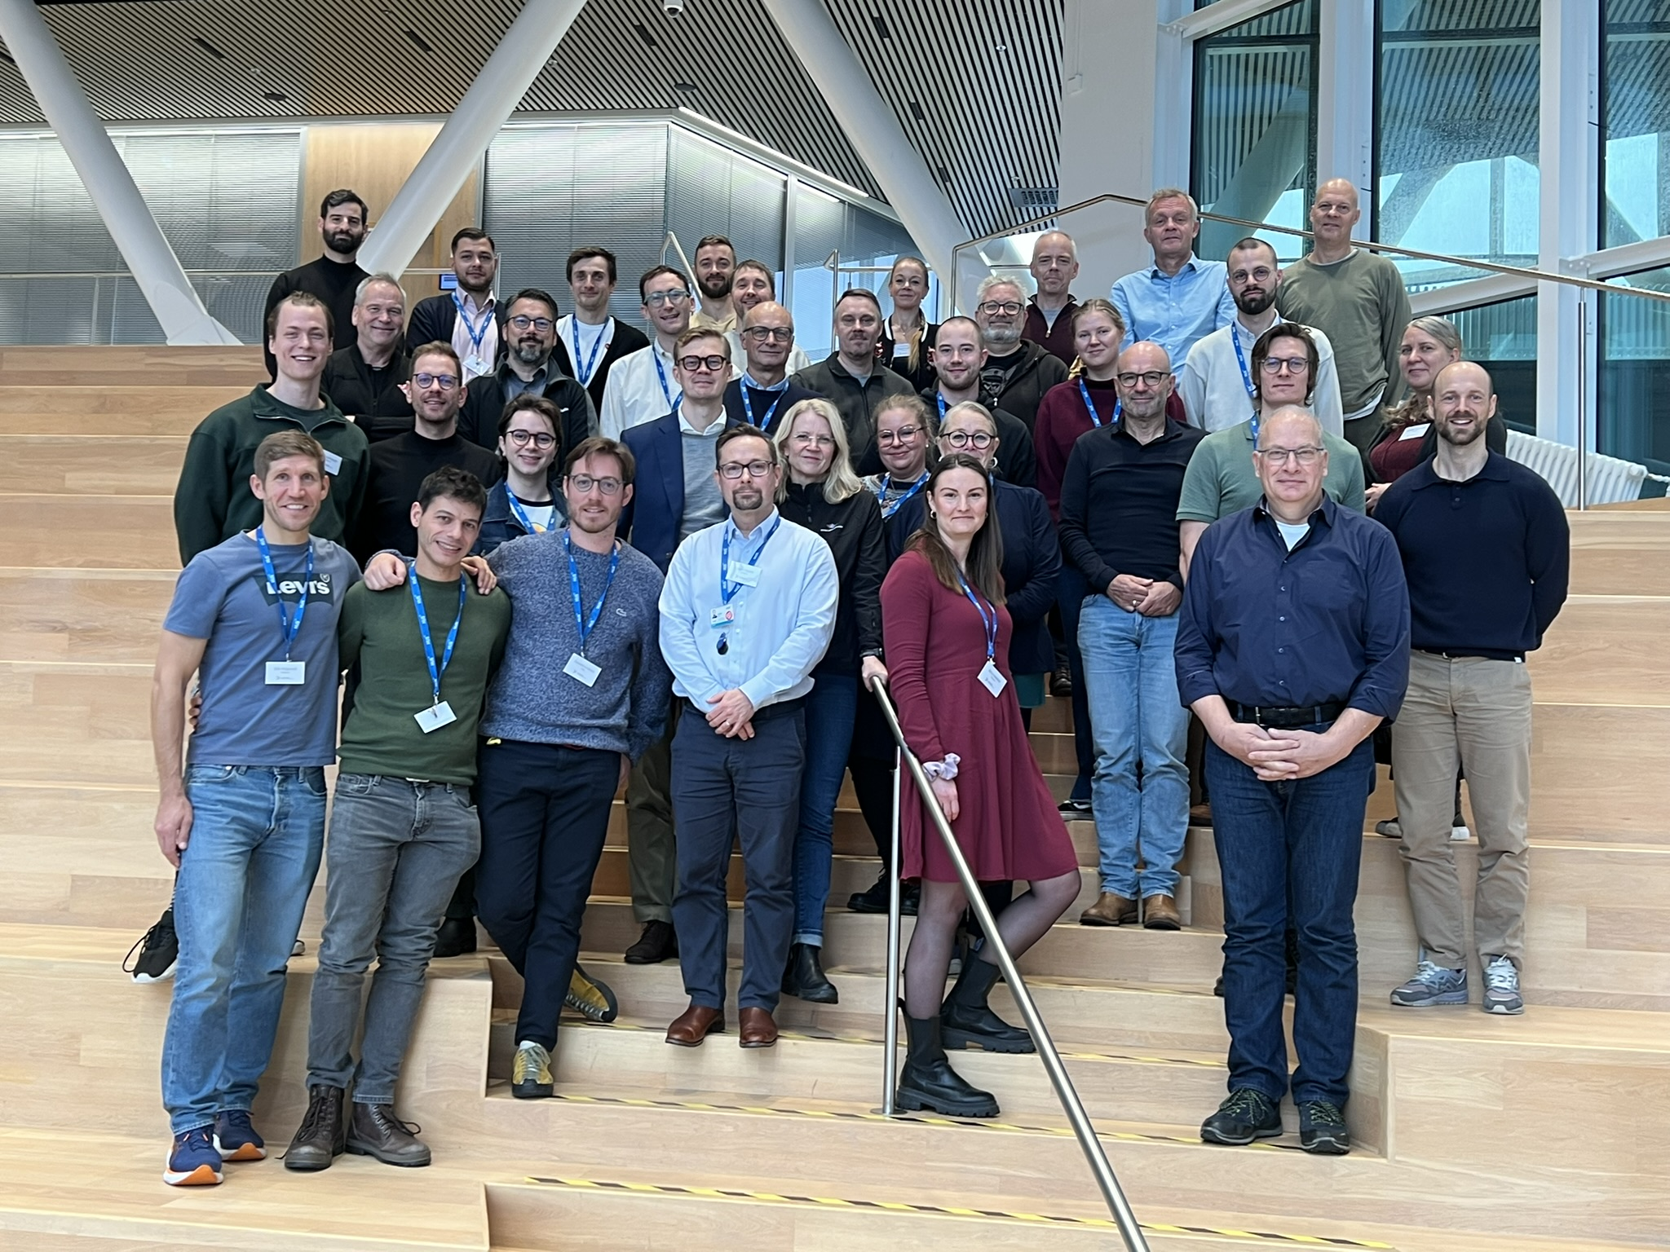
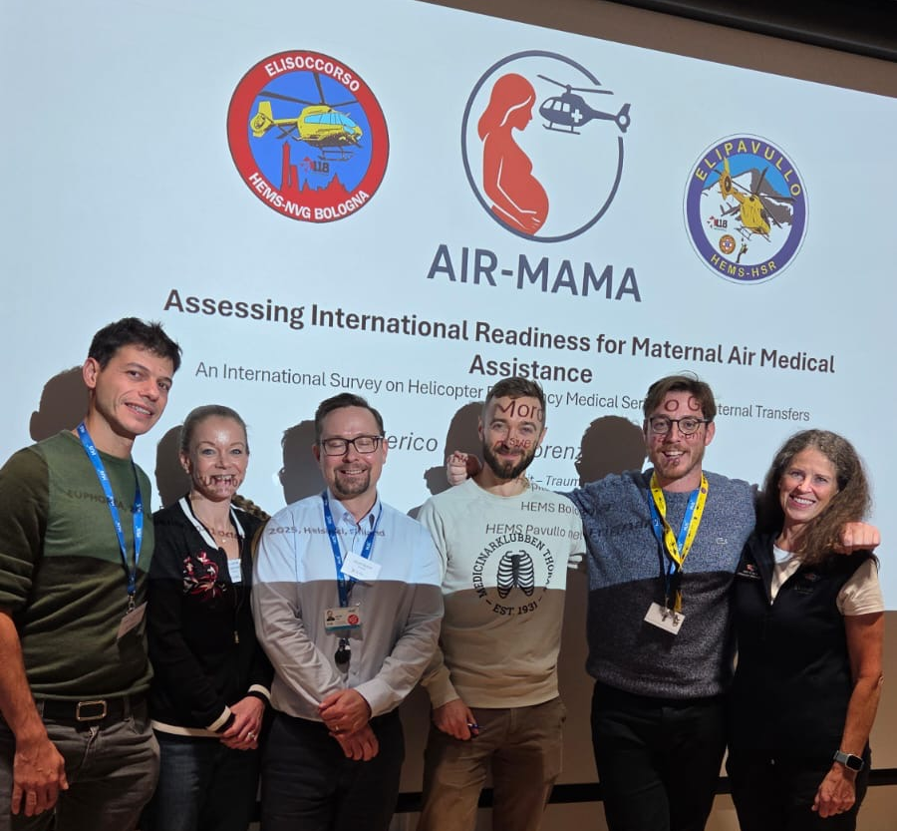

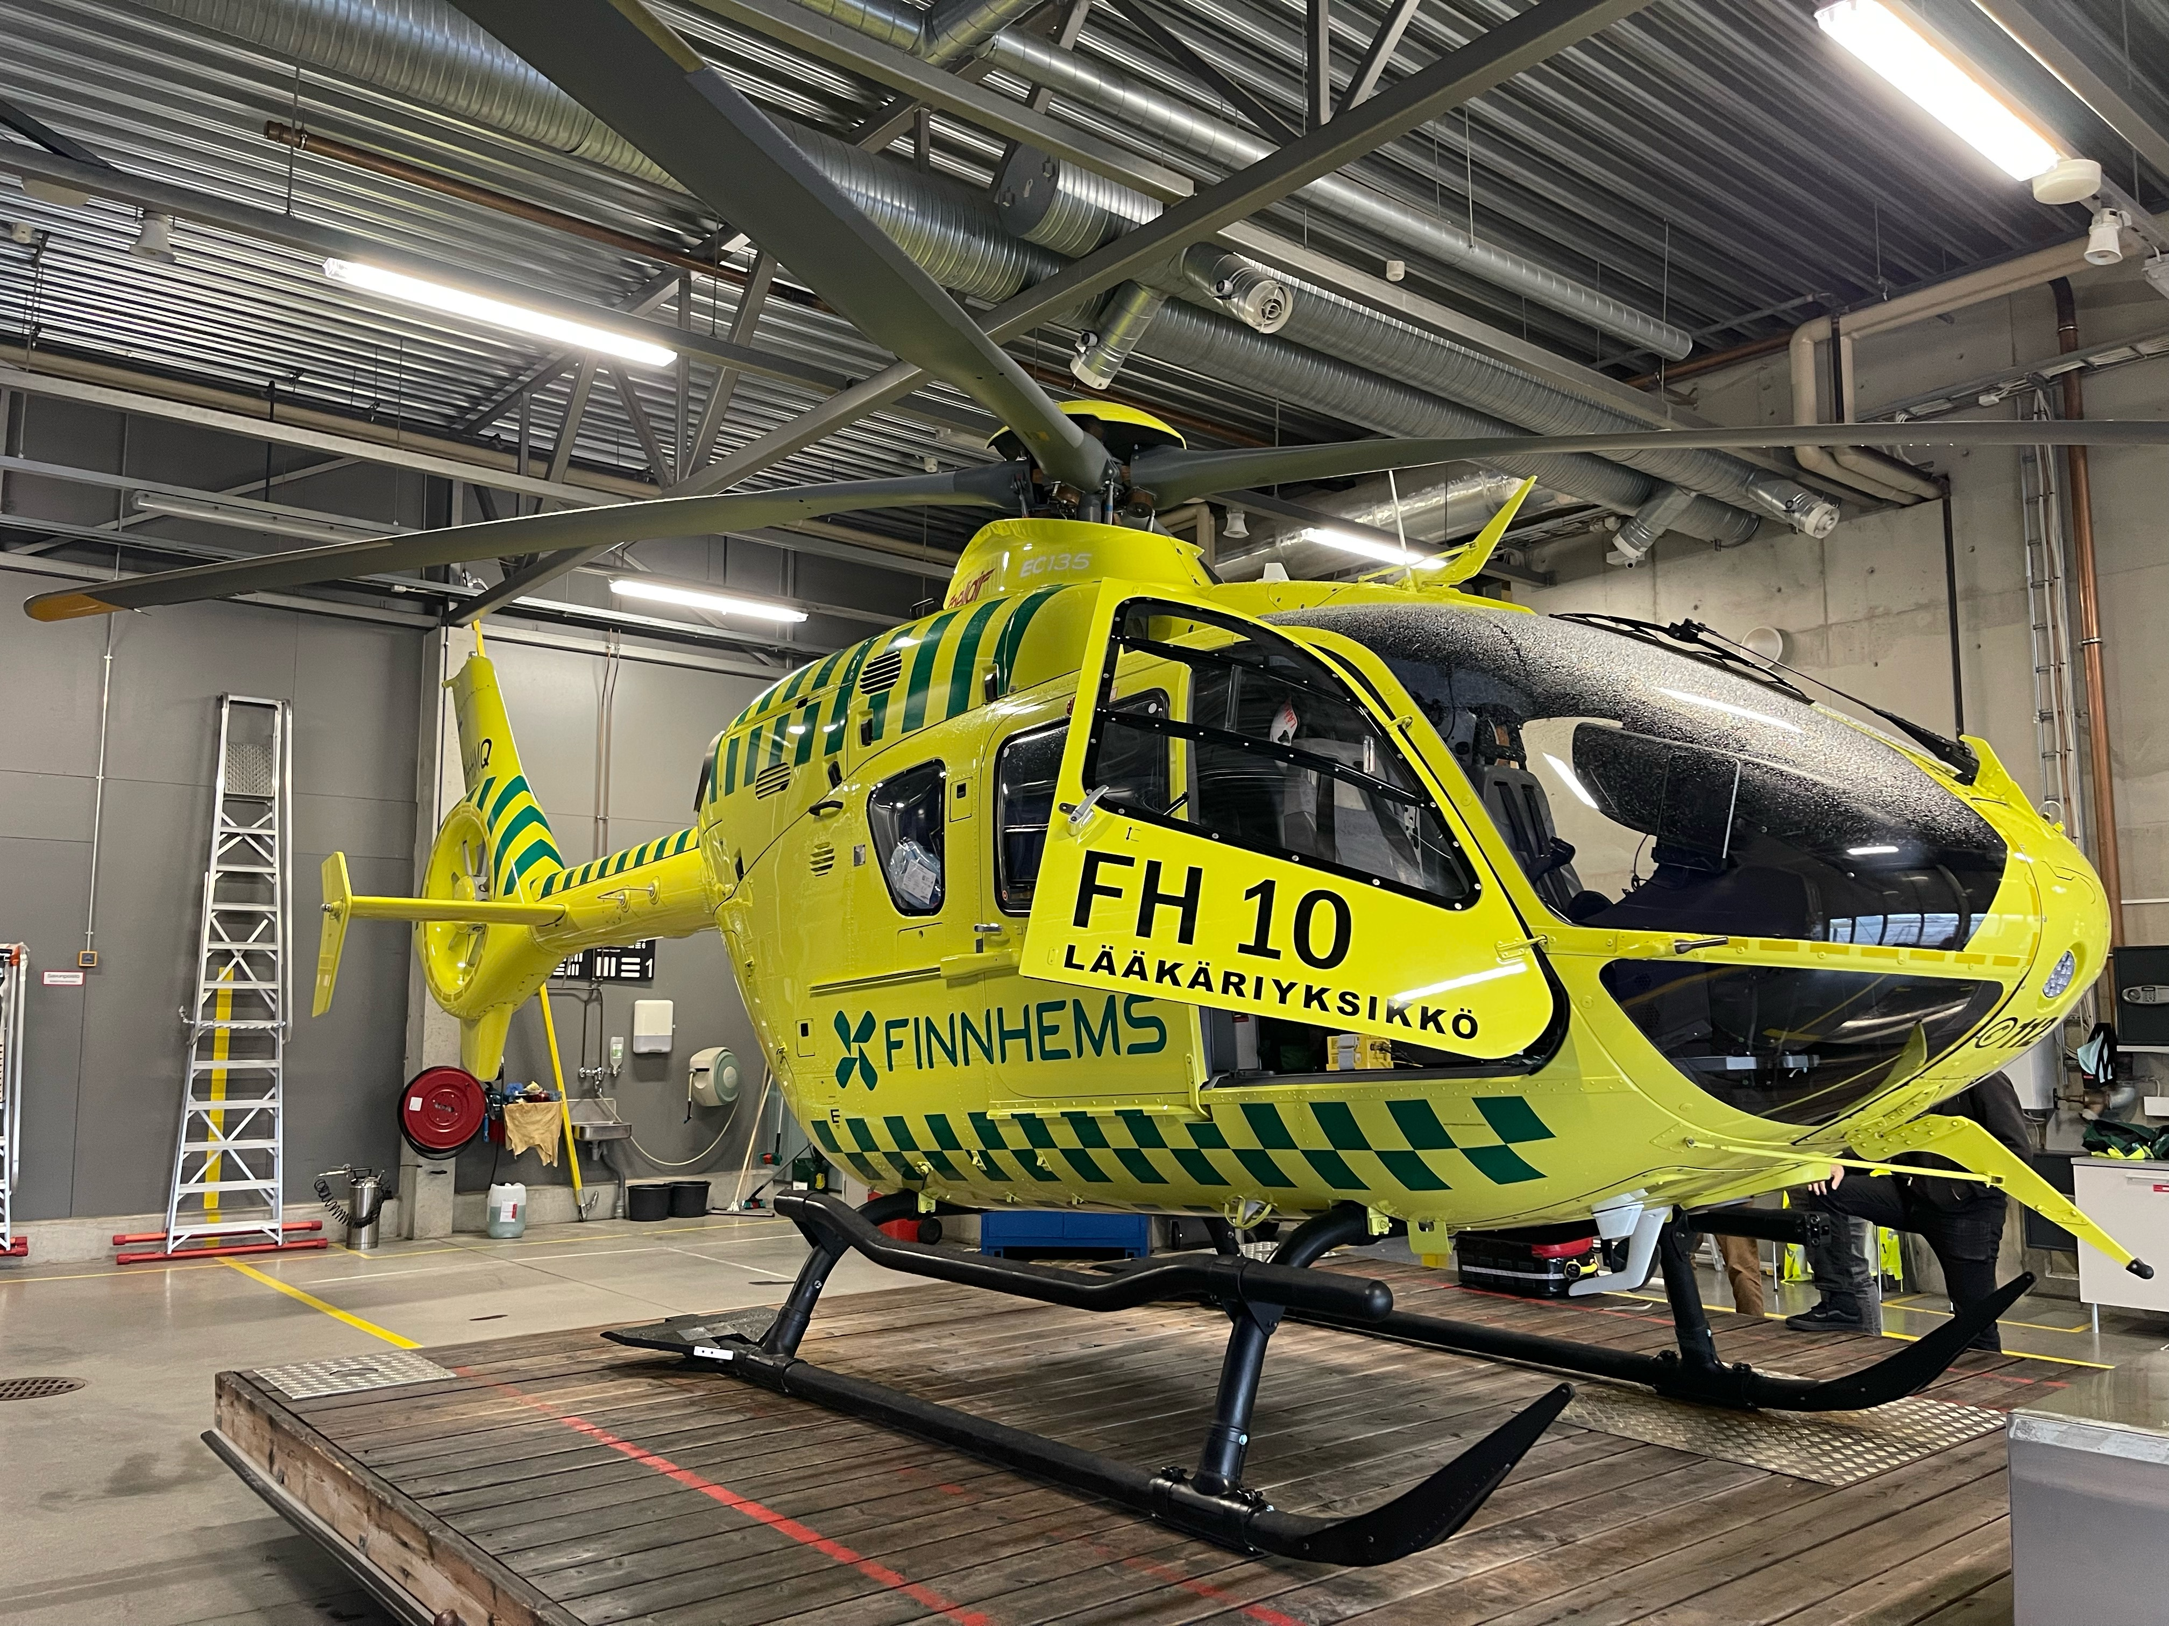

Slide 31


NATIONAL COORDINATOR ITALIA

Slide 32
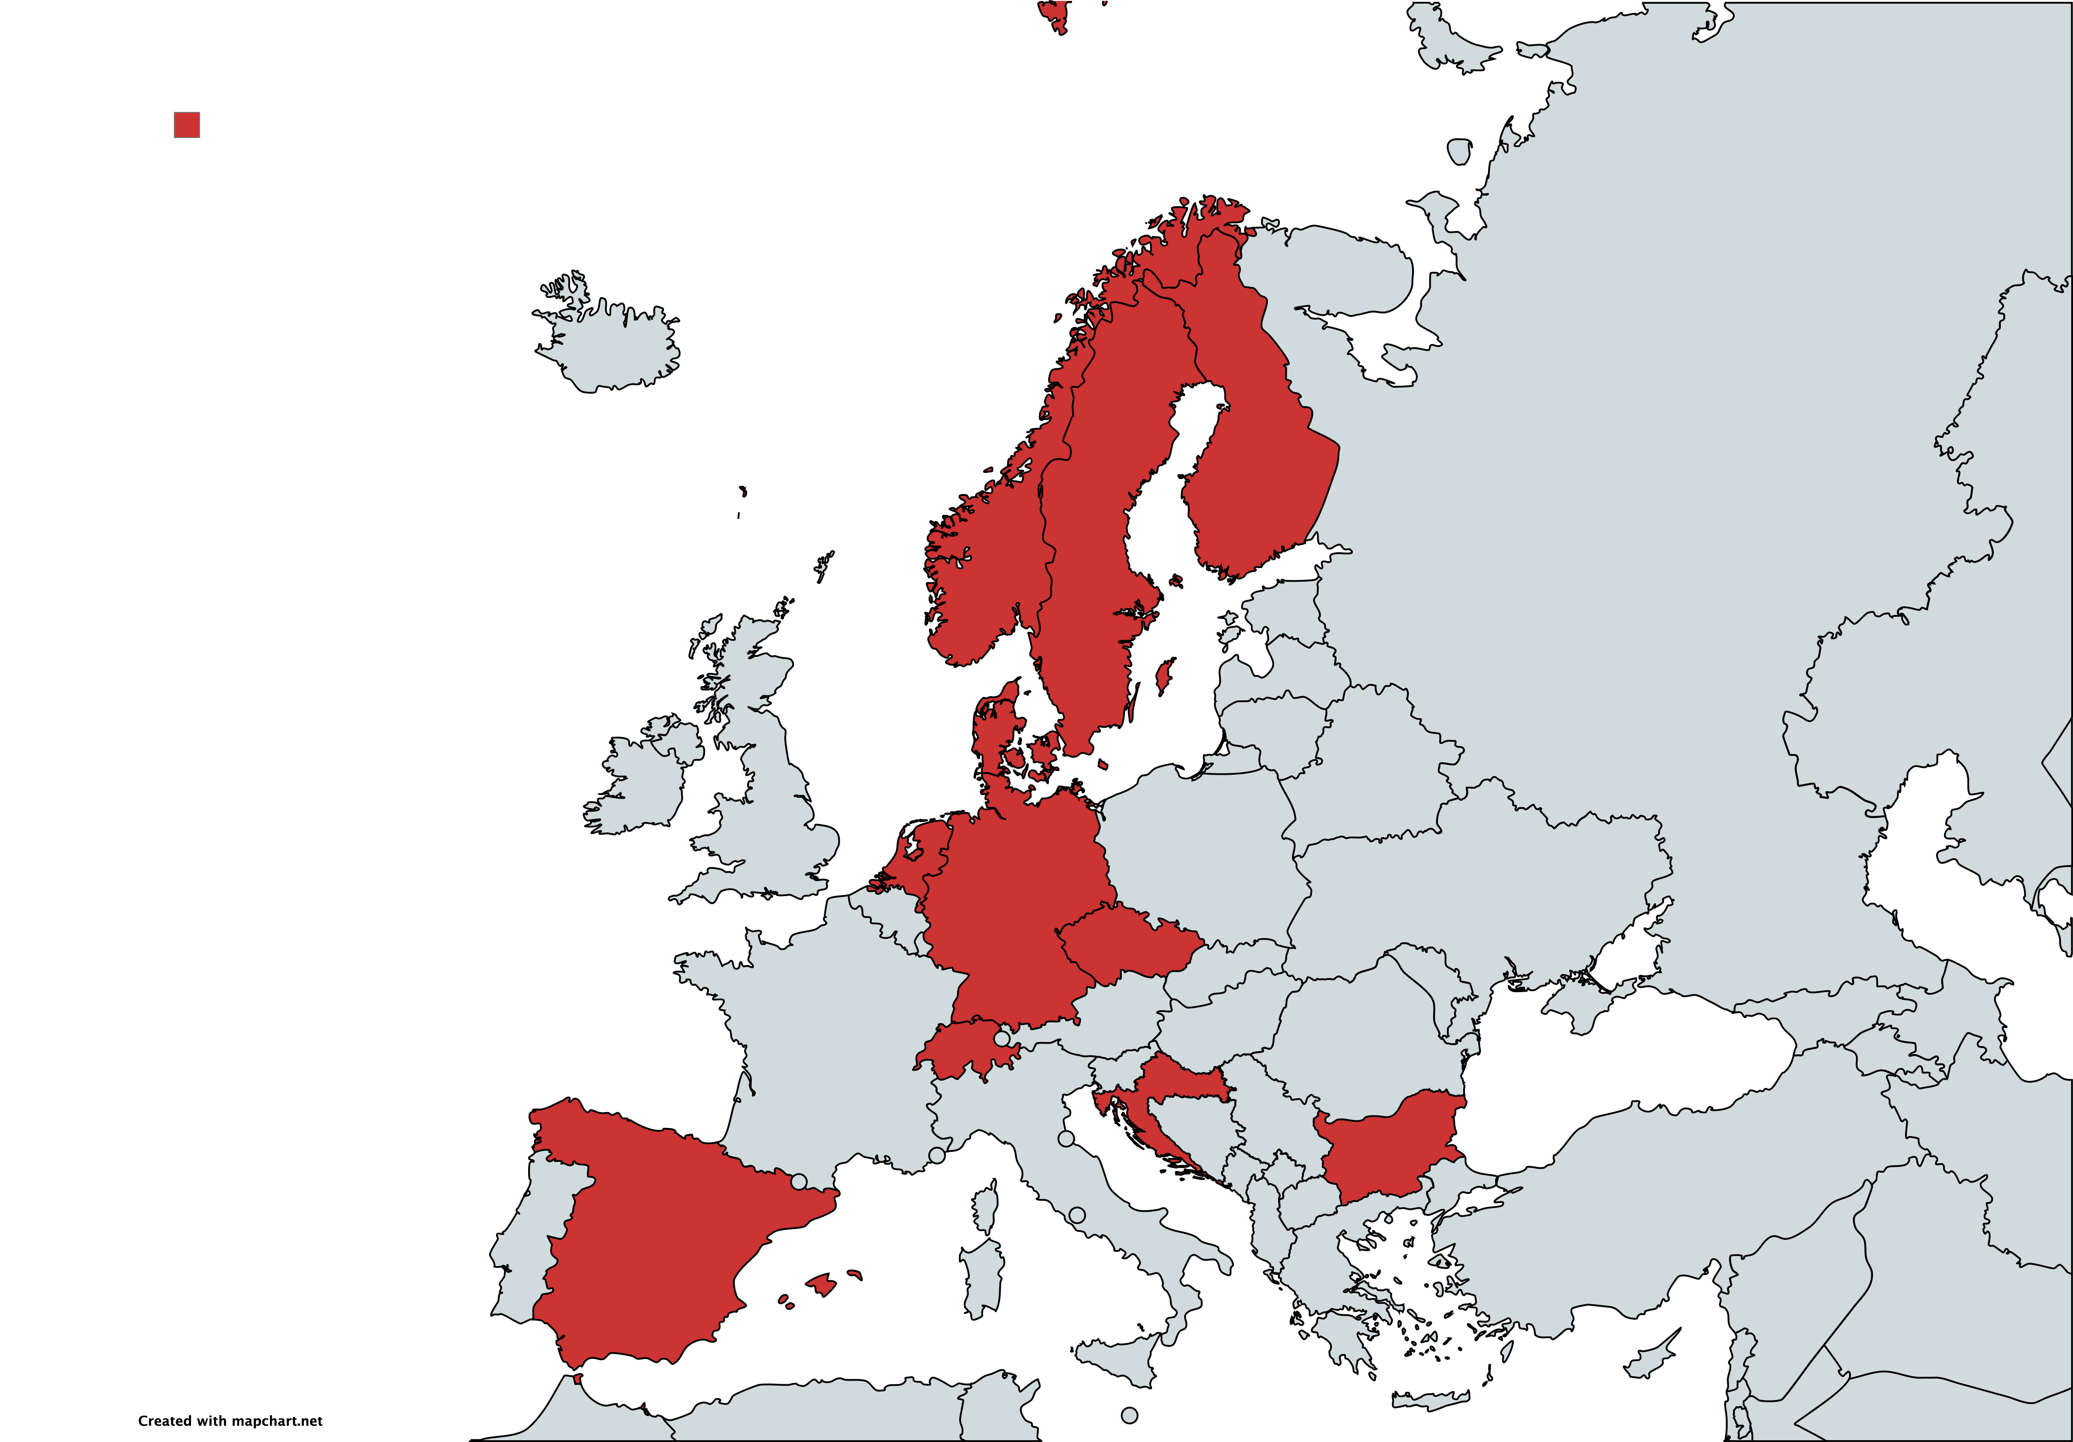


Slide 33



NEXT STEP:
Studio osservazione prospettico / “registro” gravide-HEMS
Consensuns Statement Delphi su dotazioni, formazione, gestione gravide in HEMS

Slide 35
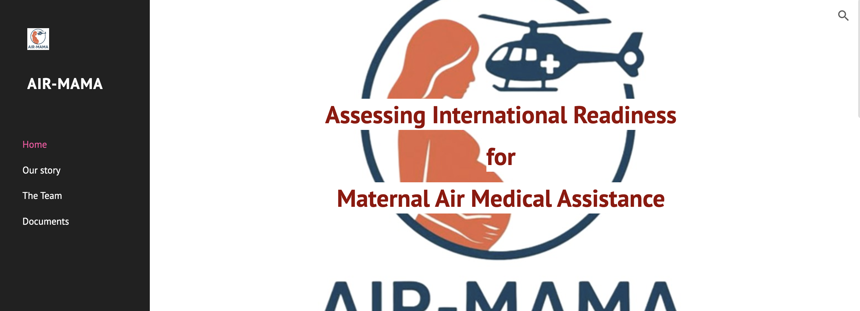

https://sites.google.com/view/air-mama

